Slide 1
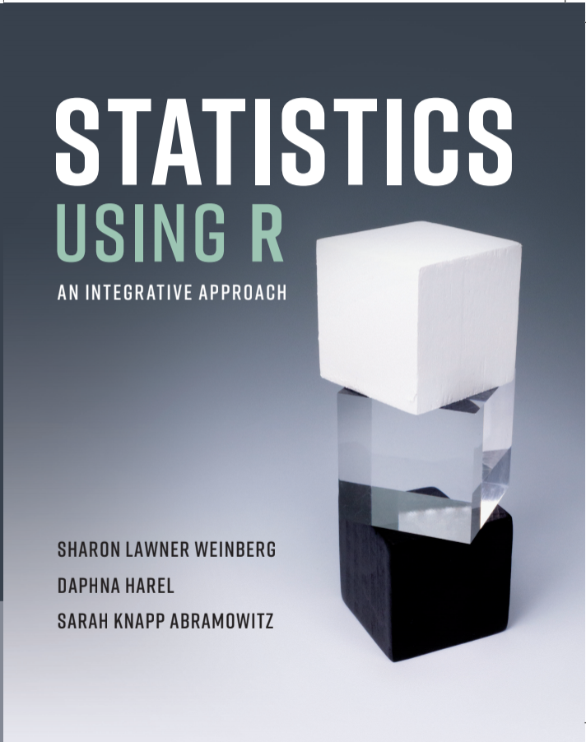
INTRODUCTION CHAPTER 1

Slide 2
Overview
Descriptive and Inferential Statistics
Variables and Constants
Levels of Measurement
Discrete and Continuous Variables
The NELS data set
Interfacing with RStudio

Slide 3
Variables and Constants
Variables – Vary from person to person or object to object
Constants – Remain constant from person to person or object to object

Slide 4
Example
A study is conducted to determine if there are gender differences in fine motor skills among five year-olds from middle class families.
What are the variables in the study?
What are the constants in the study?
Note: Whether a trait is a constant or a variable is determined by the nature of the particular study.
Gender, Fine motor skills
Age, Socio-economic status

Slide 5
Levels of Measurement
Nominal
Ordinal
Scale
Ratio
Interval

Slide 6
Nominal
Objects observed to be similar on some characteristic (e.g., college student) are assigned to the same class or category, while objects observed to be dissimilar on that characteristic are assigned to different classes or categories. (Example: Car types: Toyota, Honda, Volvo, BMW, Audi, etc.)

Slide 7
Ordinal
The ordinal level of measurement is not only based on observing objects as similar or dissimilar, but also on ordering those observations in terms of an underlying characteristic. (Example: Height in size place ranking)

Slide 8
Scale
An ordinal level of measurement can be developed into a higher level of measurement if it is possible to assess how near to each other the persons or objects are in the underlying characteristic being observed, that is, if numbers can be assigned in such a way that equal numerical differences along the scale correspond to equal increments in the underlying characteristic.
If this is done so that the score 0 corresponds to having none of the property being measured, the level of measurement is ratio. (Example: Distance from home to school) Otherwise, it is interval. (Example: Temperature Scale)

Slide 9
Other Examples
Find the levels of measurement of the following variables measured on college students:
Residence: 1 = College dormitory, 2 = Off campus apartment, 3 = Parents’ home, 4 = Other
Whether or not the student’s parents live in the same state as the student’s college
Class rank
Year graduated high school
Number of earned credits to date
Height
Family Income
Number of siblings
Nominal
Nominal or Ordinal
Ordinal
Scale: Interval
Scale: Ratio
Scale: Ratio
Scale: Ratio
Scale: Ratio

Slide 10
Discrete and Continuous Variables
A variable is discrete if the values it takes on are integers or can be thought of in some unit of measurement in which they are integers.
A variable is continuous if in any unit of measurement, whenever it can take on the values a and b, it can also theoretically take on all the values between a and b.

Slide 11
Examples
Classify each of the following variables as discrete or continuous:
Residence: 1 = College dormitory, 2 = Off campus apartment, 3 = Parents’ home, 4 = Other
Whether or not the student’s parents live in the same state as the student’s college
Class rank
Year graduated high school
Number of earned credits to date
Height
Family Income
Number of siblings
Discrete
Discrete
Discrete
Discrete
Discrete
Continuous
Continuous
Discrete

Slide 12
This is an RStudio working session which displays four windows in a single screen. The console window is on the bottom left, and the .R file window, containing a set of commands from Ch 2, is on the top left. In addition, the top right window provides three tabs (Environment, History, Connections) for displaying objects in working memory available within those tabs. For example, within the Environment tab, one may obtain a listing of the datasets you have loaded into working
memory for that session. Finally, the bottom right window contains five tabs (Files, Plots,
Packages, Help, Viewer) that when clicked displays the information relevant to that tab. In this
figure, because the Help tab is shown to have been clicked and because ?hist had been
typed into the console during this R session, a description of the histogram command
appears in this window.

Slide 13
The NELS Data Set
The NELS data set was collected by the U.S. Department of Education’s National Center of Education Statistics (NCES).
It is a nationally representative longitudinal data set to measure achievement outcomes in four core subject areas (English, history, mathematics, and science), in addition to personal, familial, social, institutional, and cultural factors that might relate to these outcomes.

Slide 14
What is the level of measurement for the following variables from the NELS data set?
Scale: Interval
Twelfth grade math achievement (achmat12).
Whether or not the student took advanced math in eighth grade (advmat08).
Urbanicity (urban).
region.
The number of hours spent on hw in school in twelfth grade (hwkin12) – Look carefully at the coding!
Similar variables are hwkout12, late12, cuts12, absent12, extracurr12.
Socio-economic status (ses).
Rating of teacher interest (tchrint).
Nominal or Ordinal
Ordinal
Nominal
Ordinal
Scale: Interval
Scale: Interval

Slide 15
Examining univariate distributions CHAPTER 2

Slide 16
Overview
Counting the occurrence of data values
Nominal and ordinal (with a limited # of categories)
Frequency and percent distribution tables
Bar and pie graphs
Ordinal (with more than a limited # of categories) and scale variables
Frequency and percent distribution tables
Histograms and Line graphs
Stem-and-leaf displays
Accumulating Data
Cumulative percent distributions
Percentiles and percentile ranks
Five number summaries and boxplots

Slide 17
Counting the occurrence of data values
Categorical variables: Nominal and Ordinal (with fewer than a limited # of values or categories)
Frequency and percent distribution tables
To create a frequency table for the region variable from the NELS dataset, type the following command in the console and hit Enter:
table(NELS$region)
To create the analogous percent table, type the following command and hit Enter:
percent.table(NELS$region)

Slide 18
Example: Frequency distribution table for region from the NELS data set
table(NELS$region)
Northeast North Central South West
106 151 150 93
percent.table(NELS$region)
Northeast North Central South West
21.2 30.2 30.0 18.6

Slide 19
Counting the occurrence of data values
Categorical variables: Nominal and ordinal (with fewer than a limited number of categories)
Bar Graph
To generate the bar chart of Figure 2.1, type the following command in the console and hit Enter.
barplot(table(NELS$region), ylab = “Frequency”)
Note: The option ylab = “Frequency” labels the y (or vertical) axis with the word Frequency.

Slide 20
Example: Bar Graph of frequency distribution for region
Figure 2.1 Bar chart of frequency distribution for region

Slide 21
Counting the occurrence of data values
Categorical variables: Nominal and ordinal with fewer than a limited # of categories
Pie Graph
To create a pie chart of the variable region, type in the Command Window and press Enter:
pie(table(NELS$region))

Slide 22
Example: Pie Graph of region
pie(table(NELS$region))
Figure 2.3. Pie chart of frequency distribution for region

Slide 23
Counting the occurrence of data values
Ordinal (with more than a limited # of categories) and Scale variables
Frequency distribution table
ses as an example
To construct a frequency distribution table for the variable ses from the NELS dataset, for example, we type:
table(NELS$ses)
in the console and press Enter. The first row contains values and the second row contains their frequencies.
We can type ?table to learn more about this command.

Slide 24
Example: Frequency Distribution Table for ses
TABLE 2.3 Frequency distribution for socioeconomic status (ses)
0 1 2 3 4 5 6 7 8 9 10 11 12 13 14 15 16 17 18 19 20 21 22 23 24 25 26 27 28 29 30 31 32 35
1 1 2 2 4 1 12 7 15 9 18 22 16 15 19 24 18 33 28 39 24 22 19 22 14 21 20 16 16 12 16 8 3 1

Slide 25
Counting the occurrence of data values
Ordinal and Scale variables
We use graphical summaries that help us understand three features of the distribution:
Level
Spread
Shape

Slide 26
Counting the occurrence of data values
Ordinal and Scale variables
Histogram
To generate a histogram of ses, for example, with frequencies on the y-axis, we type the following in the console and hit Enter:
hist(NELS$ses, main = “Histogram”, xlab = “Socio-economic Status”)
Note that the main = “Histogram” argument adds a main title to the graph, while the xlab = “Socio-economic Status” argument labels the x, or horizontal, axis.

Slide 27
Example: Histogram of ses
Default histogram of ses
This figure (Figure 2.5 in the text) has 7 bins by default. This default setting appears to provide a good balance between summarizing the data and providing details about the distribution.

Slide 28
Example: Histogram of Expected Income at Age 30, expinc30

Slide 29
Example: Histogram of Self-Concept in Twelfth Grade

Slide 30
Describing a Distribution’s Shape
Each of the previous three distributions (ses, expected income at age 30, and self-concept in grade 12) has a different shape. There are terms we may use to describe these different shapes.
Symmetric – If, when folded from left to right along its vertical axis of symmetry, one-half of the curve overlaps the other.
Asymmetric – If such overlapping does not occur.
Skewness – Positive or Negative
Which term best describes the shape of each of the previous distributions?

Slide 31
Counting the occurrence of data values
Ordinal and Scale variables
Line graph
To construct a line graph, we type:
line.graph(NELS$ses, main = "Line Graph", xlab = "Socio-economic
Status", ylab = "Density")
The argument ylab includes a y-axis (or vertical axis) label.
To obtain a smoothed version of the line graph we may type
plot(density(NELS$ses), main = "Density Graph", xlab = "Socio
-economic Status")
In the density command, the argument bw may be included to change the bandwidth (i.e., the width of the interval of ses values) used for obtaining the proportions. For less smoothing, we use a smaller bandwidth value (e.g., bw = 0.75).

Slide 32
Example: Line graphs of ses
Figure 2.10. Default density graph Figure 2.11. Less smooth density graph

Slide 33
Counting the occurrence of data values
Ordinal and Scale variables
Stem-and-Leaf
To obtain a stem-and-leaf display of pertak, for example
We type the following command in the console and hit Enter:
stem(States$pertak)
We may type ?stem to learn more about this command and its options.

Slide 34
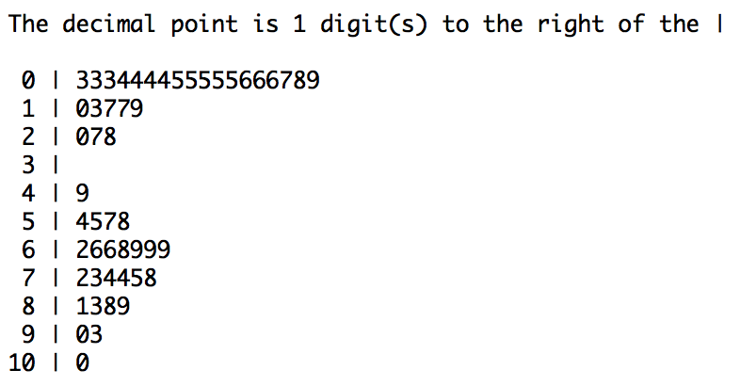
Example: Stem-and-Leaf of percentage of students taking the SAT for
the States data set, pertak
This stem and leaf sorts the 50 values into eleven groupings. The first grouping includes the values from 0 to 9 only, the second grouping includes the values from 10 to 19, the third grouping includes the values from 20 to 29, and so on. We know this to be the case because the heading of this plot notes that “the decimal point is 1 digit to the right of the |.” Accordingly, in the first row, for example, we place the decimal point to the right of the 3 and read the value of 0 | 3 as 03 or, more simply, as 3. Likewise, 10 | 0 represents the number 100, and so on. We see that there are three instances of 0 | 6 or 06 or, more simply, 6 indicating that three states have only 6% of their high school seniors taking the SAT tests.

Slide 35
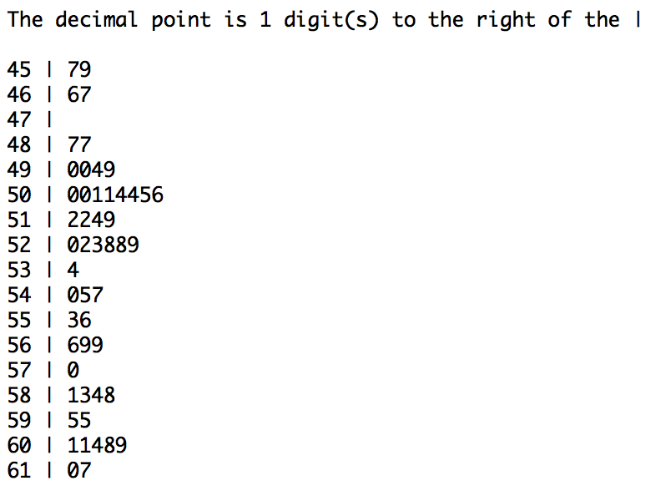
Example: Stem-and-Leaf of average math SAT for the States data set
The stem (the value to the left of |) represents the beginning digits of the values in the distribution. For example, 61 | 7 represents the value 617, the highest satm average of all 50 states. The code we used to create this graphic is stem(States$satm, scale = 2).

Slide 36
Example: Stem-and-Leaf of ses for the NELS Data Set
The decimal point is at the |
0 | 00
2 | 0000
4 | 00000
6 | 0000000000000000000
8 | 000000000000000000000000
10 | 0000000000000000000000000000000000000000
12 | 0000000000000000000000000000000
14 | 0000000000000000000000000000000000000000000
16 | 000000000000000000000000000000000000000000000000000
18 | 0000000000000000000000000000000000000000000000000000000000000000000
20 | 0000000000000000000000000000000000000000000000
22 | 00000000000000000000000000000000000000000
24 | 00000000000000000000000000000000000
26 | 000000000000000000000000000000000000
28 | 0000000000000000000000000000
30 | 000000000000000000000000
32 | 000
34 | 0

Slide 37
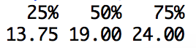
Accumulating Data (Data are at least ordinal)
Tabular: Cumulative percent distribution
Graphical: Ogive
Percentile rank = % of scores falling below
Cumulative percent = % of scores at or below
Example: Find the ses value that has a percentile rank of 25, called the 25th percentile; i.e., the value that has 25% of the values falling below.
Solution: Type the following command in the console and pressing Enter:
quantile(NELS$ses, c(0.25, 0.5, 0.75))
Note: the option c(0.25, 0.5, 0.75) in the command instructs R to find the first,
second, and third quartiles, respectively. If other quantiles were desired, it would
simply be necessary to change the values in this argument to reflect the quantiles
of interest. Based on the following output, we know that the ses value we seek is
13.75.
Solution:

Slide 38
Accumulating Data (Data are at least ordinal)
Finding the six-number summary for a single variable, ses.
To find the six-number summary of the ses distribution, we type the following command in the console and press Enter.
summary(NELS$ses) and obtain the following result:
From this six-number summary, we know that the ses distribution extends from a minimum value of zero to a maximum value of 35, with its center at 19 and its center bulk of 50% situated over the interval 13.75 to 24.

Slide 39
Boxplot of ses
A graphical representation of five of this six-number summary is given by a boxplot, also called a box-and-whiskers plot.
The next slide contains a boxplot for the ses data. The box depicts the middle 50% of the distribution, which ranges from Q₂₅ = 13.75 to Q₇₅ = 24. The middle line in the box represents Q₅₀, the middle score of the distribution, which is equal to 19. The whiskers extend out from the box on both ends. From the end representing lower values, the whisker extends to the minimum value of 0 and from the end representing higher values, it extends to the maximum value of 35. The advantage of a boxplot is that it provides in one graphic information about the level (location), spread, and shape of a distribution.

Slide 40
Boxplot of twelfth grade self-concept
By looking at the boxplots alone, we should have no problem visualizing the complete distributions of both ses and slfcnc12 variables. The several outliers, or extreme values, at the bottom of the slfcnc12 plot (the lower tail of the distribution), suggest negative skewness. Add to that the fact that the distance between the end of the top whisker and Q₅₀ is smaller than the distance between the end of the bottom whisker and Q₅₀, that is, that the bulk of the distribution of self-concept is relatively high, we have a rather full picture of the shape of the distribution of this variable.

Slide 41
Boxplot of expected income at age 30

Slide 42
We use the following command to obtain these side by side boxplots boxplot(nelss$slfcn12~nels$gender)
Boxplot of self-concept in twelfth grade for the NELS by sex

Slide 43
Measures of location, spread, and skewness CHAPTER 3

Slide 44
Overview
Measures of Central Tendency (Level)
Mode
Median
Mean
Measures of Dispersion (Spread)
Range
Interquartile Range
Variance
Standard Deviation
Measure of Shape
Skewness and Skewness Ratio

Slide 45
Measures of location: Mode
Definition: The mode is the score that occurs most often.
It is useful when data are nominal or ordinal with only a limited number of categories.
To find the mode of home language background from the NELS dataset, for example, we may type the following command in the console and hit Enter:
the.mode(NELS$region)

Slide 46
Measures of location: Mode
Example: home language background (homelang) from NELS. What is this variable’s mode?
Using the the.mode command, we obtain that the mode = English Only (which has a value of 4). To verify, we use the command: table(NELS$homelang)
Non-English Only Non-English Dominant English Dominant English Only
15 35 47 403

Slide 47
Measures of location: Mode
Example: Although the mode is technically South, North Central is close enough that this distribution may be considered bimodal.
barplot(table(NELS$region), ylab = "Frequency")

Slide 48
Measures of location: Mode
Definition: A bimodal distribution is one with two modes, usually at some distance apart from each other.
Definition: A uniform distribution is one in which all values occur with the same frequency.

Slide 49
Measures of location: Median
Definition: The median is the middle point in a distribution.
It is particularly useful when ordinal or scale data are severely skewed.
To find the median, or 50th percentile, of the NELS variable, ses, we may use either of the following commands:
median(NELS$ses)
quantile(NELS$ses, c(0.5))
From the quantile command we know the median of ses is 19. Both the median and quantile commands refer to the median as the 50th percentile or, in shortened form as p50. The median of ses is 19, which is the same value as the mode of ses.

Slide 50
Measures of location: Mean
Definition: The mean is the sum of all of the data points divided by the number of data points.
It is useful when data are scale and not severely skewed.
To find the mean of the NELS variable, seswe may use the following command: mean(NELS$ses), and the answer we obtain is 18.434.

Slide 51
Measures of location: Mean
In the case where a variable is dichotomous and coded as 0 and 1, the mean is interpreted as the proportion of 1’s in the distribution. (Example: gender)
Because gender is a string (not a numeric) variable in the NELS dataset, coded 1 (for females) and 2 (for males), we first need to re-code the values as 0 and 1 and consider the variable as numeric, not string. We use the following commands to do so, and then find the mean of this new numeric variable, numeric_gender.
NELS$numeric_gender = as.numeric(NELS$gender) - 1
mean(NELS$numeric_gender)
The mean value we obtain is: 0.546, which suggests that 54.6% of the sample of 500 is female. We verify this with the following command:
percent.table(NELS$gender)
And obtain these results, which confirm our interpretation of the mean:
Male Female
45.4 54.6

Slide 52
Measures of location: Comparing the Mean and the Median
We compare the mean and median for the following NELS variables that have different degrees and direction of skewness:
ses (reasonably symmetric)
expinc30 (highly positively skewed)
schattrt (somewhat negatively skewed)
Note: By calculating the mean of these variables, we are treating them as at least interval-leveled. na.rm=T omits missing data in calculating the values.
mean(NELS$ses, na.rm = T)
mean(NELS$expinc30, na.rm = T)
mean(NELS$schattrt, na.rm = T)
18.43
51574.73
93.65
median(NELS$ses, na.rm = T)
19
median(NELS$expinc30, na.rm = T)
median(NELS$schattrt, na.rm = T)
40000
95

Slide 53
Measures of spread Visually
When traveling to these two cities, would the same clothing be suitable for both cities at any time during the year from the point of view of warmth (Temperature)? boxplot(Temp$Temperature~Temp$City)

Slide 54
Measures of spread
How can we quantify the obvious difference in temperature variability across the year between these two cities?
By using the range or interquartile range (IQR),
or by using the variance or standard deviation.
The range is the difference between the highest and lowest values in the distribution.
The interquartile range (IQR) is the range of the middle half of the data, or the difference between the 75th and 25th percentiles. It is useful when data are ordinal or scale and severely skewed.
The variance is the average of the squared deviations from the mean. The standard deviation is the square root of the variance. These are explained more fully in a later size.

Slide 55
The Range and Interquartile Range
To obtain the IQRs for distributions of a single variable for different sub-groups, defined, for example, by the variable City, we type:
IQR(Temp$Temperature[Temp$City == "Springfield"])
IQR(Temp$Temperature[Temp$City == "SanFrancisco"])
Temp$City == "…" within the square brackets [] allows us to compute the IQR on each city separately by creating two subsets of Temperature values, one for Springfield and the other for San Francisco. Without these brackets, the IQR would be computed on all Temperature values from both cities combined. Said differently, the square brackets subset the variable Temperature by City.

Slide 56
The Variance and Standard Deviation
We may think of the standard deviation as the distance we have to travel in both directions from the mean to capture the majority of values in a distribution. The farther out we need to travel, the more spread out are the values of the distribution from the mean. These are useful when data are at least interval and not severely skewed.
To find the variance of the temperature variable from the TEMP dataset for each City, we use:
var(Temp$Temperature[Temp$City == "Springfield"])
var(Temp$Temperature[Temp$City == "SanFrancisco"])
To find the sdev, substitute sd for var in the above commands.
NOTE: The square brackets [ ] separate the variable Temp$Temperature into the subset of values for each city. In the first case, for Springfield; in the second case, for San Francisco.

Slide 57
Measures of Dispersion
Be executing the commands on the two previous slide, we obtain the following indicators of spread for temperature for the two cities.
sdev variance iqr range
Springfield 16.82 282.99 28.0 46
San Francisco 2.90 29.06 8.5 15
Consistent with the earlier boxplots, all quantitative measures show that Springfield has a greater temperature spread than San Francisco.

Slide 58
Measures of spread
Key words to indicate that a question relates to spread:
spread
variability
dispersion
heterogeneity
inconsistency
unpredictability

Slide 59
Measures of Shape
The skewness statistic is a measure of the shape of a distribution.
It is negative when the distribution is negatively skewed.
It is zero when the distribution is not skewed.
It is positive when the distribution is positively skewed.
Its calculation is based on the cubed deviations from the mean.
It is useful when data are at least interval-leveled.
To find the skew for the San Francisco temperatures, for example, we may type:
skew(Temp$Temperature[Temp$City == "SanFrancisco"])

Slide 60
Examples of Distributions with Different Shapes
skew(NELS$ses) -0.1120025
skew(NELS$schattrt) -6.212213
skew(NELS$expinc30) 10.89864

Slide 61
How the Shape of the Distribution Affects the Mean and Median
For a severely positively skewed distribution, in general, the mean is greater than the median.
For a severely negatively skewed distribution, in general, the mean is less than the median.
For a symmetric distribution, the mean equals the median.
ADD VALUES HERE

Slide 62
Which Measure of Central Tendency Should One Use
An article in the Wall Street Journal online
(http://online.wsj.com/article/SB118790518546107112.html) from
August 24, 2007 reported the following:
The average cost of a wedding is between $27,400 and $28,800.
The median is approximately $15,000.
How can we justify this apparent contradiction in the cost of a wedding?

Slide 63
Applying What We have Learned
What is the extent to which eighth-grade males expect larger incomes at age 30 than eighth-grade females (variable is expinc30)?
To what extent is there lack of consensus among males in their income expectations as compared to females (variable is expinc30)?
How are the answers to these questions influenced by the outliers and general shape of these distributions as shown in the boxplots in the last slide?

Slide 64
Descriptive Statistics for Males & FEmales
summary(NELS$expinc30[NELS$gender == "Female"], na.rm = T)
summary(NELS$expinc30[NELS$gender == "Male"], na.rm = T)
sd(NELS$expinc30[NELS$gender == "Female"], na.rm = T)
sd(NELS$expinc30[NELS$gender == ”Male"], na.rm = T)
Gender Min. 1st Qu. Median Mean 3rd Qu. SDev Max. NA’s
Female 0 30000 40000 43516 50000 26965 250000 29
Male. 1 35000 45000 60721 60000 79259 1000000 12
NOTE: NA’s are the number of expinc30 missing values for females & males. We may find the IQR by subtracting the 1st Qu. from the 3rd Qu.

Slide 65
Boxplots for Males and FEmales
boxplot(NELS$expinc30~NELS$gender)

Slide 66
RE-EXPRESSING VARIABLES CHAPTER 4

Slide 67
Linear and Non-Linear Transformations: An Overview
Linear transformations:
The effect on the shape of a distribution
The effect on summary statistics of a distribution
Common linear transformations
Standard scores
z-scores
Nonlinear transformations:
Square roots
Logarithms
Rankings
Other transformations:
Recoding
Combining Two or More Variables

Slide 68
Linear Transformations: Examples
New Test Score = Old Test Score + 10
HEIGHTCM = 2.54 * HEIGHTIN
Centigrade =

Slide 69
Linear Transformations: Definition
The general form of a linear transformation is
X_{New}= K * X_{Old} + C
where K and C are constants and K ≠ 0.
Note that multiplication includes division (multiplying by a fraction) and addition includes subtraction (adding a negative).

Slide 70
Linear Transformations: Effect on the Shape of a Distribution by Multiplying by a Non-Zero Constant
Notes:
70

Slide 71
Linear Transformations: The Effect on Summary Statistics by Multiplying by a Non-Zero Constant
The Transformation is: X_{New}= K * X_{Old}, K≠0
The Effect on Measures of Location:
Median_{New}= K * Median_{Old}
Mean_{New} = K * Mean_{Old}
Mode_{New} = K * Mode_{Old}
Notes:
71

Slide 72
Linear Transformations: The Effect on Summary Statistics by Multiplying by a Non-Zero Constant
The Transformation is: X_{New}= K * X_{Old}, K≠0
The Effect on Measures of Spread:
IQR_{New} = |K| * IQR_{Old}
SD_{New} = |K| * SD_{Old}
Range_{New} = |K| * Range_{Old}
Variance_{New.} = K² * Variance_{Old}
Notes:
72

Slide 73
Linear Transformations: The Effect on Summary Statistics by Multiplying by a Non-Zero Constant
The Transformation is: X_{New}= K * X_{Old}, K≠0
The Effect on Measures of Shape:
If K is positive
Skewness_{New} = Skewness_{Old}
Skewness Ratio_{New.} = Skewness Ratio_{Old}
If K is negative
Skewness_{New} = (-1) * Skewness_{Old}
Skewness Ratio_{New} = (-1) * Skewness Ratio_{Old}
Notes:
73

Slide 74
Linear Transformations: Effect on the Shape of a Distribution by Adding a Constant

Slide 75
Linear Transformations: The Effect on Summary Statistics by Adding a Constant
The Transformation is: X_{New}= X_{old} + C
The Effect on Measures of Location:
Median_{New}= Median_{Old} + C
Mean_{New} = Mean_{Old} + C
Mode_{New} = Mode_{Old} + C
Notes:
75

Slide 76
Linear Transformations: The Effect on Summary Statistics by Adding a Constant
The Transformation is: X_{New}= X_{old} + C
The Effect on Measures of Spread:
IQR_{New} = IQR_{Old}
SD_{New} = SD_{Old}
Range_{New} = Range_{Old}
Variance_{New} = Variance_{Old}
Notes:
76

Slide 77
Linear Transformations: The Effect on Summary Statistics by Adding a Constant
The Transformation is: X_{New}= X_{old} + C
The Effect on Measures of Skew:
Skewness_{New} = Skewness_{Old}
Skewness Ratio_{New} = Skewness Ratio_{Old}
Notes:
77

Slide 78
Linear Transformations - Examples
Translation
Reflection
Standard scores

Slide 79
Common Linear Transformations: Translation
Example: Adding a constant number of points (e.g., 4) to
each score in a distribution
Notes:
79

Slide 80
Common Linear Transformations: Reflection
Example: Consider the following item from a Likert Scale of Assertiveness -- “I can stand up for my own rights”
Notes:
80

Slide 81
Common Linear Transformations: Reflection
The item is measured on a five point Likert scale with 1 = Strongly Agree and 5 = Strongly Disagree. In this case, a higher score represents less assertiveness.
A reflection is required to create a new variable with the property that a higher score represents more assertiveness, not less.
Notes:
81

Slide 82
Common Linear Transformations: Reflection (multiplying by -1)
Reflected Assertiveness Score = (-1) * Original Score + 6
Notes:
82

Slide 83
Common Linear Transformations: Standard Scores
Means and standard deviations of commonly-used standard score systems
Notes:
83

Slide 84
Common Linear Transformations: z-scores
The z-score measures the number of standard deviations above (when positive) or below (when negative) the mean the score is.
Given a raw score, X, the formula to find the associated z-score is:
Notes:
84

Slide 85
Common Linear Transformations: z-scores
Example: Convert to a z-score: IQ = 90.
Solution: From the table of standard scores, we know that the mean and standard deviation of an IQ scale are 100 and 15, respectively.
In other words, an IQ score of 110 is .67 standard deviations below the IQ mean of 100.
Notes:
85

Slide 86
Common Linear Transformations: z-scores
Example: Manually compute the z-score associated with a score of 30 on the socioeconomic status (ses) scale from the NELS data set.
Solution: By executing the command summarize ses (or in its shortened form, sum) in Stata, we may note that the mean and standard deviation of ses are 18.43 and 6.92, respectively.
Accordingly, the z-score is:
Notes:
86

Slide 87
Common Linear Transformations: z-scores
Example: Use R to transform the ses scores in the NELS
data set into z-scores.
Solution:
(1) NELS$zses = (ses -18.43)/6.92
(2) More simply, we may use the scale function as follows:
NELS$zses = scale(NELS$ses)
The new variable, NELS$zses, will appear as the last variable in the NELS data set.
Notes:
87

Slide 88
Common Linear Transformations: z-scores
Given a z-score, the formula to find the associated raw score, X, is:
Notes:
88

Slide 89
Common Linear Transformations: Using z-scores to Detect Outliers
A score may be considered an outlier if it falls more than two standard deviations away from its distribution’s mean; that is, if its z-score is greater than 2 in absolute value.
Example: Are there outliers in the NELS$slfcnc12 distribution?
Transform NELS$slfcnc12 to NELS$zslfcnc12.
Create a table of the NELS$zslfcnc12 values that are < -2 or >+2 using the command table command:
table(NELS$zslfcnc12[NELS$zslfcnc12 > 2 | NELS$zslfcnc12 < -2])
Notes:
89

Slide 90
Common Linear Transformations: Using z-scores to Detect Outliers
According to the z-score criterion, there are 17 outliers in ses.
z-score -4.353 -3.800 -3.662 -3.109 -2.832 -2.556 -2.279 -2.141 -2.002
frequency 1 1 1 1 1 1 2 4 5
Notes:
90

Slide 91
Common Nonlinear Transformations: Square Roots and Logarithms
These nonlinear transformations are:
Monotonic because they retain the order of values in a distribution.
Nonlinear because they change the relative distances between the values in the distribution.
Often used to reduce the severity of a distribution’s skew.
Not necessarily defined for all values taken on by a variable.
Square roots are defined only on values greater than or equal to zero
Logarithms are defined only on values greater than zero.
Notes:
91

Slide 92
Common Nonlinear Transformations: Square Roots and Logarithms
Example: The distribution of expected income at age 30 (expinc30) is positively skewed and the distribution of self-concept in grade 12 (slfcnc12) is negatively skewed.
Use appropriate transformations to reduce the magnitude of the skew in both distributions, if possible.
Notes:
92

Slide 93
Common Nonlinear Transformations: Square Roots and Logarithms
Before Transformations
Notes:
93

Slide 94
Common Nonlinear Transformations: Square Roots and Logarithms – Self-concept
Reflection: NELS$slfcnc12reftr = (-1)*NELS$slfcnc12 + 44
SquRoot: NELS$slfcnc12reftrsqrt = sqrt(NELS$slfcnc12reftr)
Log₁₀: NELS$slfcnc12reftrlog = log(NELS$slfcnc12reftr, 10)
Notes:
94

Slide 95
Common Nonlinear Transformations: Square Roots and Logarithms – expinc30
Square-Root: NELS$expincsq = sqrt(NELS$expinc30+1)
Log₁₀ : NELS$expinclg = log(NELS$expinc30+1, 10)
Notes:
95

Slide 96
Common Nonlinear Transformations: Square Roots and Logarithms – comments
The transformation (sqrt or log) that yields the more symmetric distribution is typically the one that should be used.
Sometimes both sqrt and log transformations over-compensate and change the distribution of the original, untransformed variable from being skewed in one direction to be skewed in the other direction. In that case, the original, untransformed variable may be the better one to use.
As shown in the case of self-concept, a variable that is negatively skewed needs to be reflected before a sqrt or log transformation is applied, otherwise, the transformed distribution will be even more negatively skewed.

Slide 97
Common Nonlinear Transformations: Ranking Variables
Ranking variables: Use the calories and fat variables from the Hamburger data set.
For 1 to be assigned to the highest value:
Hamburger$rfat = rank(Hamburger$fat)
Hamburger$rcalories = rank(Hamburger$calories)
For 1 to be assigned to the lowest value:
Hamburger$rkfat = 6 - Hamburger$rfat
Hamburger$rkcalories = 6 - Hamburger$rcalories
Notes:
97

Slide 98
Common Nonlinear Transformations: Ranking Variables
Notes:
98

Slide 99
Common Nonlinear Transformations: Recoding Variables
Example:
In the NELS, the variable schtyp8 is coded with the values:
1 = Public, 2 = Private religious, 3 = Private non-religious.
Create a new variable schtyp8d1 with only two categories (public and private) and the new coding: 1 = public and 2 = private.
Notes:
99

Slide 100
Common Nonlinear Transformations: Recoding Variables
To use R to collapse the three categories of schtyp8 into two (public and private), we use the ifelse command.
For this command, the first argument is a logical expression (NELS$schtyp8 == "Public”). If it is True for a case, the new variable, schtypre is assigned the value “Public” and given an internal code of 1. If it is False, the new variable schtypre is assigned the value “Private” and given an internal code of 2.
NELS$schtypre = ifelse(NELS$schtyp8 == "Public", "Public", "Private")
Notes:
100

Slide 101
Common Nonlinear Transformations: Combining Two or More Variables
Example: Create the variable sumunits by adding unitmath and unitengl
Solution: Type the following command in the console and hit Enter:
NELS$sumunits = NELS$unitmath + NELS$unitengl
The new variable NELS$sumunits will appear as the last variable in the data set.
Notes:
101

Slide 102
EXPlorING relationships between two VARIABLES CHAPTER 5

Slide 103
Summarizing the Relationship Between Two Variables: An Overview
Variable Types | Summary Graphic | Summary Statistic
Both Scale | Scatterplot | Pearson Correlation
Both Ordinal | Scatterplot | Spearman Correlation
Ordinal & Scale | Scatterplot | Spearman Correlation
Scale & Dichotomy | Scatterplot or Boxplot | Pearson (point biserial)
Both Dichotomies | Clustered Bar Graph | Pearson (phi-coefficient) or Contingency Table

Slide 104
The Relationship Between Two Scale Variables: What the Scatterplot Tells Us
Whether the relationship appears linear
If linear, it also tells us:
The direction (or nature) of the linear relationship
The relative strength of the linear relationship

Slide 105
A Scatterplot Example: Hamburger Data Set
plot(Hamburger$calories~Hamburger$fat, xlab = "Fat", ylab = "Calories")
Notes:
105

Slide 106
Interpreting the fat vs. calories scatterplot
A line, as opposed to a simple curve, appears to fit the data well; i.e., a linear model appears appropriate for these data.
The direction of the linear relationship is positive because the line has a positive slope; i.e., burgers that are relatively high in fat tend also to be relatively high in calories.
The strength of the linear relationship appears to be strong because the points cluster tightly around the line.
Notes:
106

Slide 107
Scatterplot Example: States Data Set (Percentage of eligible students in the State taking the SAT (pertak) vs. the average State SAT writing score (satw))
plot(States$satcr~States$pertak, xlab = "Percent Eligble Students Taking SAT, 2012", ylab = "Average SAT Critical Reading, 2013")
Notes:
107

Slide 108
Interpreting the satw vs. pertak scatterplot
Although the points have a curvilinear shape, a line would appear to represent these points reasonably well, and so we will use it in this case.
The direction of the linear relationship is negative because the slope of the line is negative; i.e., states with a relatively low percentage of students taking the SAT tend to have higher average SAT writing scores.
The strength of the linear relationship is more moderate than in the hamburger example because the points in this case do not cluster as tightly around the line.
Notes:
108

Slide 109
Scatterplot Example: Currency Data Set (denomination (billvalu) vs. number of bills in circulation (num_circ))
plot(Currency$NumberCirculation~Currency$BillValue, xlab = "Bill Value", ylab =
"Number in Circulation")
Notes:
109

Slide 110
Interpreting the denomination vs. num_circ scatterplot
The points have a “cloud like” formation, and so neither a simple curve nor a line provides a good fit to these data.
It appears, therefore, that there is little or no relationship between the value of a bill and its number in circulation.
Notes:
110

Slide 111
Scatterplot Example: Marijuana Data Set (year vs. percentage of students reporting ever having used marijuana from 1987-1999) .
plot(Marijuana$MarijuanaUse[Marijuana$Year <= 1996 & Marijuana$Year >= 1987]~Marijuana$Year[Marijuana$Year <= 1996 & Marijuana$Year >= 1987], xlab = "Year", ylab = "Marijuana Use", main = "Marijuana Use Over the Years")
Notes:
111

Slide 112
Interpreting the Year vs. Marijuana Scatterplot
A simple curve (or two lines) provides a better fit to the data than a single line and is therefore more appropriate than a line for modeling the data.
We conclude that the relationship between marijuana use and year is non-linear.
Notes:
112

Slide 113
Quantifying a Linear Relationship between Two Scale Variables: Pearson Product Moment Correlation Coefficient
Called simply, correlation, and symbolized by the letter r.
Before calculating, use a scatterplot to verify that the relationship between the variables appears to be linear.
Measures the direction, nature (the interpretation of the direction), and strength of the linear relationship.
Direction (and Nature): Measured by the sign of r (positive or negative)
Strength: Measured by the absolute magnitude of r.
Rule of thumb (Cohen’s scale): r < .1 little or no rel, .1 <= r < .3, weak rel, .5 <= r < .5 moderate rel, r >= .5 strong rel
Notes:
113

Slide 114
Obtaining the Pearson Correlation Using R
Type the following command in the Console and press Enter:
cor(Hamburger$fat, Hamburger$calories)
We obtain the following result: r = 0.996, a near perfect correlation, suggesting, as shown in slide 4, that the points in the scatterplot all closely fall along a straight line.
Notes:
114

Slide 115
Interpreting Pearson Correlation Coefficients
The correlation between FAT and CALORIES is .996, represents a very strong positive linear relationship between these two variables.
=> Burgers that are relatively high in fat tend also to be relatively high in calories and burgers that are relatively low in fat tend also to be relatively low in calories.
The correlation between the Average SATWs of states and the percentage of students in these states who take the SAT is -.86, representing a strong negative linear relationship between these two variables (see slide 6 for scatterplot).
=> States with a relatively high average SATW tend to have a relatively low percentage of students taking the SAT; states with a relatively low average SATW tend to have a relatively high percentage of students taking the SAT.
Notes:
115

Slide 116
Other Properties of the Correlation
Correlation values are on an ordinal scale
Correlation does not imply causation, i.e. when two variables are correlated it is not necessarily true that changing one will result in a predictable change in the other
A linear transformation applied to one variable does not change the magnitude of the correlation. The sign of the correlation will change, however, if the transformation involves multiplication by a negative number
Restricting the range of one of the variables can either increase or decrease the magnitude of the correlation
Notes:
116

Slide 117
Quantifying the Relationship between Two Variables using The Spearman Rank Correlation Coefficient
The Spearman correlation, called Spearman’s rho, is a special case of the Pearson correlation that is computed on ranked data, although it can be computed on interval-level data as well after the data are transformed to rankings. R automatically transforms the data to rankings. It is interpreted in the same way as the Pearson correlation.
cor.test(Hamburger$calories, Hamburger$fat, method = "spearman")
From the execution of the above command, we obtain that rho = 0.975. The value of rho is close to, but not identical with, the value of the Pearson correlation in this case (r = .996) because of the presence of ties in the data. When there are no ties, the two correlations will produce the identical values.
Notes:
117

Slide 118
Quantifying the relationship between One Scale and One Dichotomous Variable – The Point Biserial Correlation Coefficient: Calories vs cheese
plot(Hamburger$calories~jitter(Hamburger$cheese,0.25), xlab = "Cheese", ylab = "Calories")
Note the jitter() function moves the two upper right points on the graph a bit so that they are not overlapping
Notes:
118

Slide 119
Interpreting the relationship between Calories and Cheese
cor(Hamburger$calories, Hamburger$cheese)
r = .51 between calories and cheese.
In this case r is called a point biserial correlation, a special case of the Pearson correlation coefficient
Note: The sign of the correlation is positive
The variable cheese is coded 0 (a relatively low score on the cheese metric) to represent the absence of cheese and 1 (a relatively high score on the cheese metric) to represent the presence of cheese.
=> Burgers with cheese tend to be higher in calories than those without cheese.
Notes:
119

Slide 120
Quantifying a Relationship between Two Dichotomous Variables – The Phi Coefficient
Example: Is there a relationship between gender and whether or not an individual attended nursery school (using the NELS data set)
cor(as.numeric(NELS$nursery), as.numeric(NELS$computer), use = "complete.obs")
Because both variables in this case are dichotomous, we use the Phi Coefficient, which is also a special case of the Pearson and find that
r = .204.
Notes:
120

Slide 121
plotting a Relationship between Two Dichotomous Variables – The scatterplot
plot(as.numeric(NELS$nursery)~as.numeric(NELS$gender), xlab = "Gender", ylab = "Nursery", axes = F)
box()
axis(2, at = c(1,2), labels = c("No", "Yes"))
axis(1, at = c(1,2), labels = c("Male", "Female"))
As you can see, this graphic of four dots is not informative.
Notes:
121

Slide 122
a Clustered Bar Graph as an alternative to the scatterplot
barplot(table(NELS$nursery, NELS$gender), beside = T, legend.text = c("No","Yes"), args.legend = list(x = 2, y = 140, bty = "n"))

Slide 123
Tabulating the Relationship between gender and nursery school attendance: The Contingency Table
To obtain the frequencies of each of the four cells in tabular form (called a contingency table or cross-tabulation), type the command:
table(NELS$computer,NELS$nursery)
Nursery
No Yes
Computer No 92 125
Yes 47 156
Notes:
123

Slide 124
Relationships between Other Variable Types
Dichotomous vs. Non-dichotomous Nominal or Ordinal (with limited categories): Computer Ownership vs. Region
Scale vs. Non-dichotomous Nominal or Ordinal (with limited categories): Math Achievement vs. Region.
Notes:
124

Slide 125
Graphically Representing computer ownership and Region: The Clustered Bar Graph
barplot(table(NELS$computer, NELS$region), ylab = "Owns a Computer", beside = T, legend.text = c("No", "Yes"), args.legend = list(x = 10, y = 100, bty = "n"))
Notes:
125

Slide 126
Tabulating computer ownership vs. Region: The Contingency Table
table(NELS$computer, NELS$region)
Region
Northeast North Central South West
Computer No 46 89 86 42
Yes 60 62 64 51
Notes:
126

Slide 127
Graphically Representing math achievement and Region: The Boxplot
boxplot(NELS$achmat12~NELS$region)
Notes:
127

Slide 128
Summarizing The Possibilities
Notes:
128

Slide 129
Simple linear regression CHAPTER 6

Slide 130
Simple Linear Regression
When two variables are related, you may use one to predict the other. The variable being predicted is often called the dependent or criterion or outcome variable. The variable predicting the dependent variable is called the independent variable, predictor or regressor.
In predicting one variable from another, we are not suggesting that one variable is a cause of the other.

Slide 131
Overview of Topics Covered
Simple linear regression when both independent and dependent variables are scale
The scatterplot: Graphing the “best-fitting” linear equation
The simple linear regression equation: Yhat = bX+a
The standardized regression equation
R as a measure of the goodness of fit of the model
Why the scatterplot is important
Simple linear regression when the independent variable is dichotomous

Slide 132
Graphing the Simple Regression Equation (the best fitting line) on the Scatterplot for Predicting Calories from Fat
plot(Hamburger$calories~Hamburger$fat, xlab = "Fat", ylab = "Calories", pch = 16)
abline(lm(Hamburger$calories~Hamburger$fat))
Note: By convention, the dependent variable is on the y-axis and the independent variable is on the x-axis.

Slide 133
Using the Scatterplot to Predict the Number of Calories of a Burger with 28 Grams of Fat
Answer: Approximately 520 calories.
Note: A Big Mac has 28 grams of fat, but actually has 530 calories. The predicted value of 520 calories departs from the actual value by 10 calories. This amount, the difference, d, between the actual and predicted values, is called the residual or error.
In equation form, we may say that in this case,
d = Y – = 530 - 520 = 10

Slide 134
Creating the Best-Fitting Line: Averaging (a function of) the d’s
While d = 10 in this case, d may equal a different value for each of the other four cases in this data set.
The line that best fits our data, in the sense that it provides the most accurate predictions of the outcome variable, is the one that gives rise to the overall smallest possible set of d values.
The overall set of d values is summarized as an average, and, in particular, as an average of the squared d’s rather than as an average of the d’s themselves so as to avoid the cancelling out of negative and positive d’s when forming the average. By squaring, we only are adding positive terms to get the average.

Slide 135
Creating the Best-Fitting Line: The Least Squares Criterion
Because we take an average of the squared d’s to find the best-fitting line, the criterion for creating that line is called the Least Squares Criterion.
The best-fitting line is called the (least squares) regression line or (least squares) prediction line.
The equation of the regression line is called the linear regression equation.

Slide 136
The Regression Equation
Although the derivation of the regression equation is beyond the scope of this course, the equation of the regression line itself is really quite simple.
The regression line is given by:
where

Slide 137
Interpreting Regression Coefficients: Slope, b
The value of the slope, b, gives the change in the predicted value of Y, on average, associated with each unit increase in X.
If b is positive, there will be an increase in Y, on average, associated with an increase in X.
If b is negative, there will be a decrease in Y, on average, associated with an increase in X.

Slide 138
Interpreting Regression Coefficients: Intercept, a
The value of the intercept, a, is the predicted value of Y when X = 0.
It is only meaningful when 0 is a meaningful value for the variable X and data close to X = 0 have been collected.
Based on the equation for a, we may note that a is defined so that when X = , the predicted value of Y is i.e. ( , ), which lies on the regression line.

Slide 139
Using R to Obtain the Linear Regression Equation for Predicting Calories from Fat using the Hamburger Data Set
model = lm(Hamburger$calories~Hamburger$fat)
yhat = predict(model)
yhat
1 2 3 4 5
270.68 325.51 421.48 544.87 517.45
(these are the predicted calorie values for each fat value)
YminusYhat = model$residuals
YminusYhat
1 2 3 4 5
-0.68 -5.51 8.52 -14.87 12.55
(these are the residual values for each fat value)

Slide 140
Writing the Regression Equation
The regression equation may be obtained by typing model on the Console and hitting Enter. We obtain the following R output:
lm(formula = Hamburger$calories ~ Hamburger$fat)
Coefficients:
(Intercept) Hamburger$fat
133.58 13.71
We write this in equation form as follows:

Slide 141
Interpreting the Regression Coefficients, b and a.
where Y = Calories and X = Fat
The value of the slope, b = 13.71, tells us that a one gram increase in the fat content of a burger is associated with an increase of 13.71 calories, on average.
The value of the intercept, a = 133.576, is not meaningful in this example because burgers with 0 grams of fat would be quite different from the burgers in this data set.

Slide 142
Using the Regression Equation to Predict Calories from a Burger with 28 Grams of Fat
Where Y = Calories and X = Fat

Slide 143
An Example Continued: Reviewing the Data with yhat and resid
Burger | Fat | Calories | Cheese | yhat | resid
Hamburger | 10 | 270 | 0 | 270.6751 | -0.67513
Cheeseburger | 14 | 320 | 1 | 325.5147 | -5.51471
Quarter Pounder | 21 | 430 | 0 | 421.484 | 8.51604
Quarter P. w/ c | 30 | 530 | 1 | 544.873 | -14.873
Big Mac | 28 | 530 | 1 | 517.4532 | 12.54679

Slide 144
The Standardized Regression Equation
The regression equation for predicting the standardized (z-score) values of Y from the standardized (z-score) values of X,
may be obtained by typing the following commands:
model2 = lm(scale(Hamburger$calories)~scale(Hamburger$fat))
model2
Coefficients:
(Intercept) scale(Hamburger$fat)
0.0000 0.9957
The value of r to be substituted in the equation above is r = .9957.

Slide 145
Measuring the Goodness of Fit of the Model: R or R²
R is defined as the correlation between the actual and predicted values of Y.
In the case of simple linear regression
As such, R or R² may be used to measure how well the regression model fits the data.
By typing summary(model), we obtain the following output for R²:
Multiple R-squared: 0.9915

Slide 146
Drawing the Correct Conclusions: Illustrating with Anscombe’s Data
Consider four data sets of X,Y pairs, each with the following identical set of summary statistics and regression line:
= 9.0, = 7.5, S_{X} = 3.17, S_{Y} = 1.94, r_{XY} = .82
Regression line: = 0.5X + 3
Can we draw the same conclusions about each set of data? That is, are the four scatterplots corresponding to these data sets the same? Let’s see.

Slide 147
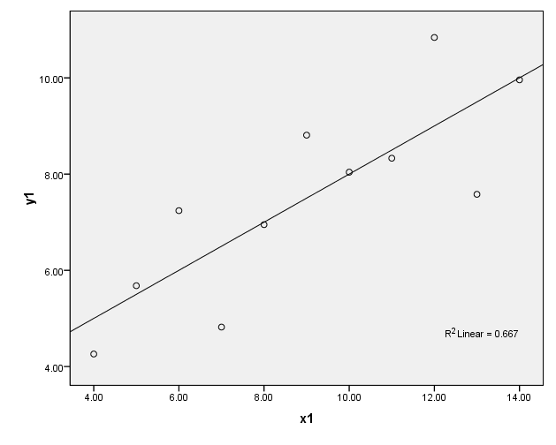
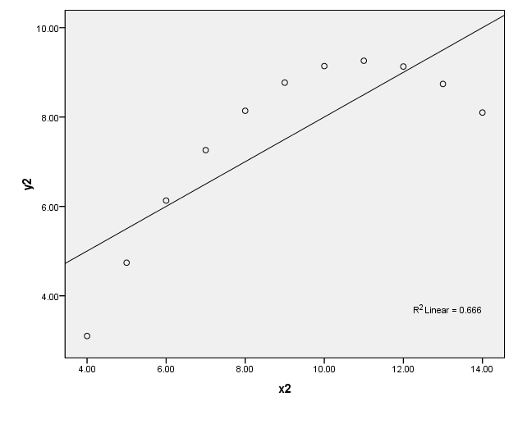
Anscombe’s Data: Panels I & II

Slide 148
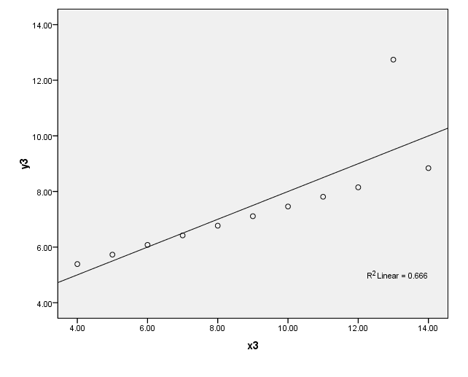
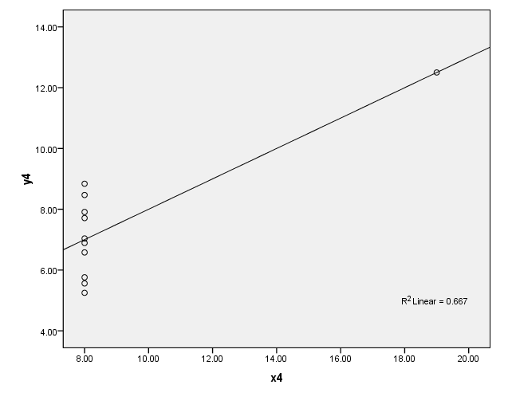
Anscombe’s Data: Panel III & IV

Slide 149
The Moral of the Story: As Illustrated by Anscombe’s Data
Summary statistics, including the linear regression model, may be misleading or in some way fail to capture the salient features of data.
The use of graphical displays, such as the scatterplot, is critical in the process of assessing how appropriate a given model is for describing a set of data.

Slide 150
Simple Linear Regression: When the predictor Variable is Dichotomous
Predict the number of calories in a burger by whether or not the burger has cheese.
Find the regression equation using the R software
Predict the calories for a burger with cheese. How else might we interpret this value?
Predict the calories for a burger without cheese. How else might we interpret this value?
Find and interpret the intercept, a.
Find and interpret the slope, b.

Slide 151
Simple Linear Regression: When the predictor Variable is Dichotomous
Using the Hamburger data set we use the following command to predict calories from cheese:
model = lm(Hamburger$calories~Hamburger$cheese)
model
We obtain the following output:
Coefficients:
(Intercept) Hamburger$cheese
350 110 we obtain
In equation form: Predicted calories = 110cheese + 350

Slide 152
Simple Linear Regression: When the Independent Variable is Dichotomous
The predicted calories for a burger with cheese is:
(110)(1) +350 = 460.
Intuitively, this is the mean number of calories for burgers with cheese.
The predicted calories for a burger without cheese is:
(110)(0) +350 = 350.
Intuitively, this is the mean number of calories for burgers without cheese.

Slide 153
Simple Linear Regression: When the Independent Variable is Dichotomous
The slope of the regression equation is 110, indicating that burgers with cheese have 110 more calories, on average, than burgers without cheese.
The intercept of the regression equation is 350, indicating that burgers without cheese are predicted to have 350 calories.
Note that in this example, the value X=0 is meaningful and
therefore, so is the intercept.

Slide 154
Probability fundamentals CHAPTER 7

Slide 155
Calculating Probability

Slide 156
An Example: Simple Probability
In the experiment of taking a fair coin and tossing it twice, what is the probability of obtaining two heads, i.e., what is the probability of the event “HH”?
Solution:
There are four possible equally likely outcomes for this experiment: {HH, HT, TH, TT} and only one of them, HH, satisfies event E, so P(E) = ¼.

Slide 157
Another Example: Simple Probability
Consider the frequency distribution table for the variable REGION from the NELS data set.
Assume that a single individual is selected at random from the NELS data set. Find the probability that the individual is:
From the Northeast
From the South
From France
From the United States

Slide 158
Solution
From the Northeast 106/500 = 21.2% = .212
From the South 150/500 = 30.0% = .300
From France 0/500 = 0% = 0
From the United States 500/500 = 100% = 1
Probability values are on a continuum from 0 (impossible) to 1 (certain). The higher the probability, the more likely the outcome.

Slide 159
The Complement Rule of Probability
If two events E₁ and E₂ are complements of each other, then
P(E₁) = 1 - P(E₂)

Slide 160
An Example: The Complement Rule
Assume that a single individual is selected at random from the NELS data set. Find the probability that the individual is not from the South.
Solution:
(500 – 150) / 500 = 100% - 30% = 1 - .300
= 350/500 = 70% = .70

Slide 161
The Additive Rules of Probability
First Additive Rule of Probability
When two events E₁ and E₂ of the same experiment are mutually exclusive or disjoint, P(E₁ or E₂ ) = P(E₁) + P(E₂ )
This rule also holds for more than two events if they are all pairwise disjoint, which means that no two of them can occur at the same time.

Slide 162
An Example: The First Additive Rule
Assume that a single individual is selected at random from the NELS data set. Find the probability that the individual is from the Northeast OR from the South.
Solution:
(106 + 150) / 500 = 21.2% + 30% = .212 + .300
= 256/500 = 51.2% = .512

Slide 163
The Additive Rules of Probability
Second Additive Rule of Probability
Given two events E₁ and E₂ of the same experiment,
P(E₁ or E₂) = P(E₁) + P(E₂) – P(E₁ and E₂)
where P(E₁ and E₂) represents the probability of the outcomes that E₁ and E₂ have in common.

Slide 164
An Example: The Second Additive Rule
A cross-tabulation of the number of students in the NELS data set by region and whether or not the family owned a computer when the student was in eighth grade is given below. If a student is selected at random from this data set, determine the probability of selecting a student who is from the South OR whose family owned a computer.

Slide 165
Solution
The events “student is from the South” and “student’s family owned a computer” are not mutually exclusive because they have 64 outcomes in common: students who are from the South and who attended nursery school.
Therefore, we use the more general Second Additive Rule with E₁ = “student is from the South” and E₂ = “student’s family owned a computer” to find:
P(E₁ or E₂) = P(E₁) + P(E₂) - P(E₁ and E₂)
= 150/500 + 237/500 – 64/500
= 323/500 = 65% = .65

Slide 166
The Multiplicative Rule of Probability
Suppose E₁ and E₂ are independent events of the same experiment, (E₁ and E₂ are said to be independent events if they have no effect on each other; that is, the occurrence of E₁ has no effect on the probability of E₂.)
Then P(E₁ and E₂) = P(E₁) • P(E₂)
This result also holds for more than two events if they are mutually independent.

Slide 167
An Example: The Multiplicative Rule
We select, at random, a student from the entire NELS data set and note whether that student ever smoked marijuana. Then we select again, at random with replacement (from the entire NELS data set) and note again whether the newly selected student (which, according to our sampling scheme, may be the same student that was selected first) ever smoked marijuana.
What is the probability that neither student smoked marijuana?

Slide 168
Solution: Part 1
According to the frequency distribution for marijuana use by students in the NELS data, 408 students, or 81.6%, never smoked marijuana.
We define E₁ as “the first student selected never smoked marijuana” and E₂ as “the second student selected never smoked marijuana.” We want the probability of the event (E₁ and E₂). At each stage of the selection process, the probability of selecting a student who never smoked is .816

Slide 169
Solution: Part 2
In addition, because we used sampling with replacement, E₁ and E₂ are independent of each other. Therefore, we can use the Multiplicative Rule of Probability.
P(neither student ever smoked marijuana) = P(first student never smoked marijuana and the second student never smoked marijuana) = P(E₁ and E₂) = P(E₁) • P(E₂) = .816 • .816 = .67

Slide 170
Another Example: The Multiplicative Rule
Three students are randomly selected with replacement from the NELS data set.
What is the probability that the first two students never smoked marijuana whereas the third student did?

Slide 171
Solution: Part 1
Let the events E1, E2, and E3 be defined as follows.
E1: “The first student never smoked marijuana.”
E2: “The second student never smoked marijuana.”
E3: “The third student smoked marijuana.”
We are looking for the probability of the event “E1 and E2 and E3.”

Slide 172
Solution: Part 2
For each student selected, the probability that the student never smoked marijuana is .816, and the probability that the student smoked marijuana is .184. Furthermore, because E1, E2, and E3 all refer to a different stage of the selection process and because sampling is with replacement, the student selected at any one stage does not affect who is selected at any other stage; these three events are independent of each other.
Therefore, we can use the Multiplicative Rule of Probability:
P(E1 and E2 and E3) = P(E1)• P(E2) • P(E3) = .816 • .816 • .184 = .1225

Slide 173
Conditional Probability
Example: We know from a previous example that the probability that a randomly selected student from the NELS data set has never smoked marijuana is 0.816.
Is this probability the same for males and females? That is, is the probability of never having smoked marijuana given that the student is male equal to the probability of never having smoked marijuana given that the student is female?

Slide 174
Solution Part 1
We obtain the cross-tabulation of gender by marijuana use for the NELS data set based on having used the command,
table (NELS$gender, NELS$marijuana)

Slide 175
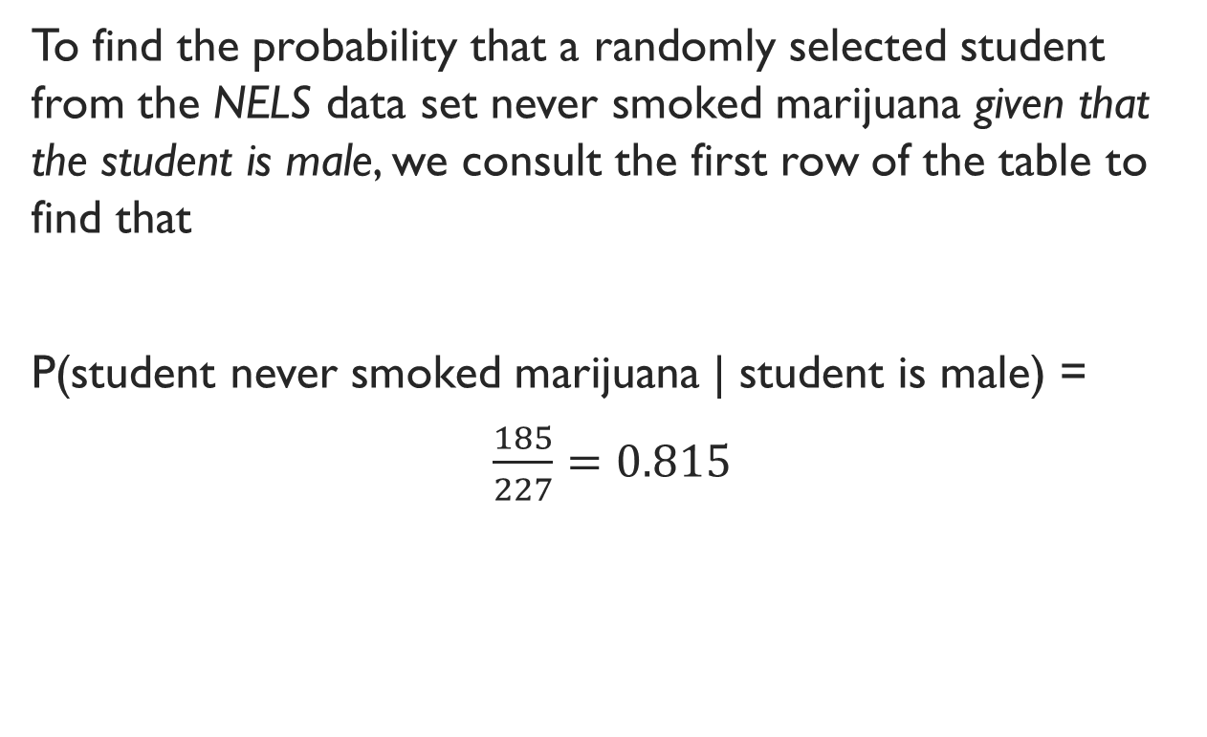
Solution Part 2
To find the probability that a randomly selected student from the NELS data set never smoked marijuana given that the student is male, we consult the first row of the table to find that
P(student never smoked marijuana | student is male) =
$\frac{185}{227}=0.815$

Slide 176
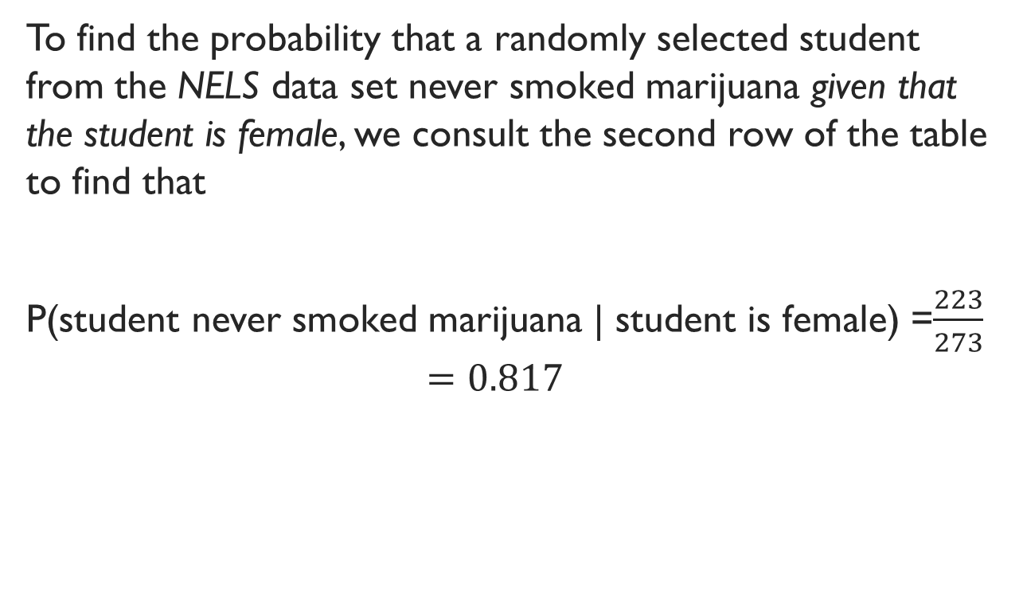
Solution Part 3
To find the probability that a randomly selected student from the NELS data set never smoked marijuana given that the student is female, we consult the second row of the table to find that
P(student never smoked marijuana | student is female) =$\frac{223}{273}$
$$=0.817$$

Slide 177
Solution Part 4
Because P(student never smoked marijuana | student is male) does not equal P(student is male | student never smoked marijuana), we may note that P(E₁|E₂) and P(E₂|E₁) do not have to be equal to each other. In fact, they will be equal to each other only when P(E₁) = P(E₂)

Slide 178
Complement of a Conditional Probability
P(E₁^{c}|E₂) = 1 – P(E₁|E₂)

Slide 179
Example: Complement of a Conditional Probability
Suppose that the probability that a pregnancy test comes back negative given that a woman is actually pregnant is .05.
Find the probability of the test coming back positive given that a woman is actually pregnant.

Slide 180
Solution
If we let E₁ be the event that the pregnancy test comes back positive, then the complement of this event, E₁^{c}, is that the pregnancy test comes back negative. Furthermore, if we let E₂ be the event that the woman is actually pregnant, we are interested in finding P(E₁|E₂).
Since we are given that P(E₁^{c}|E₂)=.05, by the equation P(E₁^{c}|E₂) = 1 – P(E₁|E₂), we know that P(E₁|E₂) must be .95.

Slide 181
The Law of Total Probability
P(A) = P(A|E₁)P(E₁) + P(A|E₁^{c})P(E₁^{c})

Slide 182
Example: Law of Total Probability
Use the information provided in the above paragraph to calculate the probability that a test would come back positive regardless of whether the woman is pregnant or not.

Slide 183
Solution
Using Equation 7.8, we note that P(E₁)=.75 and therefore P(E₂) = .25. Substituting the appropriate values into Equation 7.8, we obtain:
P(A) = P(A|E₁)P(E₁) + P(A|E₁^{c})P(E₁^{c}) = 0.95*0.75+0.01*0.25 = 0.715.

Slide 184
Bayes’ Theorem

Slide 185
Example: Bayes’ Theorem
Suppose the probability that a woman’s pregnancy test comes back positive (A) given that she is pregnant (E₁) is P(A|E₁) = 0.95, and we are interested instead in the probability that a woman is pregnant (E₁) given that her pregnancy test comes back positive (A). That is P(E₁|A). Suppose also that 75% of women who take the pregnancy test are actually pregnant and that the probability that a woman’s pregnancy test comes back positive (A) given that she is not pregnant (E₁^{c}) is P(A|E₁^{c}) = .01. Find P(E₁|A).

Slide 186
Solution

Slide 187
The Law of Large Numbers
Suppose E is an event in an experiment and the probability of E is p (P(E) = p). If the experiment is repeated n independent and identical times (each repetition may be called a trial), then the relative frequency of E occurring in these n trials will be approximately equal to p. In general, the larger the number of trials, the better p is as an approximation of the relative frequency of E actually obtained.

Slide 188
Theoretical probability models CHAPTER 8

Slide 189
Overview
The binomial probability model and distribution
The normal probability model and distribution
Using the normal distribution to approximate the binomial distribution

Slide 190
The Binomial Probability Model and Distribution
Example: Find the probability that exactly two of three students selected randomly with replacement from the NELS data set never smoked marijuana.
Applies to experiments that consist of independent and identical trials
The outcomes of any one trial may be thought of as dichotomous (as either success or failure)
This dichotomy is the reason for the name binomial – there are two outcomes (such as head/tail, pass/fail, or absent/present)

Slide 191
The Binomial Probability Model and Distribution
The number of trials is denoted by n
The probability of a success on any one trial is denoted by p
The number of successes is denoted by k
The binomial probability distribution consists of the probabilities associated with each possible number of successes, k, out of the n trials

Slide 192
Factorial Notation
Factorial notation is used to more conveniently denote the operation of sequential multiplication.
The mathematical symbol n! (read “n factorial”) is defined, for the positive integer n, as the ordered product of all the positive integers from 1 up to and including n: n! = 1 2 3 ... (n - 1) (n)
For example, 5! = 1 2 3 4 5 = 120.
Define the symbol 0! as 0! = 1.

Slide 193
Combinations & Their Notation
Given n objects, the number of ways in which k of these objects (k between 0 and n inclusive) can be combined, or selected, without regard to order of selection, is denoted by either the symbol _{n}C_{k} or the symbol and is given by

Slide 194
The Binomial Equation
The binomial equation gives the probability of each of the possible number of successes in the binomial distribution.
That is, the probability of obtaining k successes in n trials, where p is the probability of success and q is the probability of failure:
P(k successes in n trials) = p^{k}q^{(n} ^{– k)}

Slide 195
Find the probability that exactly two of three students selected randomly with replacement from the NELS data set never smoked marijuana
A trial is the selection of one student from the NELS data set
There are n = 3 trials.
The trials are independent because each student is selected at random with replacement
The trials are identical because each and every trial consists of selecting one student at random from the 500 students of the NELS data set.
Because the outcome of each trial may be categorized as either “student has smoked marijuana” or “student has never smoked marijuana,” each outcome is dichotomous.

Slide 196
Find the probability that exactly two of three students selected randomly with replacement from the NELS data set never smoked marijuana
We are interested in the probability of obtaining k = 2 “successes” in n = 3 trials
A success means the student never smoked marijuana
The probability of a success on any one trial is p = .816
For the single probability we are seeking, the number of successes is k = 2
The binomial probability distribution consists of the probabilities associated with each possible number of successes, so k takes on the values 0, 1, 2, and 3, in turn.

Slide 197
Solution: Using the Binomial Equation
We have n = 3, p = .816, and q = 1 – .816 = .184.
For k = 0, P(0 students never smoked marijuana) =
= .006.
For k = 1, P(1 student never smoked marijuana) =
= .083.
For k = 2, P(2 students never smoked marijuana) =
= .368
For k = 3, P(3 students never smoked marijuana) = = .543.

Slide 198
Solution Using R
We will find the binomial probability distribution with k = 0, 1, 2, and 3 successes in n = 3 trials, where a success is defined as “the student never smoked marijuana” and the probability of success on any one trial is p = .816.
The solution to the question will be the probability associated with k = 2.
Given a binomial distribution, we can use R’s binomial probability distribution function, dbinom(k,n,p) to obtain the probability of obtaining k success in n trials where p equals the probability of a success on each trial.
But, to generate all probabilities for this distribution, we use the commands on the following slide.

Slide 199
Solution Using r
## Create a vector of probabilities for each possible ##number of successes in 3 trials with 0.816 probability ##of success
probs = dbinom(c(0, 1, 2, 3), 3, 0.816)
## Plot probabilities as bars for each possible number of ##successes
barplot(probs, names.arg = c(0,1,2,3), xlab = "Number who never smoked marijuana (k)", ylab = "Probability")
Compute and print the probability when k = 2
dbinom(2,3,0.816)

Slide 200
Solution Using Stata
On executing the commands in the previous slide, we obtain the following binomial distribution:
The values depicted in this data set are the binomial probability distribution.
The probability of obtaining two students (k=2) who never smoked marijuana in a random sample of three students selected from the NELS data set is obtained from dbinom(k,n,p) = .368, as before.

Slide 201
Solution Using Table 3 from the online Appendix C
Accessing the online Table 3, we see that the box associated with n = 3 contains many columns, each representing the binomial distribution for fixed values of p.
Note that the highest value of p given is p = .5. In our case, we have defined “success” to be “the student never smoked marijuana,” and for a single randomly selected student the probability of success is .816.
However, because the table is made to approximate distributions with p ≤ .5, we redefine success as “the student smoked marijuana at least once.”

Slide 202
Solution Using Table 3 from the online Appendix C
Because the probability is .816 that the student never smoked marijuana, then 1 - .816, or .184, is the probability that the student smoked marijuana at least once.
Because n = 3, the event “0 students never smoked marijuana” is equivalent to the event “3 students smoked marijuana at least once.”
Because there is no value of p exactly equal to .184, we use the closest tabled value, which is p = .20.

Slide 203
Solution Using Table 3 from the online Appendix C
From the online Table 3, we see that the probability that
0 students smoked marijuana is approximately .512, that
1 student smoked marijuana is approximately .384, that
2 students smoked marijuana is approximately .096, and that
3 students smoked marijuana is approximately .008.
The probability we seek is equivalent to the probability that exactly one student smoked marijuana or .384.

Slide 204
Applicability of the Binomial Model
Explain why the binomial probability model should not be used in the following situations:
In random sampling with replacement of 10 students from the NELS data set, what is the probability that 5 are from the Northeast, 3 from the South, 1 from the West, and 1 from the North Central regions?
Solution: The outcomes of the experiment on any one trial are not dichotomous. Four events are specified on each trial.
In random sampling with replacement of 10 students from the NELS data set, what is the probability that 5 are from the Northeast, and 5 from the South?
Solution: Although only two events are specified on each trial, the sum of the probabilities, p and q, for these two events does not equal 1.00 because the events are not exhaustive.
Ten students are randomly selected from the NELS data set without replacement. What is the probability that exactly ten students are from the South?
Solution: By sampling without replacement we caused the values of p and q to change from one trial to the next. On the first trial, the probability that the student is from the South, p, is 150/500 or .30 and the probability that the student is not from the South, q, is 350/500 or .70. On the second trial, however, the probabilities of p and q depend on the outcome of the first trial.

Slide 205
Another Example Using the Binomial Probability Model
Question: Jill is taking a 10-question multiple-choice examination on which there are 4 possible answers to each question. Assuming that Jill just guesses the answer to each question, what is the probability of her getting exactly 4 of the questions correct?
Solution: Let Success on each question (or trial) be “getting the correct answer” and Failure be “getting an incorrect answer.” Because these two events are mutually exclusive and exhaustive on each trial, and because Jill is guessing on each question, p = 1/4 and q = 3/4 (there are four possible answers to each question and only one of them is correct), the binomial model is applicable to this situation (n = 10, k = 4, p = .25).

Slide 206
Solution: Using the Binomial Equation
Using Equation 8.2, we calculate that
Prob(4 successes in 10 trials) =
= .146

Slide 207
Solution Using R
We use the following R command, dbinom(n,k,p) with n= 10,
k = 4, p = .25 to print the following answer in the console:
dbinom(10, 4,.25)
.145998
If we had wanted to use Equation 8.2 to obtain this answer, we would have used the following choose command:
choose(10,4)*(.25^4)*(.75^6)
Alternatively, we could have accessed Table 3 in the online Appendix C to find this answer.

Slide 208
The Normal Probability Model and Distribution
The normal probability model was developed by Johann Friedrich Carl Gauss (1777–1855).
Many real world many traits – such as height, weight, IQ scores, and the like – have relative frequency curves that are closely approximated by the normal probability model.
Many problems in mathematical statistics can be solved by using the normal probability model or a probability model based on the normal.
The normal probability model is used to represent real variables.
The normal probability model is used in inferential statistics to describe the sampling distribution of the mean when the standard deviation of the population is known.

Slide 209
A Normal Distribution Curve: The Standard Normal Curve
## Generate 100 x values from -4 to 4
x = seq(-4, 4, length=100)
## Obtain the height of the normal curve at each x value given a mean of 0 and a ##standard deviation of 1
hx = dnorm(x, 0, 1)
## Plot the heights against the x values as a line
plot(hx ~ x, type="l", xlab="z scores", ylab="Density", main="Standard Normal Distribution")

Slide 210
The General Normal Distribution Curve
In general, all normal distributions have the same bell-shaped appearance and differ from each other only in their particular mean and standard deviation values.
The particular normal distribution with mean 0 and standard deviation 1 is called the standard normal distribution.
The family of normal probability distributions may be used to answer probability questions about sets of data that are either known, or assumed, to be normally distributed.
Probabilities generally can be obtained as proportions of area under the appropriate normal curve.

Slide 211
Properties of the Normal Distribution
A normal distribution is symmetric about its mean.
A normal distribution is asymptotic. It extends indefinitely to the right and to the left of the mean, always getting closer and closer to the horizontal axis but never quite reaching it.
The total area under the normal distribution is 1. By symmetry, this means that one-half of the area is to the right of the mean and one-half is to the left.

Slide 212
Probability and the Normal Distribution
All probability values are between 0 and 1 inclusive.
The probability that a single randomly selected score is lower than a particular score x is found by calculating the area under the normal distribution curve to the left of x. The probability that a single randomly selected score is higher than a particular score x is found by calculating the area under the normal distribution curve to the right of x.
By the Complement Rule, the probability that a single score selected at random from a normal distribution is higher than the score x may be calculated as 1 minus the probability that the score selected is lower than the score x.

Slide 213
Probability and the Normal Distribution
Because the normal distribution is symmetric, with area under the curve equal to 1, the probability that a single randomly selected score is above the mean equals .5 and the probability that the score is below the mean equals .5.
Because the distribution is continuous and the area under the curve equals 1, the probability is zero that a randomly selected score has a particular value.
As a result, the probability that a single randomly selected score is greater than a particular value x is the same as the probability that the single randomly selected score is greater than or equal to x.

Slide 214
Examples: Properties of the Normal Distribution
Select a score at random from a normal distribution. Find:
The probability that the score falls above the mean.
.5
The probability that the score falls exactly at the mean.
0
The probability that the score falls at or above the mean.
.5

Slide 215
Table 1: Areas under the standard normal curve (to the right of the z-score)

Slide 216
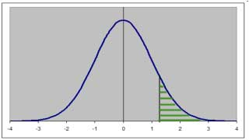
Example Using the Standard Normal Distribution (mean = 0, sd = 1)
Select a score at random from a standard normal distribution. Find the probability that z > 1.25
We need to find the shaded area:

Slide 217
Example Using the Standard Normal Distribution (mean = 0, sd = 1) in online Table 1 in Appendix C
Select a score at random from a standard normal distribution. Find the probability that z > 1.25
.1056 or 10.56 percent

Slide 218
Example Using the Standard Normal Distribution (mean = 0, sd = 1) with R
.
Question: Select a score at random from a standard normal distribution. Find the probability that z > 1.25.
Solution: To find the area under the normal curve to the left of a z-score, we would use the following cumulative distribution function command: pnorm(z, 0, 1)
Because, in this example, we want the area to the right of a z-score, we subtract from 1 the probability returned by the normal cumulative probability distribution as follows:
1- pnorm(1.25, 0, 1) OR
pnorm(1.25,0 1,lower.tail = F)
and obtain the value .10565 in the Console Window.

Slide 219
Examples Using the Standard Normal Distribution (mean = 0, sd = 1)
Select a score at random from a standard normal distribution.
Find:
The probability that z < 1.25
1-.1056 = .8944 or 89.44%
The probability that z is at least 1.25 standard deviations from the mean (in either direction)
2 x .1056 = .2112

Slide 220
Example Using the Standard Normal Distribution (mean = 0, sd = 1) with online Table 1
Find the z-score with area .025 to its right.
In contrast to the earlier example where we sought an area corresponding to a given score, in this problem we seek a score corresponding to a given area.
1.96

Slide 221
Example Using the Standard Normal Distribution (mean = 0, sd = 1) and R
Find the z-score with area .025 to its right.
Solution: We use the inverse normal probability distribution function, qnorm(area), which returns the z-score that has an area to its left equal to the value of the area given within ()’s.
Accordingly, in this example, we use the command:
qnorm(1-area)
or, more specifically,
qnorm(.975)
We obtain z = 1.96.

Slide 222
Example Using the Standard Normal Distribution (mean = 0, sd = 1) and online Table 1
Find the z-score at the 15th percentile.
The z-score with area .15 to its right is 1.04
By symmetry, the answer is -1.04

Slide 223
Example Using the Standard Normal Distribution (mean = 0, sd = 1) and r
Find the z-score at the 15th percentile.
Solution: Once again we use the command normal(area), but because the z-score at the 15th percentile is the z-score that has .15 of the area to its left, we simply substitute the value .15 for the area as follows: qnorm(.15)
As in the earlier slide, the result we obtain is -1.036.

Slide 224
Example Using the Normal Distribution
Consider a histogram of the socioeconomic status (ses) distribution in the NELS with a normal curve overlay.
The ses distribution is approximately normally distributed with mean 18.40 and standard deviation 6.92 and we may use the normal probability distribution to estimate areas under the ses curve.

Slide 225
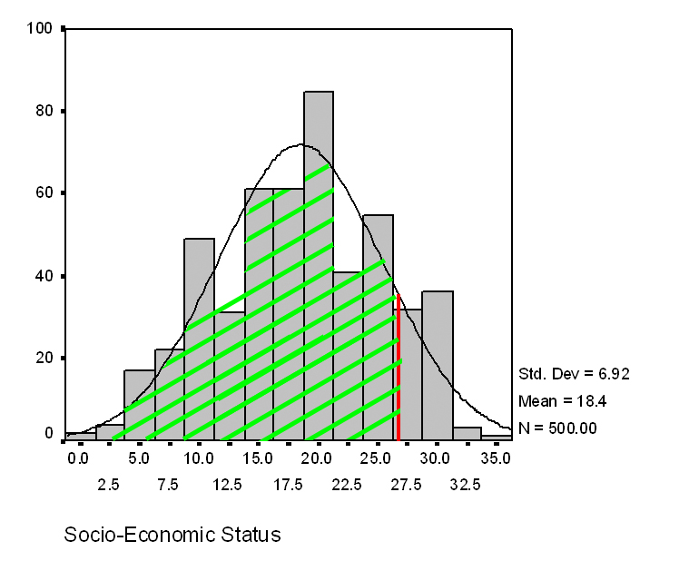
Example Using Data That Are Known or Assumed to Be Normally or Approximately Normally Distributed
For the ses distribution in the NELS data set,
approximate the proportion of students scoring < 26
By finding the shaded area under the normal curve
By using the frequency distribution table

Slide 226
Example Using Data That Are Known or Assumed to Be Normally or Approximately Normally Distributed – with online Table 1
We first convert 26 to a standard score
For the standard normal, we need to find the the probability that z < 1.10
Using the online Table 1 in Appendix C, we see that the area to the right of 1.10 is .1357
The area to the left of 1.10 is therefore 1 - .1357 = .8643

Slide 227
Example Using Data That Are Known or Assumed to Be Normally or Approximately Normally Distributed – R
Question: Estimate the proportion of students scoring < 26 in an approximately normal distribution with mean 18.40 and standard deviation 6.92.
Solution: Convert the score of 26 to a z-score and use the R command pnorm(z)
pnorm((26-18.40)/6.92,0,1)
The answer we obtain in the Console Window is: .8640

Slide 228
Actual Results Based on Frequency Distribution Table
According to the frequency distribution table, the actual percentage of students scoring <26 on ses is 85.6.

Slide 229
Comparison of Estimate Based on the Normal Distribution with the Actual Results
We see that the normal probability model estimate of 86.4 is close to the actual estimate of 85.6
In this case, the normal probability model gave a good estimate of this percentage using only the shape, mean, and standard deviation of the distribution.

Slide 230
THE ROLE OF SAMPLING IN INFERENTIAL STATISTICS CHAPTER 9

Slide 231
Overview
Samples and populations
Random samples
Sampling with and without replacement
Sampling distributions
Describing the sampling distribution of means empirically
Describing the sampling distribution of means theoretically: The Central Limit Theorem
Estimators and bias

Slide 232
Samples and populations
Whereas descriptive statistics are used to describe the data at hand, inferential statistics are used to draw inferences from results based on the data at hand to a larger population from which the data at hand have been selected.
The data at hand form what is called a sample.

Slide 233
Statistics and Parameters
When computed for populations, the values of descriptive measures are called parameters.
When computed for samples, they are called statistics.
In inferential statistics, we use statistics computed on a sample to draw conclusions about unknown parameters in the population.

Slide 234
Simple Random Samples
A simple random sample is a sample chosen from a given population in such a way as to ensure that each person or thing in the population has an equal and independent chance of being picked for the sample.

Slide 235
Sampling with and without replacement
Simple random sampling is an example of what is called sampling without replacement. That is, once an object from the population has been selected to be included in the sample, it is removed from consideration in all remaining stages of the selection process.
In sampling with replacement, every object in the population is available for selection to the sample at every stage of the selection process, regardless of whether it has already been selected.
Note that one consequence of sampling with replacement is that the same object may be picked more than once.

Slide 236
Sampling with and without replacement
The inferential statistical techniques we will present from this point on are intended only to apply to situations of sampling with replacement.
However, by assuming that all populations are at least 100 times as large as the samples being drawn from them, we will be able to use sampling without replacement and obtain quite accurate results.

Slide 237
Empirical Sampling Distributions
To obtain an empirical (or observed) sampling distribution for a given statistic based on samples of size N.
1. Repeatedly sample (with replacement) samples of size N from the parent population, and for each sample, compute and record the value of the statistic in which we are interested (e.g., the mean). In doing so, each sample of size N is replaced in the population before the next sample of size N is selected.
2. Construct a frequency distribution of the sample statistics obtained to create a sampling distribution of that statistic (e.g., mean) based on these samples of size N.

Slide 238
The Empirical Sampling Distribution of Means: A Simple Example
Let the 10 scores {0 1 3 3 5 7 7 7 8 10 } define our population.
Using Stata, we compute the mean of this population to be 5.1 and its standard deviation to be 3.25
Let our sample size be N = 2.
For each possible sample of size 2, compute the sample mean,
Notice that the means of these samples vary. This variability gives rise to a distribution of means (not every mean is the same), which we are about to construct.
The distribution of means is due to sampling that results in differences in the composition of each sample.
Hence the name sampling distribution (of means, in this case).

Slide 239
Constructing the Sampling Distribution of Means Empirically
We list an excerpt of the possible random samples of size N = 2 that could possibly be drawn from this population with their obtained sample means. Notice that the sample means vary.
Sample | Mean
{0, 0} | 0.0
{0, 1} | 0.5
{0, 3} | 1.5
{0, 3} | 1.5
{0, 5} | 2.5
{0, 7} | 3.5
{0, 7} | 3.5
{0, 8} | 4
{0, 10} | 5
{1, 0} | .5
{1, 1} | 1
{1, 3} | 2
{1, 3} | 2
{1, 5} | 3
Etc.

Slide 240
The Complete List of Sample Means from Samples of Size N=2

Slide 241
Frequency and Percent Distribution Table of Means Based on Samples of Size N = 2

Slide 242
Histogram of Sampling Distribution of Means Based on Samples of Size N =2

Slide 243
Making Use of the Empirical Sampling Distribution of Means
Use the sampling distribution of means to determine the probability that a sample mean selected at random from th population of 10 scores will be within 2 points of the actual population mean, 5.1.
Find the proportion of sample means that are between 3.1 and 7.1 inclusive.
According to the frequency distribution table, 62 of the 100 sample means fall within that range (greater than or equal to 3.1 and less than or equal to 7.1).
We conclude that the probability is .62 of obtaining a random sample that has a sample mean within 2 points of the population mean, 5.1.

Slide 244
The Empirical Sampling Distribution of Means: Increasing N from 2 to 8
Compare the histogram below, generated using the Stata bootstrap command (see the Do-file for chapter 9), depicting the empirical sampling distribution of means from the population {0, 1, 3, 3, 5, 7, 7, 7, 8, 10} based on 50,000 samples of size N = 8 randomly selected with replacement from this population, with that of samples of size N = 2.

Slide 245
The Theoretical Sampling Distribution of Means : The Central Limit Theorem
Given a population of values that is of no specified distribution with mean = µ and standard deviation = σ, the sampling distribution of means for sufficiently large samples drawn randomly with replacement from this population has a:
1. Shape that is approximately normal.
2. Mean equal to µ.
3. Standard deviation (also called its standard error) equal to

Slide 246
Making Use of the Theoretical Sampling Distribution of Means Based on the Central Limit Theorem
Example: Suppose we are given a normally distributed population of 5,000 scores with mean equal to 15 and standard deviation equal to 3.
What will the corresponding sampling distribution of means for samples of size N = 16 (with replacement) look like?
If we were to select a single sample of size N = 16 at random from this population of scores, what is the probability that the mean for this sample will fall between 13 and 17?

Slide 247
Making Use of the Theoretical Sampling Distribution of Means Based on the Central Limit Theorem
Solution to part (a):
Because the parent population is normally distributed, we know from the Central Limit Theorem that the sampling distribution of means also will be normally distributed, that its mean will be equal to 15 (the mean of the population) and that its standard deviation will be equal to .75 ( ¾).

Slide 248
Making Use of the Theoretical Sampling Distribution of Means Based on the Central Limit Theorem
Solution to part (b) via R:
(b) Because we are making a statement about the sampling distribution of means, which is known to be normally distributed with mean 15 and standard deviation .75, we use the pnorm(z, 0, 1) command with these values. To find the area between 13 and 17, we find the area below 17 and subtract from that the area below 13. We use the following R command to do so and display the result in the Console Window:
pnorm((17-15)/.75, 0, 1)- pnorm((13-15)/.75, 0, 1)
The value obtained is .992, indicating that almost all such sample means fall within the specified range.

Slide 249
Making Use of the Theoretical Sampling Distribution of Means Based on the Central Limit Theorem
Solution to part (b) via the online Table 1:
(b) Because we are making a statement about the sampling distribution of means, which is known to be normally distributed with mean 15 and standard deviation .75, we may use the online Table 1.
To find the area between 13 and 17, we convert into the z-scores -2.67 and 2.67, respectively.
Using Table 1, we see that the area to the right of 2.67 is .0038.
The area between -2.67 and 2.67 is 1 – .0038-.0038 = .99, indicating that almost all such sample means fall within the specified range.

Slide 250
Estimators and Bias
A sample statistic is said to be an unbiased estimator for a population parameter if the sampling distribution for this statistic has a mean value equal to the parameter being estimated.
In other words, the statistic is an unbiased estimator if the values of the statistic obtained from sampling are, on average, equal to the population parameter being estimated.

Slide 251
Estimators and Bias
The sample mean is an unbiased estimator of the population mean.
The sample variance is not an unbiased estimator of the population variance.
We introduce the variance estimator given by
Which is an unbiased estimator of the population variance.

Slide 252
Inferences Involving the Mean of a Single Population when sigma Is Known CHAPTER 10

Slide 253
Overview
Estimating the population mean, m, when the population standard deviation, s, is known
Interval estimation
Relating the length of a confidence interval, the level of confidence, and the sample size
Hypothesis testing
The relationship between hypothesis testing and interval estimation
Effect size
Type II error and the concept of power
Factors that increase the power of a statistical test
Increasing the level of significance
Increasing the effect size
Decreasing the standard error of the mean

Slide 254
Estimating the Population Mean, mu, When the Population Standard Deviation, sigma, is Known
The use of a single sample value such as to estimate a population value is known as point estimation, because the single value represents one point (or one number) on the real-number line.
Our empirical example of a sampling distribution from the last chapter provides an illustration of the drawbacks of point estimation.

Slide 255
Estimating the Population Mean, mu, When the Population Standard Deviation, sigma, is Known
In our example, we were given the following population of ten values:
{0, 1, 3, 3, 5, 7, 7, 7, 8, 10}. From this population, we constructed the
sampling distribution of means for all possible samples of size N = 2.
The only possible sample mean values are:
0.0 0.5 1.0 1.5 2.0 2.5 3.0 3.5 4.0
4.5 5.0 5.5 6.0 6.5 7.0 7.5 8.0 8.5
9.0 10.0
But the real mean of this population is µ = 5.1, and none of the sample
means listed is exactly equal to 5.1. In other words, in this example it
would have been impossible, using point estimation with samples of size
2, to obtain a perfectly accurate estimate of µ.

Slide 256
Interval Estimation
However, suppose that, around each sample mean
on the list, we had constructed an interval of length
6 centered at the sample mean. Considering the
intervals, rather than just the sample points
themselves, we find on the next slide that 79 of the
100 intervals (or 79 percent) actually contain the
population mean 5.1.

Slide 257
Interval Estimation

Slide 258
Interval Estimation
For this example we arbitrarily chose an interval length of 6.
If, for example, we wanted to have more than 79 percent of the confidence intervals contain μ, we would need to make the intervals longer.
It is always possible to choose an interval length for which some nonzero percent of intervals contains (“captures”) the population mean µ.
Furthermore, in most cases it is possible to determine just what length interval should be used to give exactly any desired percent of intervals that “work” (captures µ).

Slide 259
Interval Estimation
The interval
is called a confidence interval (CI) for µ, and its confidence level is defined as the proportion of such intervals that can be expected to capture µ.
Given that in this case we are adding and subtracting 1.96 standard errors to the observed sample mean, we can expect that .95, or 95 percent, of the intervals will capture µ in this case.

Slide 260
Interval Estimation
The three most common confidence levels are 90, 95, and 99 percent.
A general equation for the CI for estimating µ is
where z_{c} = 1.645 for a 90 percent CI.
1.960 for a 95 percent CI.
2.576 for a 99 percent CI.

Slide 261
Interval Estimation
This formula for the CI applies only when the sampling distribution of the mean is normally or approximately normally distributed. That is, when the population is known to be normally distributed or the sample size is larger than 30.
Also this formula relies on the assumption that the value of σ is known and does not need to be estimated. In practice, this assumption is not tenable and one typically needs to estimate σ. We make this assumption here for heuristic reasons and present a more realistic approach in the next chapter.

Slide 262
Interval Estimation: An Example
Suppose we want to estimate the battery life for a certain flashlight. Assume that the population standard deviation of the battery life is 4 hours (σ = 4).
We randomly select 100 flashlights and use them until their batteries run out; we record the time it takes for that to happen.
If the observed time it takes the batteries in the sample to run out is, on average, 150 hours ( = 150), estimate the average battery life of this type of flashlight using a 95 percent confidence interval for µ.

Slide 263
Interval Estimation: An Example
N = 100 is large enough to permit us to use the CLT
We know that s = 4, N = 100, z_{c} = 1.96 and = 150.
Accordingly,
=
Therefore, our 95 percent CI for µ is between 149.216 and 150.784 hours.

Slide 264
Interval Estimation: Interpreting CI’s Incorrectly
The CI (149.216, 150.784) does not have a 95 percent chance of containing the true average lifetime of these new flashlights, µ.
We are not 95 percent confident or certain that the true average lifetime of these new flashlights is between 149.216 and 150.784 hours.
It is not necessarily true that 95 percent of all such new flashlights last between 149.216 and 150.784 hours.

Slide 265
Interval Estimation: Interpreting CI’s Incorrectly
It is not necessarily true that 95 percent of the particularly new flashlights in our sample of 100 flashlights last between 149.216 and 150.784 hours.
It is not necessarily true that there is a 95 percent probability that each of the flashlights in our sample of 100 lasts between 149.216 and 150.784 hours.

Slide 266
Interval Estimation: Interpreting CI’s Correctly
Said simply, the level of confidence (in this case 95 percent) is a statement about the likely true population mean lifetime of such flashlights, not about the lifetime of individual flashlights themselves.
Once we have selected our sample, calculated, and found the corresponding CI, µ, the true average lifetime of these new flashlights, either is in this interval or it is not, and the probability that the interval contains that true mean is either 1 (if it contains µ) or 0 (if it does not contain µ), not .95.

Slide 267
Interval Estimation: Interpreting CI’s Correctly
Likening this process to tossing a fair coin. Before the coin is tossed, we may say that the probability of getting a Head is .5, but once the coin is tossed, even if we do not see the result, the probability of getting a Head is either 1 (if it is a Head) or 0 (if it is not a Head, but rather a Tail).
What we can say is that if we repeated the process of randomly sampling 100 flashlights from the population of flashlights so that for each sample of 100 flashlights we computed the average lifetime of the sample of flashlights, and then computed for each sample a 95% CI for µ, 95 percent of all such intervals so computed would contain µ.

Slide 268
Interval Estimation: A Correct Interpretation
The particular interval that we have constructed (149.216, 150.784) may be either one of the 95 percent that do contain the true average lifetime of these new flashlights or one of the 5 percent that do not.
However, because such a large proportion of all the intervals would contain µ, we cannot help but believe that this particular interval is one of the 95 that does.

Slide 269
Relating the Length of a Confidence Interval, the Level of Confidence, and the Sample Size
If we increase the confidence level, say from 90 to 95 percent, and keep the sample size the same, the resulting CI becomes longer. That is, by increasing our confidence in capturing µ, with all else constant, our estimate becomes less precise.
If we increase the sample size N and keep the confidence level the same, the resulting CI is shorter. That is, by increasing N, with all else constant, our estimate becomes more precise.

Slide 270
Using CI’s to Test Hypotheses: An Example
Using the information from the flashlight example,
suppose we want to test whether the average
flashlight life is 151 hours.
In contrast to interval estimation, where we do
not need to begin with an a priori belief about the
population parameter of interest (e.g., µ), in
hypothesis testing we do.

Slide 271
Hypothesis Testing: Null and Alternative Hypotheses
The hypothesis represents our belief that the flashlights last, on average, 151 hours. Because it represents our current thinking, that which is believed to be true until shown to be implausible (or nullified), it is called the null hypothesis, denoted in this book by the symbol H₀. The null hypothesis is sometimes called the hypothesis of no effect.
By contrast, the alternative hypothesis is the statement we would switch to if, through our experiment or study, H₀ were shown to be implausible and H₁ plausible; that is, if our observed results were inconsistent with H₀ relative to H₁.
In this example, the null hypothesis is H₀: µ = 151, the mean life of the flashlight is 151 hours.
And, the alternative hypothesis is H₁: µ ≠ 151, the mean life of the flashlight is different from 151 hours

Slide 272
Using CI’s to Test Non-Directional Hypothesis: Why it is possible to do so
The values in the (1- α)% CI are those that would be considered plausible as null hypothesis values at level of significance α.
The values not in the (1- α)% CI are those that would not be considered plausible as null hypothesis values at level of significance α.
Accordingly, we may reject or not reject a given H₀ in favor of (a non-directional) H₁ at significant level αdepending upon whether the CI does not include the null hypothesis value or it does.

Slide 273
Hypothesis Testing Using CI’s: Example Cont’d
Because the resulting 95% CI (149.216, 150.784) does not contain the value 151, we conclude that the null hypothesis (H₀: µ = 151) is not plausible and we reject it in favor of the alternative hypothesis that μ is different from 151 (H₁: µ ≠ 151).
Because all of the values in the CI are lower than 151, we may conclude further that μ is lower than 151. On average, the flashlights last a statistically significantly fewer number of hours than 151.

Slide 274
Testing Hypotheses Directly by Computing p-Values: The Flashlight Example Cont’d
Given the same flashlight example where N = 100, σ = 4, and = 150 hours. If we have an a priori belief about the mean value of the population, the null and alternative hypotheses are as follows:
The null hypothesis is H₀: µ = 151.
The alternative hypothesis is H₁: µ ≠ 151.

Slide 275
Testing Hypotheses Directly by Computing p-Values: The Flashlight Example Cont’d
We assume the H₀ to be true (that µ = 151), and use the CLT to identify the relevant sampling distribution of means that will provide us with the information to determine the probability of occurrence of all possible sample mean outcomes given H₀ to be true .
Those sample mean outcomes which have reasonably high probabilities of occurrence are deemed likely to occur by chance (they are consistent with the null hypothesis) and those which do not have reasonably high probabilities of occurrence are deemed unlikely to occur by chance (they are not consistent with the null hypothesis).

Slide 276
Testing Hypotheses Directly by Computing p-Values: The Flashlight Example Cont’d
In this example, we know from the CLT that the sampling distribution of means is approximately normally distributed, with mean = 151 and standard deviation σ/√N = 4/ √ 100 = 0.4.
The sampling distribution of means is given in the figure in the next slide.
The shaded area under the curve represents the probability of obtaining a sample mean by chance that is as or more extreme than the actual sample mean observed in either direction, given that the null hypothesis is true.
This probability is called the p-value of the test and is an index of how
consistent the observed sample mean is with the hypothesized population mean.
Said differently, the p-value is an indication of the strength of evidence to reject or not to reject the null hypothesis in favor of the alternative.

Slide 277
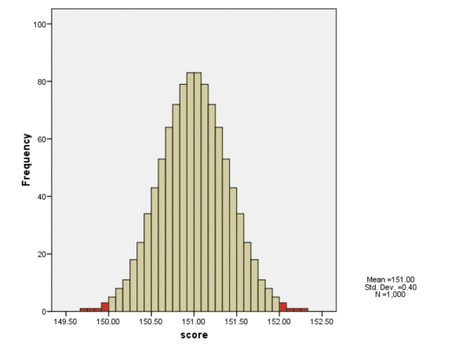
Testing Hypotheses Directly by Computing p-Values: The Flashlight Example Cont’d
Because the observed sample mean of 150 is one point different from the hypothesized mean of 151, the values marking off the red areas are 150 on the left and 152 on the right.

Slide 278
Testing Hypotheses Directly by Computing p-Values: The Flashlight Example Cont’d
The p-value, in this case, is the probability of obtaining a sample mean of 150 or less, or 152 or more when the population mean is 151.
Using techniques of Chapter 8, we find that this probability is .0124.
Because this probability is so small given that the null hypothesis is true, it is very unlikely for us to have observed this result or one more extreme by chance.
Accordingly, we conclude that the null hypothesis is likely not true (that it is implausible) and we reject it in favor of the alternative hypothesis that μ is different from 151.

Slide 279
Testing Hypotheses Directly: The Significance Level
Although we have categorized .0124 as a probability associated with an unlikely outcome, it is up to the researcher to decide, when setting up the hypothesis test, the probability level that distinguishes between likely and unlikely outcomes.
The probability level that the researcher chooses to distinguish an unlikely outcome from a likely one is called the significance level of the test and is denoted by α.
Whereas p-values depend on the particular result observed, significance levels do not. A significance level may be considered a standard or criterion from which to judge the strength of evidence against the null hypothesis.

Slide 280
Testing Hypotheses Directly: The Significance Level
Commonly used significance levels are α = .10, α = .05, and α = .01.
When a significance level is set at .01, for example, stronger evidence is required to reject the null hypothesis than when either .05 or .10 is used.
Accordingly, α = .01 is considered to be a more stringent criterion for significance than either α = .05 or .10.

Slide 281
Testing Hypotheses Directly by Computing p-Values: The Flashlight Example Cont’d
In this example, we will use the most commonly applied significance level, α = .05.
We see that p = .0124 < α = .05, so we reject the null as implausible in favor of the alternative and we say that the result is statistically significant.
We conclude that the flashlights do not last 151 hours, on average, but rather, last an amount different from 151 hours.
It is useful to know whether the flashlights last statistically significantly less or more than 151 hours, on average.
Because the observed sample mean is 150, we conclude that μ is lower than 151 hours.

Slide 282
Testing Hypotheses Directly by Computing p-Values: The Flashlight Example Expressed More Formally as a z-test
Because this test is based on a variation of the z-score formula, in general a hypothesis test of the parameter µ when σ is known is called a z-test.
That is,
From Table 1, the area under the normal curve to the left of -2.5 and to the right of 2.5 equals .0124, the p-value for this test.

Slide 283
Hypothesis Testing: A Second Example -- on Pre-Conditioning
Is there an effect of pre-conditioning on the time it takes to solve an anagram task?
In the past, with no pre-conditioning, the average time it took students to solve an anagram task was 275 seconds, with standard deviation equal to 20 seconds.
We assume that pre-conditioning has no effect on the standard deviation of the time required to solve an anagram task, i.e. that the standard deviation of the population of students given the pre-conditioning is also 20 seconds (i.e., σ = 20).
We select a random sample of students of size N = 100 and give them pre-conditioning before asking them to solve an anagram task.

Slide 284
Hypothesis Testing: A Second Example on Pre-Conditioning
Because preconditioning may have the effect of increasing or decreasing the time it takes to solve the set of anagram problems, we are testing whether the mean time to complete the set of anagrams is different (either more or less) with pre-conditioning than without.
Until evidence is provided to the contrary, we assume that the mean time to solve this set of problems is 275 seconds, the same as without preconditioning. Therefore, our null and alternative hypotheses are
H₀: µ = 275
H₁: µ ≠ 275
where µ represents the mean time (in seconds) for the population to solve the anagram task with preconditioning.

Slide 285
Hypothesis Testing: The Second Example Cont’d
Because the null hypothesis specifies a particular value for µ (i.e., 275) and the sample size is larger than 30, we can use the CLT to describe the sampling distribution of means.
If we assume H₀ is true, the sampling distribution of means for samples of size N = 100 from this population is approximately normal, with mean, µ = 280 and standard error σ/√N = 20/√100 = 20/10 = 2.
Assume that our observed sample mean time to complete the anagram task is 276 seconds.

Slide 286
Testing an Hypothesis Re: Preconditioning Using Confidence Intervals
Because our observed sample mean is 276, the 95% confidence interval is obtained as
276 ± 1.96*2 = (272.08, 279.92)
Because the null hypothesis value of µ=275 is contained within the confidence interval, it represents a plausible null hypothesis value and we do not reject the null hypothesis in favor of the alternative.
We conclude that the result is not statistically significant.
That is, that the amount of time required to complete the anagram puzzle is not statistically significantly different from 275 seconds.

Slide 287
Testing the Hypothesis Re: Preconditioning Using the z-test
Because = 276 seconds, the observed mean is 1 second different from the hypothesized population mean, µ = 275.
A result that is more extreme than 1 second away from 275 is defined as: 276 or more seconds or 274 or fewer seconds.
According to the CLT, the sampling distribution of means is approx. normally distributed with mean 275 and standard error σ/√N = 20/√100 = 2.
Therefore,
According to Table 1, and the techniques of Chapter 8, we find the p-value for the two-tailed area to the left of 274
(z=-0.5)and to the right of 276 (z=0.5) to be .6170.

Slide 288
Testing the Hypothesis Re: Preconditioning Using the z-test
Because the significance level for this test has been set at α = .05, and because p is greater than α in this case, we fail to reject the null hypothesis in favor of the alternative and conclude that the result is not statistically significant.
That is, the amount of time required to complete the anagram puzzle is not statistically significantly different from 275 seconds.

Slide 289
Hypothesis Testing: A Third Example
Test the hypothesis, at the α = .05 significance level, that the SAT Math score for college students in California is higher, on average, than 500, which is the mean SAT Math score for the rest of the country.
We assume that the standard deviation (σ) for all students in the rest of the country is 100, and that the students in California do not have a standard deviation that is different from that.
We randomly select a sample of 1,600 students in California.
(A) What is the conclusion if the mean for the sample of 1,600 students is 505?
(B) What is the conclusion if the mean for the sample of 1,600 students is 502?
(C) What is the conclusion if the mean for the sample of 1,600 students is 499?

Slide 290
Hypothesis Testing: Third Example
We state the null and alternative hypotheses:
H₀: µ = 500.
H₁: µ > 500.
Because N > 30, we know from the CLT that the sampling distribution of means is approximately normally distributed with mean = 500 and standard deviation
σ/√N = 100/√1600 = 100/40 = 2.5.
From this information we can find the z-test values and corresponding p-values associated with the three specified sample means: 505, 502, and 499.
A confidence interval is not appropriate for assessing these directional alternative hypothesis.

Slide 291
Hypothesis Testing: Third Example – Part (A)
If the sample mean is 505,
Using the techniques of Chapter 8 we find that p = .023.
Because p < .05, we conclude that the SAT Math score for college students in California is statistically significantly higher, on average, than it is for the rest of the country.

Slide 292
Effect Size: Cohen’s d
Although the hypothesis test tells us the likelihood of the observed sample result given that the null hypothesis is true, it tells us nothing about the degree to which the null hypothesis is false – that is, the degree to which the observed result departs from the value of the null hypothesis.
To be useful in helping us discover truths about phenomena of interest, the null hypothesis test should be supplemented by other forms of analysis that are independent of sample size to determine the nature and magnitude of the obtained result.
Knowing the magnitude of the obtained result, called the effect size, allows us to determine whether our statistically significant result is also practically significant.

Slide 293
EFFECT SIZE: COHEN’S D
An algebraic expression for Cohen’s d is given by
The sign indicates the direction of the effect, whereas the absolute value indicates the magnitude of the effect.
Cohen (1988) offers the following guidelines for evaluating effect sizes in terms of d:
d = .20 represents a “small” effect size
d = .50 represents a “medium” effect size
d = .80 represents a “large” effect size.

Slide 294
Calculating the Effect Size for the Third Example – Part (A)
Given that we rejected H₀ in favor of H₁, we may now ask the question of whether the statistically significant result is practically significant.
For this example, the Effect Size is d = (505-500)/100 = .05
Accordingly, we may say that the SAT Math score for college students in California is only .05 standard deviations higher, on average, than it is for the rest of the country, which represents a very small effect.

Slide 295
Calculating the Effect Size for the Flashlight Example
Recall that for the flashlight example: H₀: µ = 151 H₁: µ ≠ 151
And that N = 100, σ = 4, and = 150 hours
Recall also that based on the CI results, we rejected the null hypothesis (H₀: µ = 151) in favor of the alternative hypothesis that μ is different from 151 (H₁: µ ≠ 151).
Given we have a statistically significant result, we may ask whether the result is practically significant and answer that question by calculating the effect size of the result.
Because the observed mean is only .25 standard deviations away from the hypothesized mean, we say that the effect is relatively small

Slide 296
Hypothesis Testing: The Third Example – Part (B)
If the sample mean is 502,
Using the online Table 1 and the techniques of Chapter 8 we find that p = . 21.
Because p > .05, we conclude that the SAT Math score for college students in California is not statistically significantly higher, on average, than it is for the rest of the country.
Because the result is not statistically significant, it is not meaningful to ask whether the result is practically significant and so we do not compute an effect size.

Slide 297
Hypothesis Testing: The Third Example – Part (C)
If the sample mean is 499, the result is in the opposite direction from the alternative hypothesis that the mean is greater than 500.
Accordingly, we could never reject the null hypothesis in favor of the alternative hypothesis and there is no need to carry out the hypothesis test in this case.

Slide 298
One- and Two-Tailed Tests
Directional alternative hypotheses of the population mean are of the form
H₁: µ < c or H₁: µ > c
and always give rise to one-tailed tests.
Non-directional alternative hypotheses of the population mean are of the form
H₁: µ ≠ c
and always give rise to two-tailed tests.

Slide 299
p-values & One- and Two-Tailed Tests
If the alternative hypothesis is directional, and we are using a one-tailed test, the p-value is obtained from that direction of the tail that allows us to reject the null in favor of the alternative.
If the alternative hypothesis is of the form H₁: µ > c, then the appropriate tail is on the right. If the alternative hypothesis is of the form H₁: µ < c, then the appropriate tail is on the left.
In the case of a non-directional alternative hypothesis, the p-value is obtained from both tails because an extreme value in either tail would logically allow us to reject the null hypothesis in favor of the alternative.
The use of confidence intervals to conduct a hypothesis test are appropriate only when alternative hypotheses are non-directional.

Slide 300
Type II Error and the Concept of Power
When a decision is made based on a hypothesis test, four different situations can result:
H₀ is true but we reject it.
H₀ is true and we retain it.
H₀ is false and we reject it.
H₀ is false but we retain it.
Notice that situations 1 and 4 represent incorrect decisions, and situations 2 and 3 represent correct decisions.
These outcomes and their probabilities of occurrence are displayed in a table on the following slide.

Slide 301
Type II Error and the Concept of Power

Slide 302
Type II Error and the Concept of Power
The incorrect decision of situation 1 is what we call a Type I error. The risk of committing a Type I error equals the α level of the test, the level at which we would regard an observation to be unlikely to occur by chance.
The incorrect decision of situation 4 is what is called a Type II error. The risk of committing a Type II error equals the β (beta) level of the test.
When we conduct a hypothesis test, we want to minimize the probability of making either a Type I or a Type II error. Unfortunately, these two types of errors are, in a sense, inversely related. The typical research situation of concern in this book is one in which H₀ represents some established procedure and H₁ represents a deviation from it. A decision to reject H₀ in favor of H₁ might therefore result in further expenditures, further testing, and possibly even in some basic changes in the established procedure.

Slide 303
Type II Error and the Concept of Power
Accordingly, if we are to reject H₀, we certainly do not want to reject it falsely (commit a Type I error), so we generally try to set our test so that the significance level α is the one that is kept small at the possible expense of having a relatively large β.
The correct decision of situation 2 arises when the test does not detect a difference from the null hypothesis when the null hypothesis is in fact true. The probability of this correct decision is represented by the complement of α, 1 – α.
Finally, the correct decision of situation 3 arises when the test does detect a difference from the null hypothesis when the null hypothesis is in fact false (when the alternative hypothesis is true). The probability of this correct decision is represented by the complement of β, 1 – β, and because of its importance within the null hypothesis test procedure this probability is called the power of the test.

Slide 304
Factors that Affect the Power of a Test
Effect Size, d
Level of Significance, α
Sample Size, N
Whether the test is one- or two-tailed

Slide 305
Inferences Involving The Mean When σ Is Not Known: One- And Two-Sample Designs
Chapter 11

Slide 306
Overview
The t-distribution and degrees of freedom
One sample t-test
Independent samples t-test
Paired samples t-test

Slide 307
The t-Distribution
In general, the t-distribution is a family of curves. Like the standard normal curve, each is symmetric and unimodal, but each is flatter at the middle and taller in the tails. The exact shape varies as a function of the sample size, N, known as the degrees of freedom (df) of the t-distribution.

Slide 308
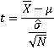
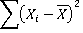
Degrees of Freedom (df)
Definition: The df of a statistic is the number of independent pieces of data used in computing that statistic.
The one-sample t-statistic is:
Note that the t-statistic relies on which in turn relies on
Let .

Slide 309
Degrees of Freedom, Cont’d.
If we let N=5, then recall that d₁+d₂+d₃+d₄+d₅=0.
=> We have the freedom to select any values we choose for d₁ d₂ d₃ and d₄ BUT, not for the last value, d₅
Let’s verify by example. Let’s have members of the class choose 4 values for the first four d’s. Do we have the freedom to choose the fifth d value? Or, is the last d value fixed given that the five d’s must sum to zero??
We say that in this case, df = 4. In general, for this type of problem, exemplified by the t-statistic, df = N-1.

Slide 310
One-Sample t-test
Design: One sample of scores (e.g., IQ) randomly selected from a normally distributed population of such (IQ) scores.
Question of Interest: Is the mean of the population from which the sample has been randomly selected different from (or greater than or less than) some particular value, c?
Example: Is the mean IQ of freshmen at this institution different from 100?
Select a randomly selected sample of say, N=100 freshmen; record their IQ’s, and compute the and

Slide 311
One-Sample t-test: Example 1
Example 1: Is the mean IQ of freshmen at this institution different from 100?
Select a randomly selected sample of say, N=100 freshmen; record their IQ’s, and compute and .
Assume the population of IQ scores for freshmen is normally distributed, an underlying assumption of this t-test.
Type of test: Two-tailed, one sample t-test.
Notes:
311

Slide 312
Example 1: Is the mean IQ of freshmen at this institution different from 100?
Using a Confidence Interval Approach:
Assume that = 105 and that = 15.
= = 1.5; t_{c} = 1.985 (α=.05,two-tailed; df=99)
Upper Limit = + t_{c} = 105+1.985(1.5)=107.98
Lower Limit = - t_{c} = 105-1.985(1.5)=102.02
H₀: μ = 1200
H₁: μ ≠ 1200
Notes:
312

Slide 313
Example 1: Conclusions based on CI
The 95% confidence interval for μ is (102.02, 105.98)
Because 100 is not contained in the interval, the result is statistically significantly different from 100.
The values in the CI are all higher than 100.
On average, freshmen at this institution have IQ scores that are statistically significantly higher than 100.
We estimate the mean freshman IQ for this institution to fall between 102.02 and 105.98.
Notes:
313

Slide 314
Example 1: Is the mean IQ of freshmen at this institution different from 100?
Using a Hypothesis Testing Approach:
(1) State the null and alternative hypotheses.
(2) H₀: μ=100; H₁: μǂ100
(3) =105; = 1.5
(4) t-statistic
= (105-100)/1.5=3.33
(5) p = .002
Notes:
314

Slide 315
One Sample t-Test: General Procedure
0
Is N > 30?
Is N>30?
No: Need to check
Normality
Yes: Test robust to normality violations
Is skewness ratio
less than 2?
Yes: Normality
Tenable
No: Normality
not Tenable
Is the test 1-tailed (i.e., H₁: μ < c or H₁: μ > c )
or 2-tailed (i.e., H₁: μ ≠ c)?
Stop.
Test result may not be valid.
Use a non-linear transformation
or a non-parametric test.
1-tailed
2-tailed
Does sample mean differ in the direction
Indicated for μ in the alternative hypothesis?
For p-value, is p < .05?
For confidence interval,
is the null hypothesized value
For μ outside of the CI?
Yes
No
Result is not stat. sig.
Report result.
Yes
No
Yes
No
Result is stat. sig. Look at
sample mean to determine the
direction of the difference.
Report result, calculate
and report effect size.
Result is stat. sig.
Report result, calculate
and report effect size.
Result is not
stat. sig.
Report result.
Result is not stat. sig.
Report result.
Notes:
315

Slide 316
Example 1: Conclusions based on Hypothesis Test
Given the observed t-value is 3.33, the probability of observing such an extreme value or one more extreme is p = .002 (from Table 2, with df = 99).
That is, the probability of observing a sample mean of 105 from a population with true mean 100 is very, very small.
The observed result is not likely to have occurred by chance.
We reject the null hypothesis in favor of the alternative -- the true population appears to be different from 100.
We say the result is statistically significant.
Notes:
316

Slide 317
The Normality Assumption: How To Evaluate Whether It’s Been Met
The normality assumption is met when the scores are normally distributed in the population.
We evaluate the normality assumption or indicate why the test is robust to violations of the normality assumption:
If N ≥ 30, then the test is probably robust to violations of the normality assumption and we may proceed with the t-test without testing normality.
If N < 30, we test the normality assumption.
If the skewness ratio is less than two, the normality assumption is tenable and we may proceed with the t-test.
If the skewness ratio is greater than two, the normality assumption is not tenable and we do not proceed with the t-test.

Slide 318
Example 2: Do current smokers (at time 1) have a different mean body mass index (at time 1) from the published mean BMI for all adults?
The published BMI mean for all adults is μ = 28.0
Because we have no reason to assume that the BMI sd for all adults is the same as that for current smokers, we use the data from our sample of current smokers to estimate the BMI sd for the population of current smokers, .
Accordingly, a t-distribution, rather than a z-distribution, represents the appropriate sampling distribution of means in this case.
For heuristic reasons, we estimate the population mean BMI for diabetics using a 95% confidence interval and also conduct a one-sample t-test at α = .05.
Notes:
318

Slide 319
Example 2: Constructing the 95% Confidence Interval Using R and the Framingham Data Set
Because we only are interested in the subsample of current smokers at time 1, we add [CURSMOKE1 == “Yes”] inside the R command and construct the 95 percent CI for the μ of BMI at time 1 when σ is not knowns as follows:
t.test(Framingham$BMI1[Framingham$CURSMOKE1=="Yes"])$conf.int
Notes:
319

Slide 320
Example 2 Cont’d: R Output
The 95% confidence interval is shown below on the right hand side. In particular, the 95% confidence interval for μ is (24.61, 25.71).
Notes:
320

Slide 321
Example 2: Conclusions Based on the CI
The 95% confidence interval for μ is (24.61, 25.71)
Because 28 is not contained in the interval, the result is statistically significantly different from 28.
The values in the CI are all lower than 28.
On average, current smokers have BMI scores that are statistically significantly lower than 28.
We estimate the mean BMI value for current smokers at time 1 to fall between 24.61 and 25.71.
Notes:
321

Slide 322
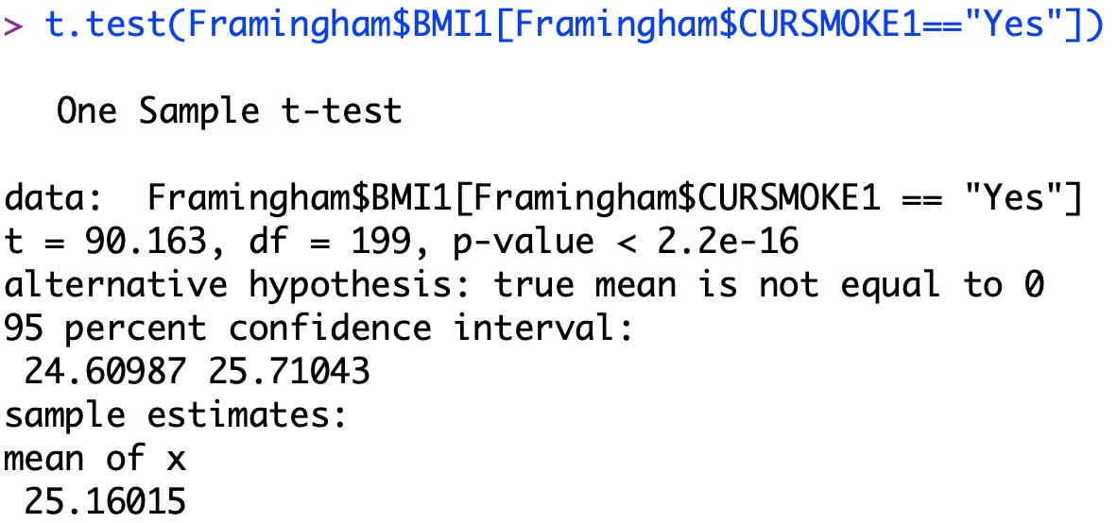
Example 2: Conducting the Corresponding Hypothesis Test
The hypotheses for this test are: H₀: μ=28; H₁: μǂ28
We follow the same steps as before, but now rely on the p-value. That p-value is p < 2.2e-16
Notes:
322

Slide 323
Example 2: Conclusions based on the Hypothesis Test
Given the observed t-value is -10.18, the probability of observing such an extreme value or one more extreme is numerically equal to 0.
That is, the probability of observing a sample mean of 25.16 from a population with true mean 28 is very, very small.
The observed result is not likely to have occurred by chance.
We reject the null hypothesis in favor of the alternative -- the true population appears to be different from 28.
We say the result is statistically significant.
Notes:
323

Slide 324
Example 2: Calculating and Interpreting the Effect Size
This effect size value indicates that the sample mean of 25.16 falls approximately 3/4sd below the hypothesized population mean of 28. This degree of difference represents a large effect size given Cohen’s guidelines.
Notes:
324

Slide 325
Two-Sample t-tests
Consider the following questions:
Example 1: Is there a difference in BMI at time 1 between males and females who are current smokers at time 1?
Example 2: Is there a change in BMI from time 1 to time 3 for females who are current smokers at both times 1 and 3?
Notes:
325

Slide 326
Independent and Paired Samples t-Tests
Independent Samples: Compares two independent groups where the scores cannot be matched on a pairwise basis, as in Example 1 in the previous slide. Involves a scale and a dichotomous variable.
Paired Samples: Compares two variables where the scores can be matched on a pairwise basis (e.g., variables measured on the same person before and after some event or passage of time, or on a set of father/son pairs, etc.) as in Example 2 in the previous slide. Involves two scale variables.
Notes:
326

Slide 327
Independent Samples t-Test: Underlying Assumptions
Normality – The parent populations are normally distributed for both groups. The independent samples t-test is robust to violations of the normality assumption when the sample sizes of both groups are greater than 30.
Homogeneity (or equality) of variance – The variance in the parent populations are the same for the two groups. The independent samples t-test is robust to violations of the homogeneity of variance assumption when the sample sizes of both groups are the same.
Notes:
327

Slide 328
Homogeneity of Variances
Tested via Levene’s Test.
The null hypothesis is that the variances are equal
The alternative hypothesis is that the variances are not equal
If p (for Levene’s test) > .05 use the equal variances line (independent samples t-test)
If p (for Levene’s test) < .05, use the unequal variances line (adjusted independent samples t-test)
Notes:
328

Slide 329
Independent Samples t-test:
0
Are N₁ and N₂
> 30?
Yes: Test robust
To normality
violations
No: Need to check normality
Yes: Normality
tenable
Is N₁ =N₂?
Is
for both groups?
Is skewness ratio
less than 2?
No
Need to check homogeneity of variances.
From Levene’s test, if p < α, use unequal
variances line for t-test . Otherwise,
use equal variances line.
Yes:
The equal and unequal variance output are the same
No: Normality
not tenable
Is the test 1-tailed
(i.e. H₁: μ₁ > μ₂ or H₁: μ₁ < μ₂ )
or 2-tailed
(i.e. H₁: μ₁ ≠ μ₂)?
Test result may not be valid.
Perform a non-linear transformation
Or use a non-parametric test.
2-Tailed
1-Tailed
Do sample means differ in the
direction specified in the alternative
hypothesis?
For p-values is p < .05?
For confidence intervals, is 0 outside of the range of values?
Yes
No
Is (Two tailed sig./2) < .05?
Result is not stat. sig.
Report result.
Yes
No
Yes
Result is stat.sig. Look at sample
mean to determine the direction
of the difference.
Report result. Calculate
and report effect size.
Result is not
stat.sig.
Report result.
No
Result is stat. sig.
Report results. Calculate
and report effect size.
Result is not stat.sig.
Report results.
Notes:
329

Slide 330
Independent Samples t-test: Example 1
Example 1: Is there a difference in BMI at time 1 between males and females who are current smokers at time 1?
We first test for the Homogeneity Assumption using the Levene’s test and then the non-directional t-test itself using the following two respective R commands: levenes.test(Framingham$BMI1[Framingham$CURSMOKE1 == "Yes"], Framingham$SEX[Framingham$CURSMOKE1 == "Yes"]) t.test(Framingham$BMI1[Framingham$CURSMOKE1 == "Yes"]~Framingham$SEX[Framingham$CURSMOKE1 == "Yes"], var.equal = T)
Because the male and female sample sizes exceed 30 (N=100 for each sample), we can assume, based on the Central Limit Theorem, that the normality assumption is tenable in this case.
Notes:
330

Slide 331
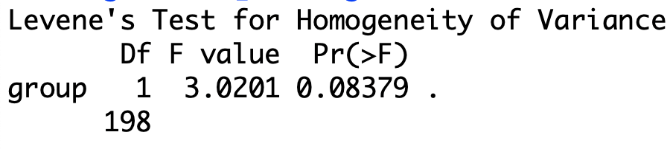
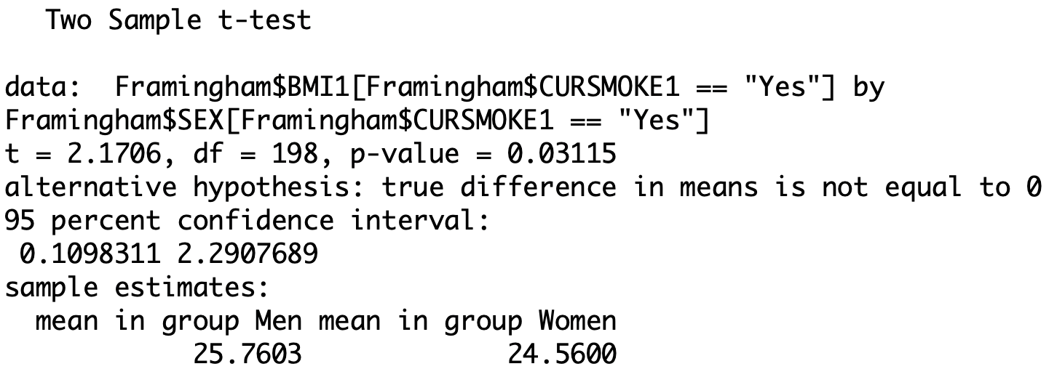
Output: The Levene’s Test & Independent Samples t-Test
Levene’s Test:
Given that p>0.05, the
assumption of
homogeneity of variance
appears tenable.
t-Test: Given that
the test has a p-value
< .05, we reject H₀ the
in favor of H₁ &
conclude that men and women who smoke at time 1 have
different BMI values on average.
Notes:
331

Slide 332
Effect Size for Independent Samples t-Test
Formula:
If N₁= N₂, the above formula may be simplified to:
Notes:
332

Slide 333
Effect Size Calculation for Example 1
The average BMI at time 1 for males is .31 standard deviations higher than for females, which is a reasonably moderate effect, suggesting that the difference is both statistically and substantively significant.
Notes:
333

Slide 334
0
Paired Samples t-test:
Is N₁ = N₂ > 30?
Yes: Test is robust
to violations of normality
No: Need to check normality
Yes: Normality
tenable
Is
for both groups?
Because N₁ = N₂ , the test is
robust to violations of the
homogeneity of variances
assumption.
Is skewness ratio
less than 2?
No
Is the test 1-tailed
(i.e. H₁: μ₁ > μ₂ or H₁: μ₁ < μ₂ )
or 2-tailed
(i.e. H₁: μ₁ ≠ μ₂)?
Test result may not
be valid. Perform a
non-linear transformation
or use a non-parametric
test.
1-tailed
2-tailed
Do sample means differ in the
direction of the alternative
hypothesis?
For p-values is p < .05?
For confidence intervals
Is 0 outside of the range of values?
Yes
No
Is (p/2) < .05?
Yes
No
Result is not stat. sig.
Report result.
Result is stat. sig. Look at
sample mean to determine
the direction of the difference.
Report results. Calculate
and report effect size.
Result is not
stat.sig.
Report result.
Yes
No
Result is stat. sig.
Report results.
Calculate and report
effect size.
Result is not stat.sig.
Report result.
Notes:
334

Slide 335
Paired Samples t-Test: Example 2
Example 2: Is there a change in BMI from time 1 to time 3 for people who are current smokers at both times 1 and 3?
We use the following R command:
t.test(Framingham$BMI1[Framingham$CURSMOKE1 == "Yes" & Framingham$CURSMOKE3 == "Yes"], Framingham$BMI3[Framingham$CURSMOKE1 == "Yes" & Framingham$CURSMOKE3 == "Yes"], paired = T)
Because this sample size exceeds 30 (N=160), we can assume, based on the Central Limit Theorem, that the test is robust to violations of the normality assumption.
Notes:
335

Slide 336
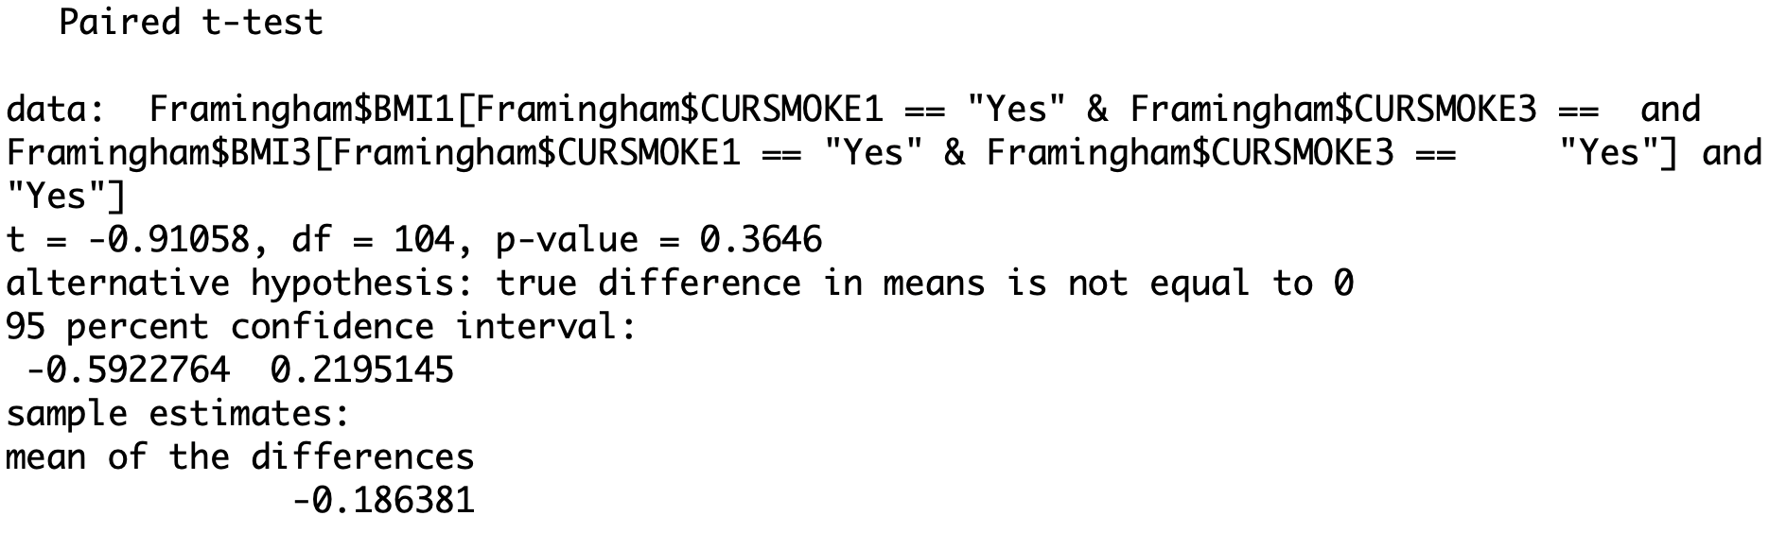
Output: Example 2
Given that the test has a p-value > .05 (p=0.3646), we do not reject H₀ the in favor of H₁ and conclude that, on average, the BMI of people who smoke at both times 1 and 3 does not change from time 1 to time 3. Because the result is non-significant, we do not compute an effect size.
Notes:
336

Slide 337
Conducting Power Analyses for t-Tests of Means: Two-Tailed One Sample t-Test
Example: Find the sample size necessary to achieve a power of 0.80 to detect a minimum mean difference of 0.20 standard deviations, from the null hypothesis value of 100 with α set to 0.05.
We first load the library named pwr
library(pwr)
We then use the following command:
pwr.t.test(d = 0.2, sig.level = 0.05, power = 0.8, type = "one.sample", alternative = "two.sided")
Notes:
337

Slide 338
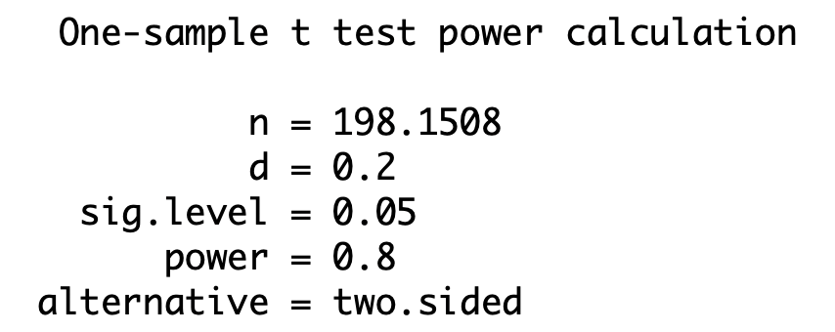
Conducting Power Analyses for t-Tests of Means: Two-tailed One Sample t-Test
According to R,
the estimated
sample size is
N = 199
Based on these results, for this two-tailed test, we would need a sample of size 199 to obtain a power of 0.80 to detect a small effect size of 0.2 standard deviations with α = 0.05.
Notes:
338

Slide 339
Conducting Power Analyses for t-Tests of Means: One-Tailed One Sample t-Test
Example: Find the sample size necessary to achieve a power of 0.80 to detect a minimum mean difference of 0.20 standard deviations, from the null hypothesis value of 100 with α set to 0.05. Note that the only change from the previous example is that the alternative hypothesis is now directional.
Notes:
339

Slide 340
Conducting Power Analyses for t-Tests of Means: One Sample t-Test
Solution: We use the R command:
pwr.t.test(d = 0.2, sig.level = 0.05, power = 0.8, type = "one.sample", alternative = "greater")
According to the R output, the estimated sample size is N = 156
Based on these results, for this one-tailed test, we would need a sample of size 156 to obtain a power of 0.80 to detect a small effect size of 0.2 standard deviations with α = 0.05.
Notes:
340

Slide 341
Conducting Power Analyses for t-Tests of Means: One Sample t-Test
Notice with all things being equal, the required sample size to detect a small effect size with power equal to 0.80 and α equal to 0.05 is only 156 individuals for the one-tailed test as opposed to 199 for the two-tailed test.
In general, all things being equal, one-tailed (one-sided) tests are more powerful than two-tailed (two-sided) tests and therefore typically require smaller sample sizes to achieve a desired level of power, as long as the direction of the difference is specified correctly in the alternative hypothesis.
Notes:
341

Slide 342
Conducting Power Analyses for t-Tests of Means: Independent Samples t-Test
Example: Find the sample size necessary to achieve a power of 0.80 to detect a minimum mean difference of 0.50 standard deviations, from the null hypothesis value of 100 with α set to 0.05 in a two-tailed independent samples t-test.
Notes:
342

Slide 343
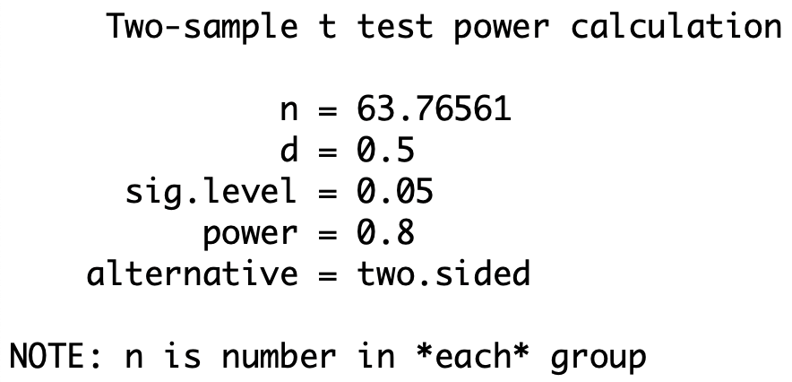
Conducting Power Analyses for t-Tests of Means: Independent Samples t-Test
Solution: We use the R command
pwr.t.test(d = 0.5, sig.level = 0.05, power = 0.8, type = "two.sample", alternative = "two.sided")
According to the R output,
the estimated
sample size is
N = 128 with
An n per group
of 64.
Notes:
343

Slide 344
Conducting Power Analyses for t-Tests of Means: Paired Samples t-Test
Example: Find the sample size necessary to achieve a power of 0.80 to detect a minimum mean difference of 0.50 standard deviations with α set to 0.05 in a two-tailed paired samples t-test.
Notes:
344

Slide 345
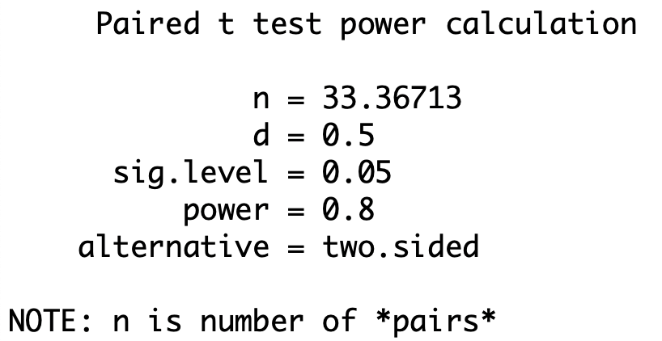
Conducting Power Analyses for t-Tests of Means: Paired Samples t-Test
Solution: We use the R command:
pwr.t.test(d = 0.5, sig.level = 0.05, power = 0.8, type = "paired", alternative = "two.sided")
According to the R output, the estimated sample size is N = 34.
Notes:
345

Slide 346
Research Design: Introduction and Overview
Chapter 12

Slide 347
Overview
Questions and their links to types of research studies
Study types: Descriptive, Relational, Causal
Observational studies with intact groups
The randomized control study:
The true experiment as the gold standard of causal studies
Quasi-experiments and confounders
Counterfactuals and true control groups
The fundamental problem of causal inference
Threats to the internal and external validity of a study
Caveats and final comments

Slide 348
Variable Measurement
Want the measure to be valid: That it measures what it claims to measure
Want the measure to be reliable: That it is free from random errors that could occur at the time of measurement that would cause the recorded value to vary from one occasion to the next; to be inconsistent or unstable
Reliability of a measure at a single point in time is often measured by Cronbach’s alpha internal consistency reliability coefficient on a scale from 0 (not at all reliable) to 1 (perfectly reliable)

Slide 349
More about Validity and Reliability
Measures may lack validity, yet be highly reliable as in a situation in which hair length is used to measure a person’s weight from one day to the next.
For traits that do not change naturally from time to time, an index of test-retest reliability may be used, but for traits that do change naturally from time to time (like mood), assessing the reliability of a measure at a single point in time would be more appropriate than using test-retest methods.

Slide 350
Types of Studies and Their Aims
Descriptive study – Used to describe the way things are. E.g., “How much do male and female college freshmen weigh?”
Relational study – Used to determine if and how two or more things are related. E.g., “Is there a relationship between gender and weight considering the population of male and female college freshmen?”
Causal study – Used to determine if two or more things are causally related -- if changing the value on one variable results in a predictable change in another variable. E.g., “Does Diet A cause weight loss in college freshmen?”

Slide 351
More on Causal Studies
To be able to claim that variable X causes variable Y:
X must be correlated with Y (Those on Diet A weigh less than those not on Diet A after some time period)
X must precede Y in time (Weight loss occurred only after eating according to Diet A)
There must be no alternative plausible explanation for the observed X-Y relationship; that is, the X-Y relationship must not be attributable to any other variable not included in the study (Those who ate according to Diet A did not also exercise more because if they did, the increased exercise could be the real reason for their weight loss rather than Diet A.)

Slide 352
Example from the Text: Injustices at Work May Harm Men’s Hearts
Based on men’s responses to a survey about
perceived justice at work as well as on data on
whether or not these men showed incidence of
coronary heart disease (CHD), the authors found
that those who perceived a high level of justice at
work showed evidence of CHD at 70% of the rate of
those who did not.
Can the authors conclude with authority that being treated unfairly at work may cause heart problems?

Slide 353
Example from the Text: Injustices at Work May Harm Men’s Hearts
An important question: Are the two groups balanced on all covariates related to incidence of CHD?
According to the authors, the group who believed they were treated fairly were older, more likely to be married, have a higher education level, higher employment grade, and lower BMI [Body Mass Index] compared to those who believed they were treated unfairly.
Even after the authors controlled for these and other variables, the relationship was still found to exist.

Slide 354
Example from the Text: Injustices at Work May Harm Men’s Hearts
Another important question: Could the imbalance in the two groups on several variables be the true cause of the noted difference in CHD, rather than the difference in perceived levels of justice?
I.e., could these other variables on which the two groups differ be the ones that are the real reasons for the observed increase in CHD by those who perceived the workplace to be unfair?
As a result, could the causal conclusion that injustices at work may harm men’s hearts be unjustified?

Slide 355
Example from the Text: Injustices at Work May Harm Men’s Hearts
Contributing problem: Study is observational and not a randomized control (a true experiment).
In an observational study, individuals merely are observed and data are collected on an outcome (or outcomes) of interest.
In this study, a survey was used to collect data on men’s perceptions of being treated fairly at work and other data were used to obtain evidence of CHD.

Slide 356
Observational Studies and Intact Groups
Intact groups were used, formed merely by their scores on the survey.
The treatment group was comprised of those who were observed to perceive a high level of justice at work.
The comparison or control group was comprised of those who were observed to perceive a low or moderate level of justice at work.
No treatment was administered; therefore, no treatment and control group was formed at the outset of the study.

Slide 357
Randomized Control Studies
When, instead, a treatment is to be administered, and individuals are assigned to treatment and control groups randomly,
We have what is called a controlled randomized study or true experiment.
Random assignment to the two groups guarantees that with large enough samples, the two groups will be balanced (not different) on all variables.
Neither group will be more endowed on a variable or set of variables that might affect the outcome, leaving the treatment itself as the only possible cause of the obtained outcome result.

Slide 358
The True Experiment as Gold Standard
Random assignment with large enough sized groups will produce groups that are equivalent at the outset but for the fact that one group is given the treatment and the other group is not.
Any difference on the outcome variable between the two groups must therefore be because one group was given the treatment and the other group was not;
Accordingly, a true experiment, defined by random assignment to groups, provides the gold standard for reaching causal conclusions.

Slide 359
Quasi-Experiments and Confounders
If a treatment is to be administered, and individuals are assigned to treatment and control groups using other than random assignment, we have what is called a nonrandomized controlled study or quasi-experiment.
Without non-random assignment to groups, the groups may differ on variables that could explain the observed difference in the outcome measure.
Variables such as these are called confounders as they confound the interpretation of results.
In the Injustice at Work example, age, BMI, education are examples of potential confounders.

Slide 360
Kidney Stone Example
Two treatments for kidney stones, A and B.
Overall Treatment B appears to a more effective procedure than Treatment A
But, doctors tend to administer Treatment B to the severe cases and Treatment A to the milder cases
When the severity of the case (kidney stone size) is taken into account, the reverse occurs -– Treatment A is more effective than Treatment B.
The severity of the case confounds the interpretation of results and must be taken into account to achieve the correct conclusion.

Slide 361
Measuring Average Treatment Effect (ATE) Without a Control: Diet Example
What is the causal effect of a particular college freshman diet provided by a university on weight gain/loss from September to June? (Lord, 1967)
Want to measure the average effect of the diet on weight loss from September to June – the ATE.
To claim that the diet itself is the cause of weight loss, need to rule out other possible causal explanations (e.g., more exercise, greater stress, etc. ).
I.e., need a comparison group that shares the same values on all these other characteristics.
But do not have a comparison group in this example. Have only the group exposed to the university diet.

Slide 362
Counterfactuals: The Diet Example
To estimate the university diet’s ATE we would need to know the amount by which the college freshmen’s weight would have changed from
September to June if they were NOT exposed to the
particular diet provided by the university?
But, there is no one in the freshman class who was not exposed to this particular university diet.
What we need is information related to a situation that is literally contrary to fact.
Such situations are called counterfactuals.

Slide 363
Other Examples of Counterfactuals
If I had taken three Advil instead of only one, my headache would be gone by now.
If I were you, I would have applied for the job, eaten more spinach, run the marathon, etc.
The term counterfactual is often used as a synonym for control group or comparison.
What is the counterfactual? This question just usually means, “To what is the treatment being
compared?”
When causative claims are made in a research study, it is always sensible to ask, “What is the counterfactual?”

Slide 364
Without A True Control (or Counterfactual)
We have data to obtain the average weight change for all college freshmen from September to June by subtracting the students’ mean weight in September from their mean weight in June.
But, in order to obtain a true ATE estimate, we would need, instead, to subtract from the students’ mean weight in June the average weight of college freshmen in June who were assigned to a true control group diet.
The difference in the first bullet will equal the difference in the second, only if we assume that the students’ mean weight in September equals the mean weight in June of students in a true control diet group.

Slide 365
Are these two mean weights equal?
To test the assumption that the students’ mean weight in June under a control diet equals their mean weight in September, we would need weight data from September and June on the same students exposed to a true control group condition.
But the same students cannot be exposed to the control diet given they were exposed to the treatment diet.
So our belief in the truth of this assumption must be based only on intuition and/or subject-matter expertise. It cannot be tested with available data.

Slide 366
The fundamental problem of causal inference
The fundamental problem of causal inference is that the same students cannot be exposed to the control diet given they were exposed to the treatment diet.
That is, we only can observe students under one condition, not both.
As such, one or more assumptions must be made about what would have happened had that person
been in the other group or taken the other path.
This is what gives causal inference in observational settings an air of uncertainty.

Slide 367
New Methods for Bolstering Claims of Causality from Observational Data
Three examples of advanced analytic approaches for bolstering a researcher’s claim of causality by helping to reduce or even eliminate bias in the estimation of a treatment effect or other variable in which one is interested.
Propensity Score Matching
Instrumental Variables
Regression Discontinuity Designs
(For greater detail, see the text and related references given in the text.)

Slide 368
More on Quasi-Experiments
Recall, there is no randomization to treatment and control groups
Yet, other aspects of an experimental design (e.g., selection of research participants, use of a control group, repeated observations) are included.
Issue -- groups likely not balanced at the outset
Imbalances may create threats to the internal validity of the study as they may bias the estimation of an average treatment effect
Another issue – generalizability of results to other populations, settings, etc.
The latter are threats to the external validity of the study.

Slide 369
Some Threats to Internal Validity
Maturation – Changes in the participants that occur over time within the course of the study that could differentially affect the outcome variable for the groups (e.g., growing older, more tired, more aware of being in an experiment).
Experimental Mortality – Differential attrition of subjects from the treatment and control groups.
Selection Bias – Differential selection of subjects for groups; subjects in the treatment group compared to the control group, on average, have different endowments on the pretest and other relevant covariates that are known to affect the outcome.

Slide 370
Threats to External Validity
Typically involves an interaction between some aspect of the design and the treatment group.
Given a study to test whether a film on sexual harassment in the workplace is effective in making individuals more aware of the issues and problems related to such harassment.
If a pretest were administered before the film was shown to measure baseline knowledge of sexual harassment issues, the pretest could sensitize the individuals in that study to the topic of sexual harassment, in general, and, in turn, amplify the effects of the film for those individuals in the study.

Slide 371
Some Caveats
Randomization to treatment and control groups does not guarantee the validity of the resulting causal claim
Other factors may intervene after randomization that can compromise the validity of findings
Accordingly, even in the context of a true experiment, one should consider the range of alternative plausible factors or threats that could contribute to an invalid causal conclusion.
Good questions to pose are on the next slide.

Slide 372
Questions Worth Posing re: Threats
(1) How would the threat apply in this case?
(2) Is there evidence that the threat is plausible rather than just possible?
(3) Does the threat operate in the same direction as the observed effect, so that it could partially or totally explain the observed findings?
From Shadish, Campbell, & Cook, 2002: p. 40

Slide 373
Final Comments
The goals of achieving internal and external validity are often at odds with each other.
Given a choice between bolstering the internal versus the external validity of a design, one should give clear priority to bolstering the internal validity and to including elements in the design that do so.
After all, and simply stated, only valid causal conclusions are worthy of being generalized.

Slide 374
One Way Analysis of Variance (ANOVA)
SHARON LAWNER WEINBERG SARAH KNAPP ABRAMOWITZ
Chapter 13

Slide 375
One-Way ANOVA
Looks at population mean differences for ≥2 groups.
If there are 3 populations, for example,
H₀: μ₁=μ₂=μ₃ versus H₁: not H₀
Better than multiple t-tests because it controls Type I error rate. [with K groups, α_{FW}=1-(1-α)^{K}]
Significance Test based on the ratio of between groups to within groups variance. [MS_{B}/MS_{W}]
Assumptions: (1) Independence, (2) Normality, (3) Homogeneity of variances.
An alternative is the Bonferroni adjustment when there are planned comparisons.

Slide 376
One-Way ANOVA: Examples based on NELS
Example 1: Among college-bound students that are always at grade level (CBAAGL), are there regional differences in the number of years of math taken in high school, on average?
Example 2: Among CBAAGL students, are there regional differences in the size of the family, on average?
Example 3: Among CBAAGL students, are there gender differences in eighth grade math achievement, on average?
Example 4: Among CBAAGL students, are there differences in SES by urbanicity, on average?

Slide 377
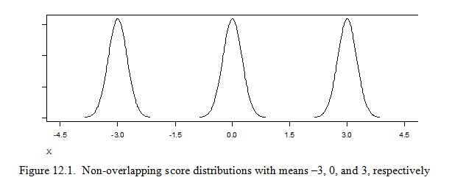
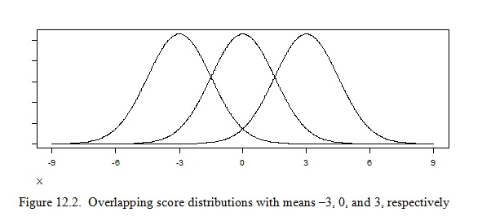
One-Way ANOVA : Represented Graphically
Notes:
377

Slide 378
One-Way ANOVA : The Between Group Variance (MS_{B})
The MS_{B} is computed as a variance on the group means.
It represents the amount of difference each group mean is from the grand mean and each another.
When there are large differences between group means, MS_{B} will be large.
Large differences between group means are suggestive, but not determinative, of population mean differences.
We need to compare MS_{B} to MS_{W} in order to be sure.
The formula for MS_{B} is given by Equation 13.3 in our text.

Slide 379
One-Way ANOVA : The Within Group Variance (MS_{W})
The MS_{W} is computed as a pooled variance of the scores within each group.
It represents the amount of difference each individual’s score in a group is from its own group mean and from the other individuals’ scores in that group.
The individual differences represented by MS_{W} are regarded as error or noise in the system.
If there were no noise in the system, every individual in a group would have the same score. I.e., individuals would not respond differently, for example, to the treatment administered to that group.
The formula for MS_{W} is given by Equation 13.4.

Slide 380
One-Way ANOVA : F-ratio -- an Index of Separation (MS_{B}/MS_{W})
If certain assumptions are satisfied by our K populations, then the distribution of all possible F-ratios, called an F-distribution, will have a particular shape.
We use the F-distribution in much the same way we used the t-distribution, to judge whether our observed statistic, in this case, the observed F-ratio, may be attributable to chance.

Slide 381
One-Way ANOVA : Underlying Assumptions
The null hypothesis is true.
The scores are independent of each other.
The parent populations are normally distributed for all groups under study.
The parent populations have equal variances (this is called homogeneity of variance) for all groups under study.

Slide 382
One-Way ANOVA: General Procedure
0
Are N₁, N₂, …, N_{k} > 30?
Yes: Test robust
To normality
violations
No: Need to check normality
Are sample sizes all equal?
Yes: Normality tenable
Is |(skew)/(s.e. skew)|
less than 2 for all
groups?
Yes:
Test robust
To violation of
Homogeneity
Of variances.
Need to check homogeneity of variances.
For Levene’s test, is p > α?
Yes
No
No. Homogeneity of variances not tenable
Test result may not be valid.
Perform a non-linear transformation
or use a non-parametric test.
Yes
For ANOVA is p < α?
Test result may not be valid.
Perform a non-linear transformation
or use a non-parametric test.
Yes
No
Result is statistically significant.
Calculate and interpret effect size.
If the number of groups is greater than two,
Conduct. Post-hoc test and interpret result.
If the number of groups is equal to 2,
use sample means to interpret result.
Result is not stat.sig.
Report result.
Notes:
382

Slide 383
Conducting a One-Way ANOVA Using R
Example 1: Among college-bound students that are always at grade level (CBAAGL), are there regional differences in the number of years of math taken in high school, on average?
Use the following R commands:
results = aov(NELS$unitmath~NELS$region)
summary(results)
levenes.test(NELS$unitmath, NELS$region)
Notes:
383

Slide 384
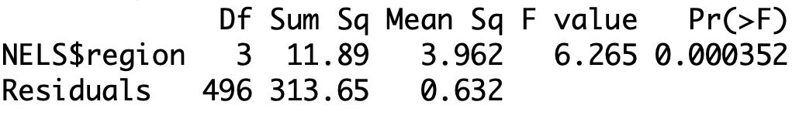
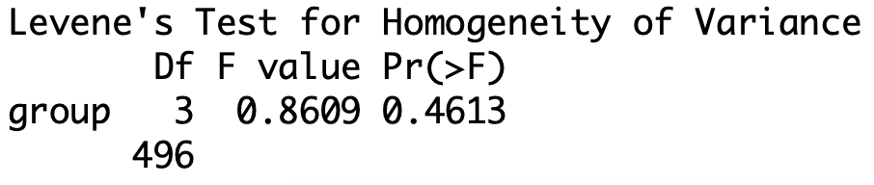
R Output for Example 1
Notes:
384

Slide 385
Example 1: Among college-bound students that are always at grade level (CBAAGL), are there regional differences in the number of years of math taken in high school, on average?
The normality assumption does not need to be tested because all sample sizes are greater than 30. The homogeneity of variance assumption is met (p = .46 for Levene’s test).
The results of the ANOVA indicate that there are statistically significant regional differences in the amount of math taken in HS, on average (p = .0004).
Notes:
385

Slide 386
Example 1: Among college-bound students that are always at grade level (CBAAGL), are there regional differences in the number of years of math taken in high school, on average?
Effect size:
Magnitude according to Cohen’s rule of thumb:
Small = .01
Moderate = .09
Large = .25
Notes:
386

Slide 387
Example 1: Among college-bound students that are always at grade level (CBAAGL), are there regional differences in the number of years of math taken in high school, on average?
Approximately four percent of the variance in years of math taken in HS can be explained by region, a small (or small to moderate) effect.
Notes:
387

Slide 388
One-Way ANOVA: Post-Hoc Testing
When the result of the ANOVA is statistically significant and there are more than two groups being compared, we conduct post-hoc tests to determine the nature of the mean differences.
We will use the Tukey Honestly Significant Difference (HSD) post-hoc test for pairwise comparisons among means executed using the following R commands:
library(DescTools)
PostHocTest(results, method = "hsd")
Notes:
388

Slide 389
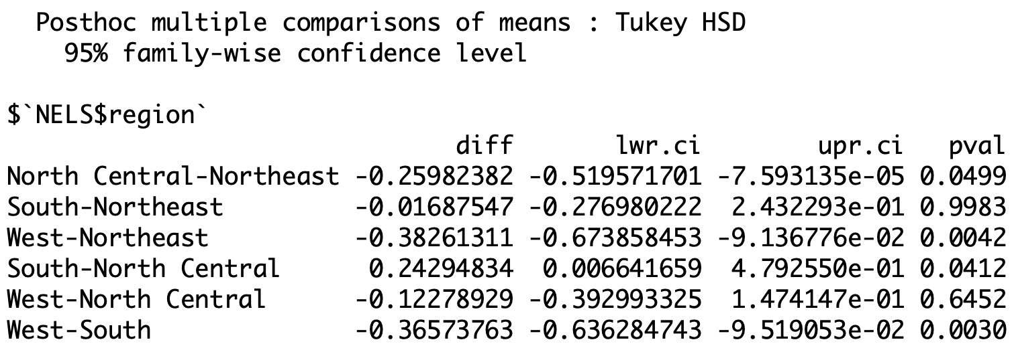
Example 1: Among college-bound students that are always at grade level (CBAAGL), are there regional differences in the number of years of math taken in high school, on average?
The results obtained from the Tukey test are as follows:
Notes:
389

Slide 390
Example 1: Among college-bound students that are always at grade level (CBAAGL), are there regional differences in the number of years of math taken in high school, on average?
Students in the Northeast take statistically significantly more years of math than those in the North Central and West, on average. And those in the South take significantly more years of math than those in the North Central, on average.
No other statistically significant differences are detected.
Notes:
390

Slide 391
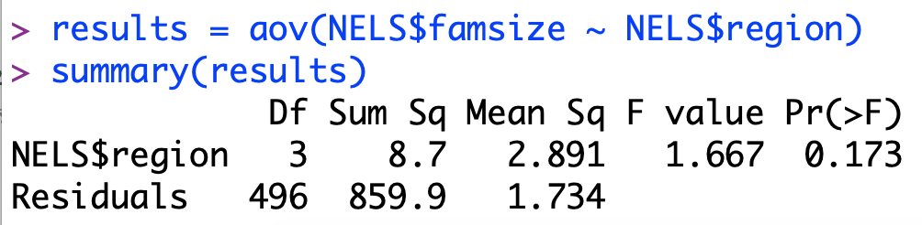
Example 2: Among CBAAGL students, are there regional differences in the size of the family, on average?
Notes:
391

Slide 392
Example 2: Among CBAAGL students, are there regional differences in the size of the family, on average?
The normality assumption does not need to be tested because the sample sizes are greater than 30.
The results of the ANOVA indicate that there are no statistically significant regional differences in the average family size (p = .17).
Hence, there is no need to follow up with post-hoc tests.
Notes:
392

Slide 393
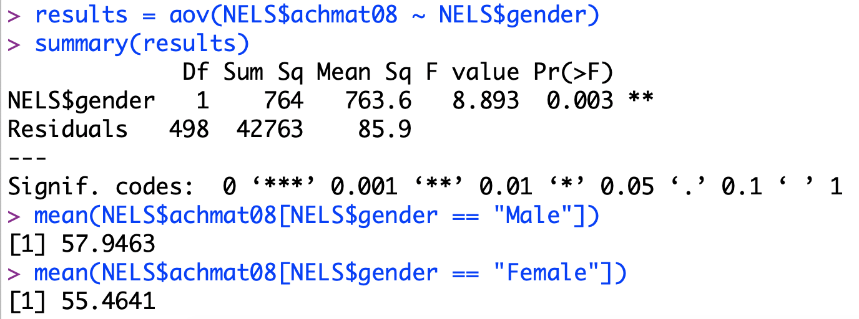
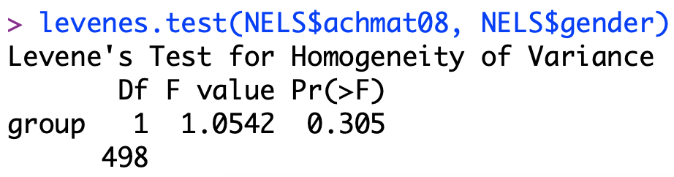
Example 3: Among CBAAGL students, are there gender differences in eighth grade math achievement, on average?
Notes:
393

Slide 394
Example 3: Among CBAAGL students, are there gender differences in eighth grade math achievement, on average?
The normality assumption does not need to be tested because both groups are large.
According to Levenes’s test, the homogeneity of variance assumption is met, p = .305.
The results of the ANOVA indicate that there are gender differences in eighth grade math achievement, on average, p = .003.
Because there are only two groups, there is no need to follow-up with post-hoc tests.
We can determine the nature of the gender difference by simply looking at the sample means.
Notes:
394

Slide 395
Example 3: Among CBAAGL students, are there gender differences in eighth grade math achievement, on average?
Males have statistically significantly higher eighth grade math achievement than females, on average.
R² = 763.6/43526.9= 0.02, which is a small effect
Because there are only two groups, we also could have done an independent-groups t-test and gotten the same result.
Because with 1 df in the numerator, F = t², the t-value would have been equal to √8.893=2.98.
Notes:
395

Slide 396
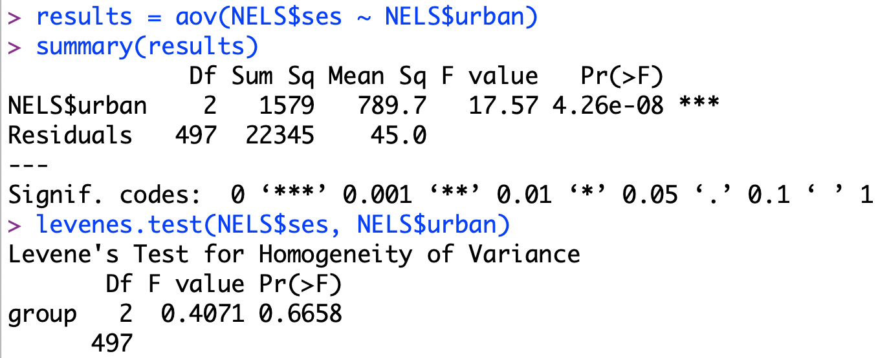
Example 4: Among CBAAGL students, are there differences in ses by urbanicity, on average?
Notes:
396

Slide 397
Example 4: Among CBAAGL students, are there differences in ses by urbanicity, on average?
The normality assumption does not need to be tested because both groups are large.
According to Levene’s test, the homogeneity of variance assumption is met, p = .67.
The results of the ANOVA indicate that there are differences in ses by urbanicity, on average, p < 0.0001.
Notes:
397

Slide 398
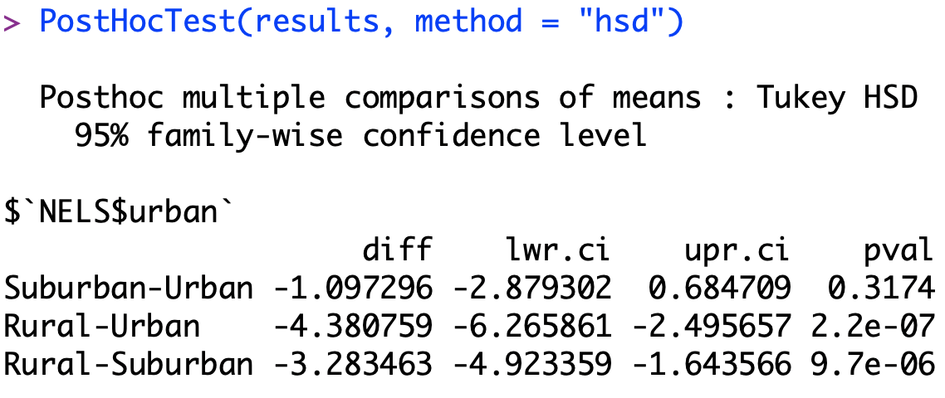
Example 4: Among CBAAGL students, are there differences in SES by urbanicity, on average?
Notes:
398

Slide 399
Example 4: Among CBAAGL students, are there differences in SES by urbanicity, on average?
The average ses for rural students is statistically significantly lower than it is for suburban or urban students, on average.
Notes:
399

Slide 400
Recall the following effect size indices and guidelines for judging their magnitudes from Chapter 10
Test | Index | Small | Medium | Large
t-test for means | d | 0.20 | 0.50 | 0.80
t-test for correlation | r | 0.10 | 0.30 | 0.50
F-test for regression | f² | 0.02 | 0.15 | 0.35
F-test for ANOVA | f | 0.10 | 0.25 | 0.40
Chi-square | W | 0.10 | 0.30 | 0.50
Notes:
400

Slide 401
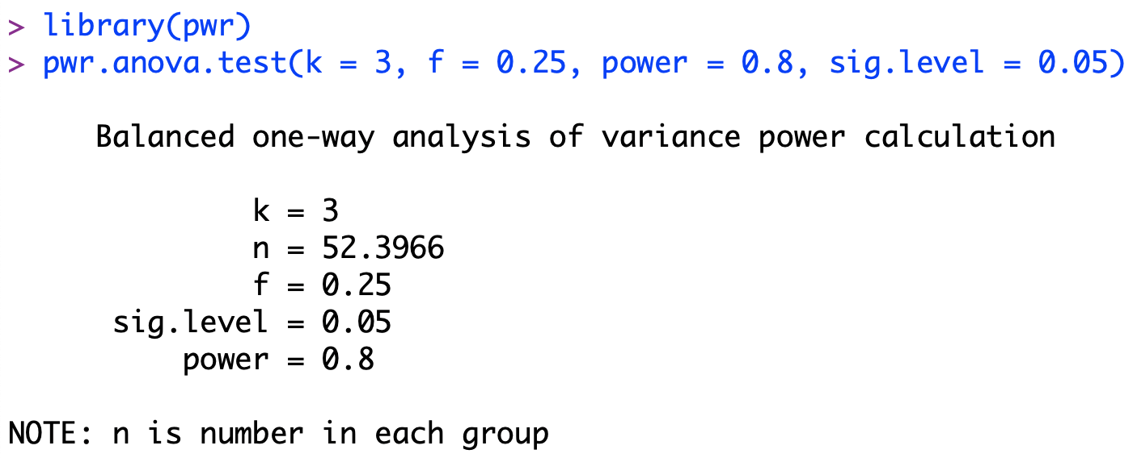
Example 5: Use R’s power command to determine the sample size required to detect a medium effect size with power = 0.80 and α = 0.05 for a balanced design one-way ANOVA consisting of three groups.
Solution: Given that f = 0.25, we use the following commands and get that we need 53 people per group.
Notes:
401

Slide 402
Two Way Analysis of Variance (ANOVA)
Chapter 14

Slide 403
Two-Way ANOVA
Looks at population mean differences of a single scale variable by two grouping variables, called factors.
Example: Factor 1– Treatment; Factor 2 – Gender
Each row represents a category, or level, of Gender
Each column represents a category or level of Treatment.
Each of the six cells in the design represents a unique combination of a level of the Gender factor and a level of the Treatment factor.
Called a 2 X 3 factorial design that is crossed -- all unique combinations are represented in this design (males & females each receive all levels of treatment, 1, 2, and 3).

Slide 404
Two-Way ANOVA: Questions Answered
Is there main effect due to Factor 1?
I.e., Is there is an effect due to Treatment (regardless of Gender)?
Is there is a main effect due to Factor 2?
I.e., Is there is an effect due to Gender (regardless of Treatment)?
Is there is an interaction between Factors 1 and 2?
I.e., Does the effect of Treatment on individuals vary as a function of Gender?
Better than two separate one-way ANOVA’s on the two separate main effects because can test for an interaction with two-way ANOVA.

Slide 405
An Example: Manual Dexterity Performance Scores as the Continuous or Scale Dependent Variable
 | Treatment 1 | Treatment 2 | Treatment 3
M | 10, 9, 8, 8, 7 M₁₁ = 8.4 | 5, 4, 3, 2, 1 M₁₂ = 3 | 4, 3, 3, 2, 2 M₁₃ = 2.8 | Row 1 Mean = 4.73
F | 6, 6, 6, 5, 5 M₂₁ = 5.6 | 4, 4, 3, 2, 2 M₂₂ = 3 | 6, 6, 5, 5, 4 M₂₃ = 5.2 | Row 2 Mean = 4.60
 | Col 1 Mean = 7.0 | Col 2 Mean = 3.0 | Col 3 Mean = 5.2 | Grand Mean = 4.67

Slide 406
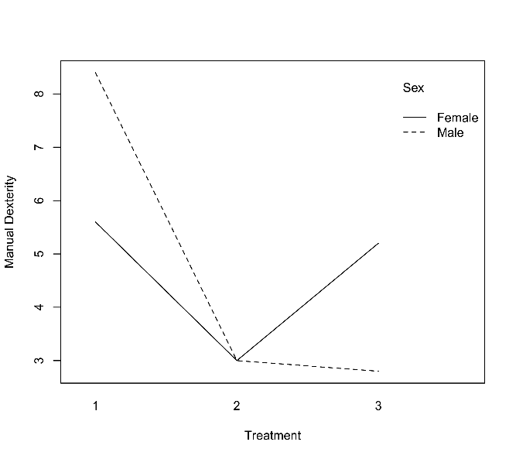
Graphical Profile: The Manual Dexterity Performance Scores by Gender–Example of a Disordinal Interaction

Slide 407
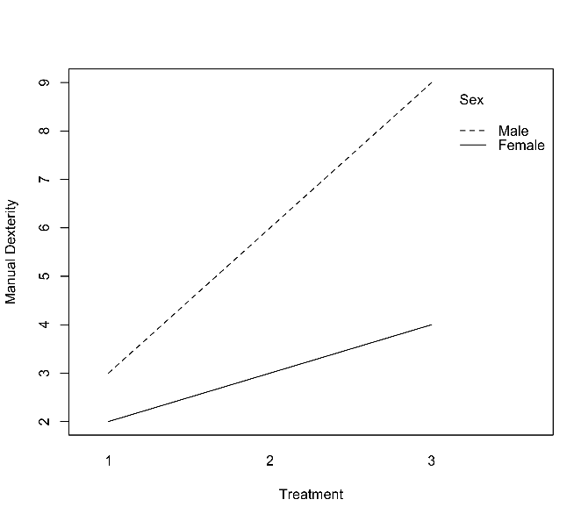
Example of an Ordinal Interaction – Based on a Different Set of Data

Slide 408
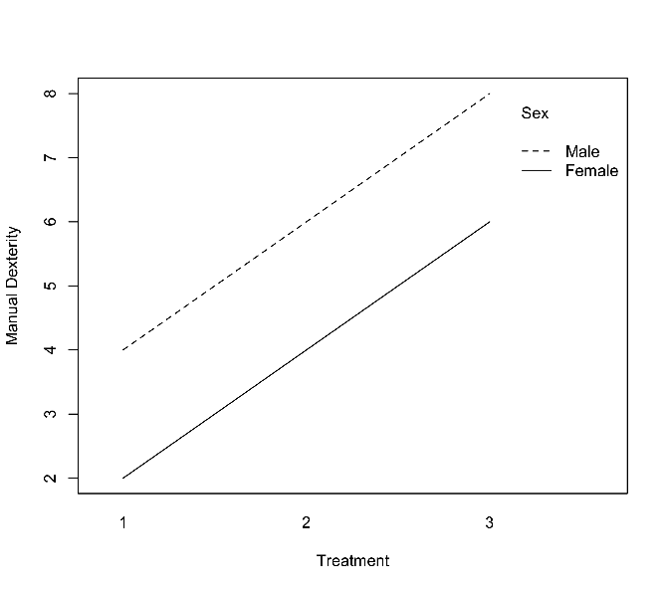
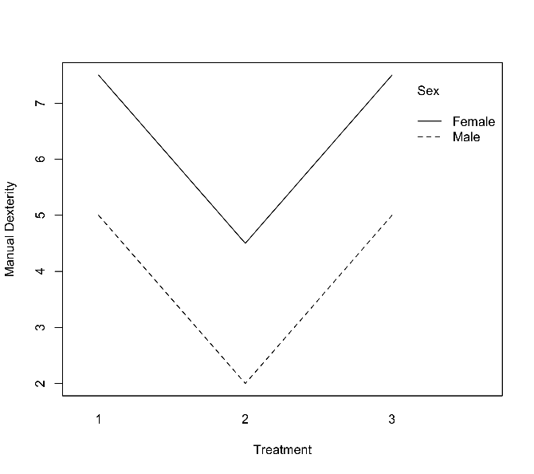
Examples of No Interaction -- Relative effects of one factor are constant across levels of the other factor

Slide 409
Analyzing Variances: Extending to two-way designs
In one-way ANOVA, we partitioned the total variability (SS_{TOT}) into a Between-Group SS (due to Factor 1 – e.g., Treatment) and a Within-Group SS (what’s left over, called the error or residual, once the variability due to Factor 1 is accounted for).
SS_{T} = SS_{TREATMENT} + SS_{WITHIN}
In two-way ANOVA, we breakdown the Within-Group SS further into the variability that is due to Factor 2 (e.g., Gender), the Interaction between Factors 1 and 2, and what’s left over within-cell.
SS_{T} = SS_{TREATMENT} + SS_{GENDER} + SS_{INTERACTION} + SS_{WITHIN-CELL}
The formulas for these SS terms are, respectively, in your text as Eqs. (14.7), (14.4), (14.3), (14.5), & (14.6).

Slide 410
Example 1: Investigating the relationship between Type of Light and Type of Watering on a Plant’s Biomass
A plant biologist randomly assigns seedlings to one of four conditions: sunlight and drip watering, artificial light and drip watering, sunlight and hand watering, artificial light and hand watering. She measures the biomass of each plant after three weeks.
How would two-way ANOVA be used to determine whether there are differences in biomass, on average, depending on the conditions under which the plant is raised?
Notes:
410

Slide 411
Example 1: Investigating the relationship between Type of Light and Type of Watering on a Plant’s Biomass
In this example, the two types of treatment (Type of Light & Type of Watering) can each be described in terms of two levels as follows:
IV’s: Watering (drip, hand); Light (sun, artificial)
DV : Plant’s Biomass
And may be organized as a 2x2 two-way design:
Watering
 | Drip | Hand
Sun
Artificial
Light
Notes:
411

Slide 412
Example 1: Investigating the relationship between Treatment and Sex for Manual Dexterity
Questions addressed by this two-way ANOVA:
Is there a difference in manual dexterity, on average, resulting from treatment type? (I.e., Is there a main effect of treatment on manual dexterity)
(2) Is there a difference in manual dexterity, on average, resulting from sex? (I.e., Is there a main effect of sex on a manual dexterity)
(3) Does the average difference in a manual dexterity resulting from the treatment type vary by sex? (I.e., Is there an interaction between sex and treatment on manual dexterity)
Notes:
412

Slide 413
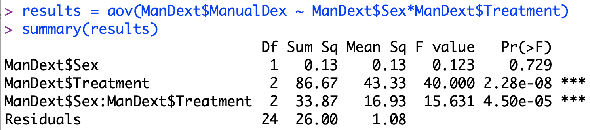
Example 1: Investigating the relationship between Treatment and Sex for Manual Dexterity
Source: The ManDext dataset in the sur package in R
The independent variables are Sex and Treatment.
The dependent variable is Manual Dexterity.
There is no main effect due to Sex. There is a main effect due to Treatment, and there is an interaction between Treatment and Sex.
Notes:
413

Slide 414
Two Way ANOVA: Underlying Population Distribution Assumptions
As with the one-way ANOVA, the population distribution assumptions for the two-way ANOVA are:
Normality – the within-cell samples of scores come from populations that are normally distributed
Homogeneity of variance – the within-cell samples of scores come from populations that have equal variances.
Notes:
414

Slide 415
Two Way ANOVA: The Normality Assumption
If the cell sizes are large (30 or more scores per cell), the results of the ANOVA are robust to violations of the normality assumption.
If the cell sizes are small (fewer than 30 scores in at least one cell), we need to assess whether the normality assumption is tenable. We do so by calculating the skewness ratio for all the cells. If it is less than 2 in magnitude for every cell, we say that normality is tenable. If it is greater than 2 in magnitude for any cell, normality is not tenable and we should apply a non-linear normalizing transformation to the dependent variable.
Notes:
415

Slide 416
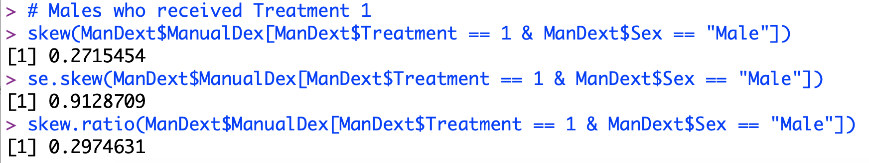
Two Way ANOVA: Testing the Normality Assumption
In this example, the cell sizes are small (n = 5) so we check the tenability of the normality assumption.
We find the skewness and skewness ratio for each of the 3X4 or 12 cells.
As an example, we can find:
Notes:
416

Slide 417
Two Way ANOVA: Homogeneity of Variance Assumption
Tested via Levene’s through the ANOVA procedure.
In this case, Levene’s test is based on testing “the null hypothesis that the error variance of the dependent variable is equal across groups.”
Because the residual scores contain all the information of the original scores minus the row, column, and interaction effects, tests on the error variance of the dependent variable are equivalent to tests on the original score variance of the dependent variable.
Notes:
417

Slide 418
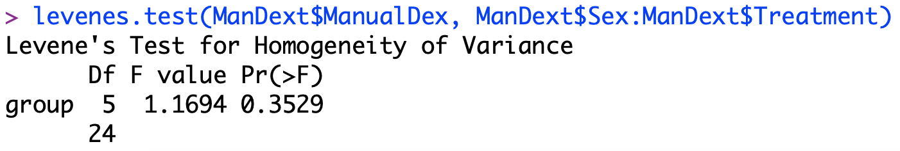
Homogeneity of Variance Assumption
Notes:
418

Slide 419
Two Way ANOVA: Additional Assumptions
As in the one-way ANOVA model, the two-way ANOVA model is based on the assumption that the scores are independent. Scores are independent if, for example, each score is from a separate individual who has been randomly assigned to one of the treatment conditions of the design.
In the one-way ANOVA, no restriction was placed on the relative sizes of the samples that comprised each level of the factor studied. The model, as described, allowed for either equal or unequal cell sizes. The model presented in this chapter for two-way ANOVA is based on the assumption that the number of subjects in each cell is equal or proportional; this is to ensure that the design is balanced (or orthogonal).
Notes:
419

Slide 420
Testing the three hypotheses in the two-way ANOVA: The F-ratio
R = number of levels of one of the independent variables.
C = number of levels of the other independent variable.
Notes:
420

Slide 421
Effect Size in Two-Way ANOVA
We calculate a measure of effect size for each of the statistically significant effects.
One option is to calculate the proportion of variance explained by the effect, much as we did for one-way ANOVA
Notes:
421

Slide 422
Effect Size in Two-Way ANOVA
Another option is called partial eta squared.
It is based on controlling for or partialing out the other effects in the design.
The values of partial eta squared are reported in the SPSS output and may be calculated as
In general, for any given effect, η² is larger than the corresponding R² for that effect.
Notes:
422

Slide 423
Reporting Statistically Significant Effects in a paper using APA Style
We report the distribution, F, the degrees of freedom for the effect and error (sometimes called within), the F value itself, and the corresponding p value.
F(df_{Effect} , df_{Error} ) = xxx, p = xxx
In the current example, for the main effect of treatment, we have F(2, 24) = 86.67, p < .0001.
Notes:
423

Slide 424
Example 2: Post-Hoc Testing of Main Effects
Conduct post-hoc tests to determine the nature of the main effects only when the interaction is not statistically significant.
If the main effect has only two levels, the sample means should be used to determine the nature of the mean differences. No post-hoc testing is necessary.
If the main effect has more than two levels, use the Tukey post-hoc test.
Notes:
424

Slide 425
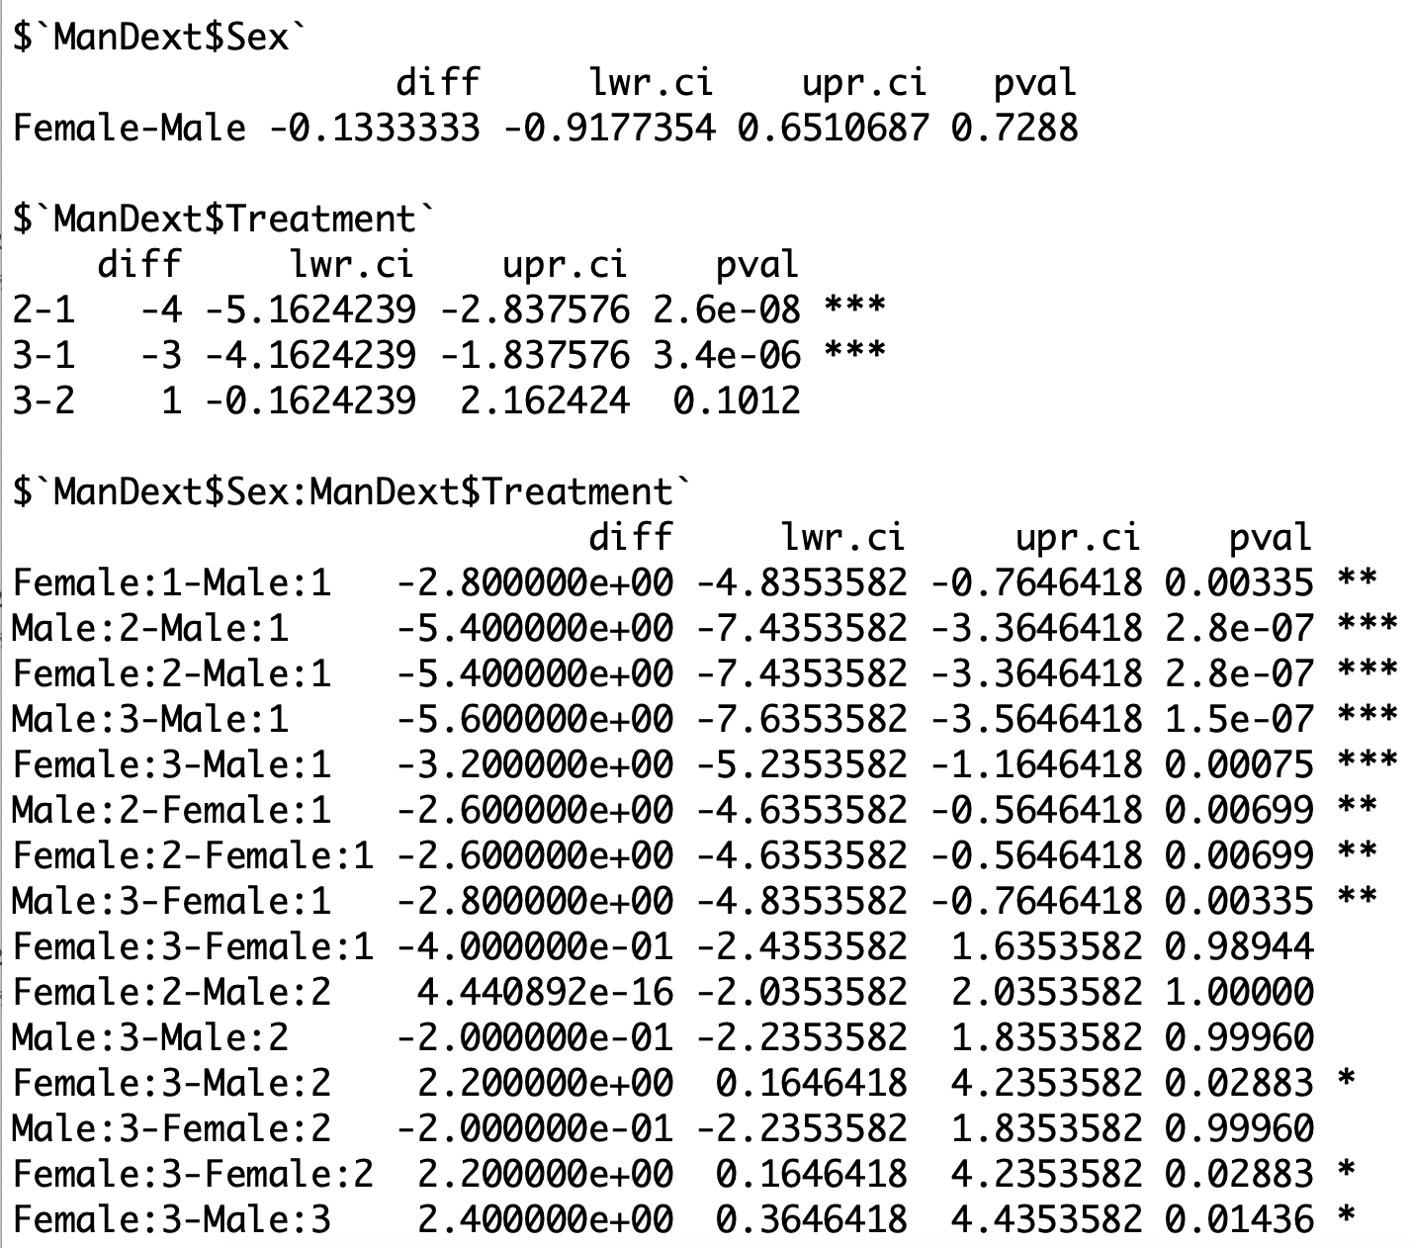
Post Hoc Testing of Main Effect in Two-Way ANOVA in R
To conduct post hoc tests on the significant main effect due to
Treatment, we first load library(DescTools), and then type:
PostHocTest(results, method = "hsd")
Notes:
425

Slide 426
Post Hoc Testing of Main Effect in Two-Way ANOVA in R
We see below that, on average, treatment 1 has statistically significantly higher Manual Dexterity than treatments 2 and 3.
Furthermore, there are many statistically significant interaction terms.
Notes:
426

Slide 427
Two-Way ANOVA:
0
Are all cell sizes > 30?
Yes: Test robust
To normality
violations
No: Need to check normality
Are sample sizes all equal?
Yes: Normality tenable
Is |(skew)/(s.e. skew)|
less than 2 for all
cells?
Yes:
Test robust
To violation of
Homogeneity
Of variances.
Need to check homogeneity of variances.
For Levene’s test, is p > α?
Yes
No
Yes. Homogeneity of variances tenable
Test result may not be valid.
Perform a non-linear transformation
or use a non-parametric test.
No. Homogeneity of variances not tenable
For at least one of the three effects is p < α?
Test result may not be valid.
Perform a non-linear transformation
or use a non-parametric test.
Yes
No
Report all statistically significant results.
Calculate and interpret effect size for all
Statistically significant results.
Turn to next slide to determine the
Appropriate post-hoc testing
procedure.
There are no statistically
Significant effects.
Report result.
Notes:
427

Slide 428
Two-Way ANOVA
Post-Hoc Testing:
0
Is the p-value associated with the
interaction < α?
Yes: Interaction
is statistically
significant
No: Interaction is not statistically
significant
Test for simple effects of the row
factor within the column factor and,
if desired, test for simple effects
of the column factor within the row
factor as well.
Conduct pair-wise comparisons on the marginal
means for each main effect that is
statistically significant.
Does the main effect variable
have only two levels?
Adjust the significance level to control
the family-wise Type I error for testing
simple effects.
For the row factor use α=α_{FW}/C
For the column factor use α=α_{FW}/R
Where α_{FW} is the family-wise (original) α
C is the number of levels in the column factor
R is the number of levels in the row factor
Yes
No
Use the sample means to determine
The nature of the mean differences.
No post-hoc testing is necessary.
Conduct post-hoc tests using
the Tukey test obtained
through the Post-Hoc option.
Conduct tests of
pairwise comparisons on the
individual group means
within each simple effect.
If meaningful, conduct pairwise
comparisons on the marginal means for each
main effect that is statistically significant.
Notes:
428

Slide 429
Recall the following effect size indices and guidelines for judging their magnitudes from Chapter 10
Test | Index | Small | Medium | Large
t-test for means | d | 0.20 | 0.50 | 0.80
t-test for correlation | r | 0.10 | 0.30 | 0.50
F-test for regression | f² | 0.02 | 0.15 | 0.35
F-test for ANOVA | f | 0.10 | 0.25 | 0.40
Chi-square | W | 0.10 | 0.30 | 0.50
Notes:
429

Slide 430
Power Analysis in Two-Way ANOVA
Use R’s power command to determine the sample size required to detect a medium effect size with power = 0.80 and α = 0.05 for each of the three hypotheses tested in a 3 x 4 balanced ANOVA design.
Notes:
430

Slide 431
Power Analysis in Two-Way ANOVA
Solution:
Load library(pwr2)
Obtain the sample size for the main effect due to rows
ss.2way(a = 3, b = 4, alpha = 0.05, beta = 0.2, f.A = 0.25, f.B = 1, B = 100)
Obtain the sample size for the main effect due to columns
ss.2way(a = 3, b = 4, alpha = 0.05, beta = 0.2, f.A = 1, f.B = 0.25, B = 100)
For the main effect due to rows, we have N = 168
For the main effect due to columns, we have N = 180
Notes:
431

Slide 432
Correlation and Simple Regression as Inferential Techniques
Chapter 15

Slide 433
Overview
The bivariate normal distribution
Inferences on correlation
Inferences on regression
Regression diagnostics

Slide 434
The bivariate normal distribution
A bivariate normal distribution has the following three properties:
Normality
Taken separately, the X and Y variables are both normally distributed.
When X is held constant at any value, the distribution of all the Y values corresponding to this value of X is normally distributed.
When Y is held constant at any value, the distribution of all the X values corresponding to this value of Y is normally distributed.
Homoskedasticity
All the conditional distributions of Y given X have the same standard deviation.
All the conditional distributions of X given Y have the same standard deviation.
Linearity
The means of all the conditional distributions of Y given X fall along a straight line.
The means of all the conditional distributions of X given Y fall along a straight line.
Notes:
434

Slide 435
Inferences on Correlation Example 1. Does the temperature outside relate to the number of ice cream bars sold?
We have two measures: ice cream bars sold and temperature outside. We are interested in understanding how these two measures relate to each other.
Data is available in the sur package in R under the name “IceCream”
Notes:
435

Slide 436
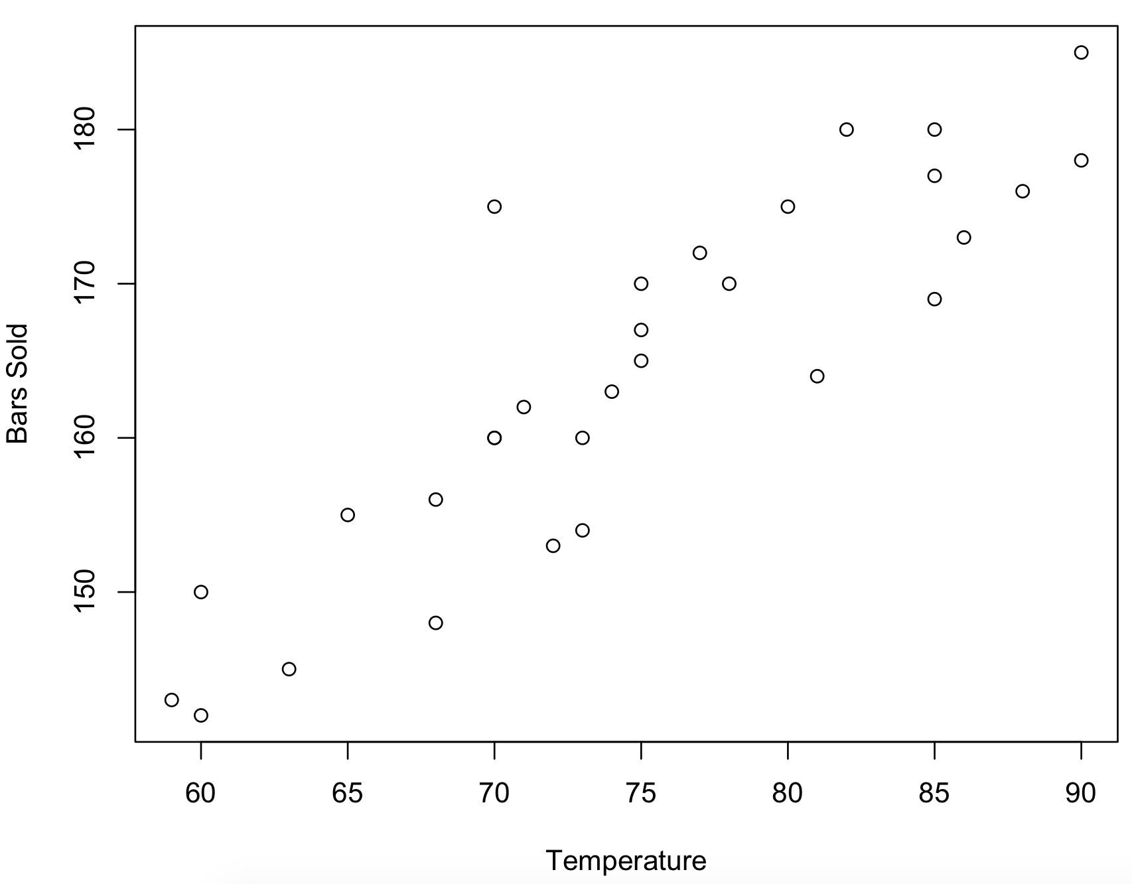
Reviewing the Data Via a Scatterplot
plot(IceCream$barsold ~ IceCream$temp, xlab = "Temperature", ylab = "Bars Sold")
As the temperature increases, so do the number of bars sold
Notes:
436

Slide 437
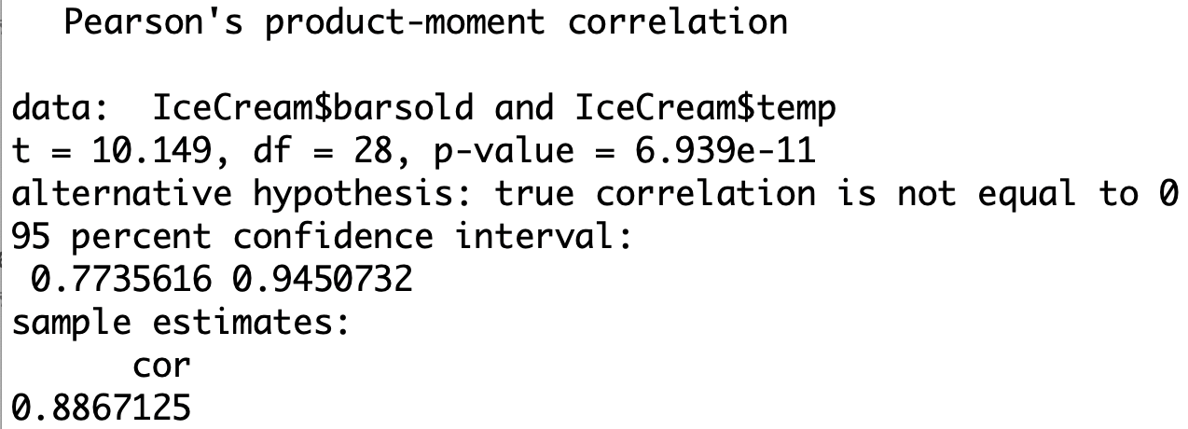
Example 1: Does the temperature outside relate to the number of ice cream bars sold?
A statistical test on the correlation can be used to determine if it is significantly different from 0.
H₀: ρ = 0
H₁: ρ ≠ 0
Results: Given N = 30 r = .88, p < 0.0001, we know that r is statistically significantly different from 0.
Notes:
437

Slide 438
Guidelines for Measuring the Strength of the Correlation
We may use Cohen’s guidelines to determine for the strength of the correlation
Magnitude of r | Strength
r < .1 | Little or no
.1 ≤ r < .3 | Weak
.3 ≤ r < .5 | Moderate
.5 ≤ r | Strong
Notes:
438

Slide 439
Inferences on Simple Linear Regression
Recall the formula for the regression equation is
where and
Notes:
439

Slide 440
Interpreting the Regression Coefficients
b is the slope; it is the change in y associated with a one unit change in x, on average. If the slope is 0, there is no linear relationship between the two variables. What is the predicted y value in that case?
a is the y-intercept; it is the predicted y value associated with x = 0
Notes:
440

Slide 441
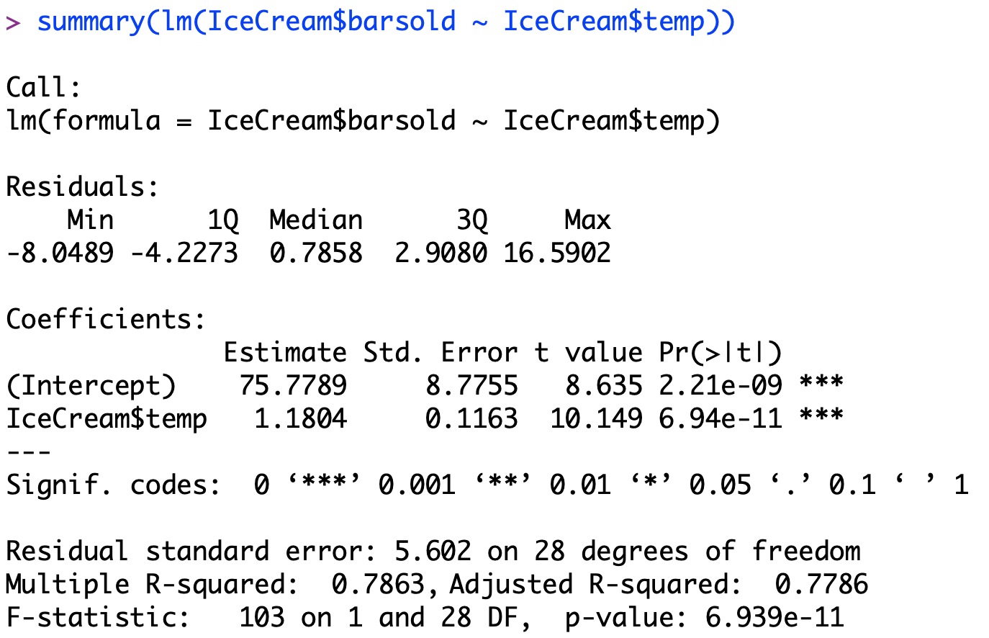
Constructing the Linear Model to Predict Bars of Ice Cream Sold from Temperature
Est’d barsold = 75.78 + 1.18 temp
Each unit increase in temperature is associated, on average, with a 1.18 increase in the number of bars sold. The intercept is not meaningful as no data are collected at a temperature of 0.
Notes:
441

Slide 442
Testing the Statistical Significance of the Linear Regression Model
There are several equivalent tests that may be used to determine whether this simple linear regression model is statistically significant.
The b-weight associated with cunr (t=8.635, p<0.0001).
The F-value associated with the ANOVA summary table
The F value associated with the R²= .79
(F(1,28)=103, p<0.0001)
Notes:
442

Slide 443
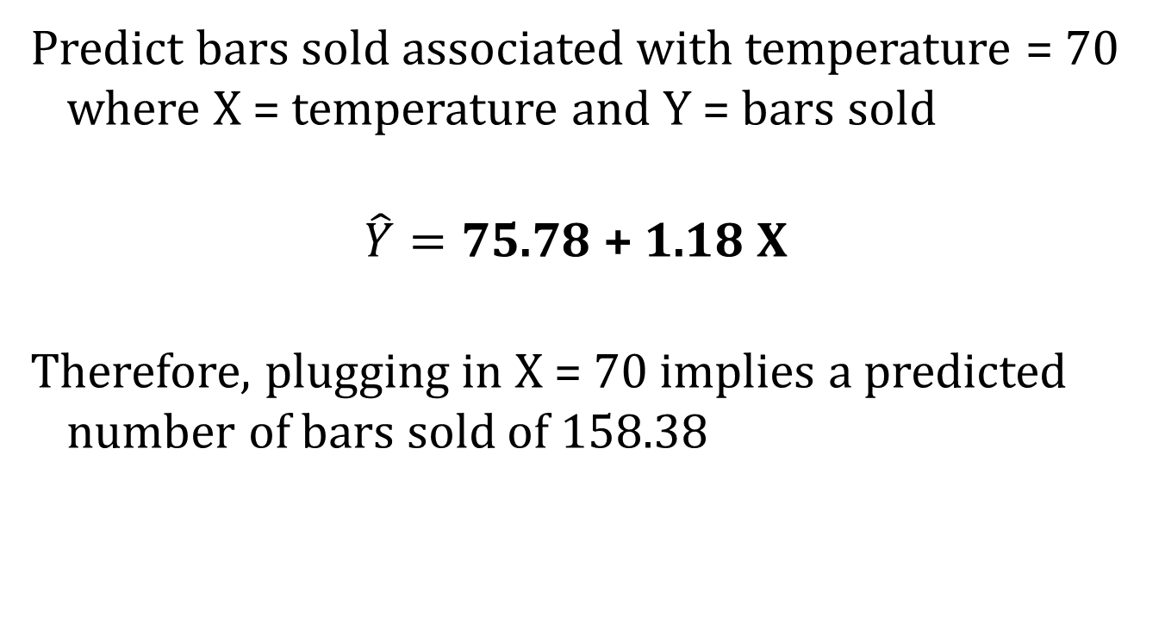
Using the Model to Predict Labor Force Participation Rates
Predict bars sold associated with temperature = 70 where X = temperature and Y = bars sold
$$\hat{Y}=\text{75.78 + 1.18 }\text{X}$$
Therefore, plugging in X = 70 implies a predicted number of bars sold of 158.38
Notes:
443

Slide 444
Evaluating the Goodness of Model Fit: the Effect Size
The effect size for regression is given by the values of R² or adjusted R².
The adjusted R² is generally used when there are fewer than 30 cases per independent variable.
The formula is
Notes:
444

Slide 445
Evaluating the Fit of the Regression Equation: Diagnostics
Assumptions about deviations from the regression line in the population informally:
Normality – There should not be any bivariate outliers that influence the results unduly. For all values of x, the y distributions are approximately normal. This restriction can be relaxed if the sample size is large.
Homoskedasticity – Y values should be similarly spread out for all values of x.
Linearity – A simple curve should not be a better fit to the data than a line.
Notes:
445

Slide 446
Checking Assumptions with Scatterplots and Residual Plots
The residual for each individual in the data set is the actual Y value minus the predicted Y value (Y – Yhat).
If the assumptions underlying the linear regression model are met, then the residual plot with residual values along the vertical axis and X values along the horizontal axis will be rectangular in shape.
Notes:
446

Slide 447
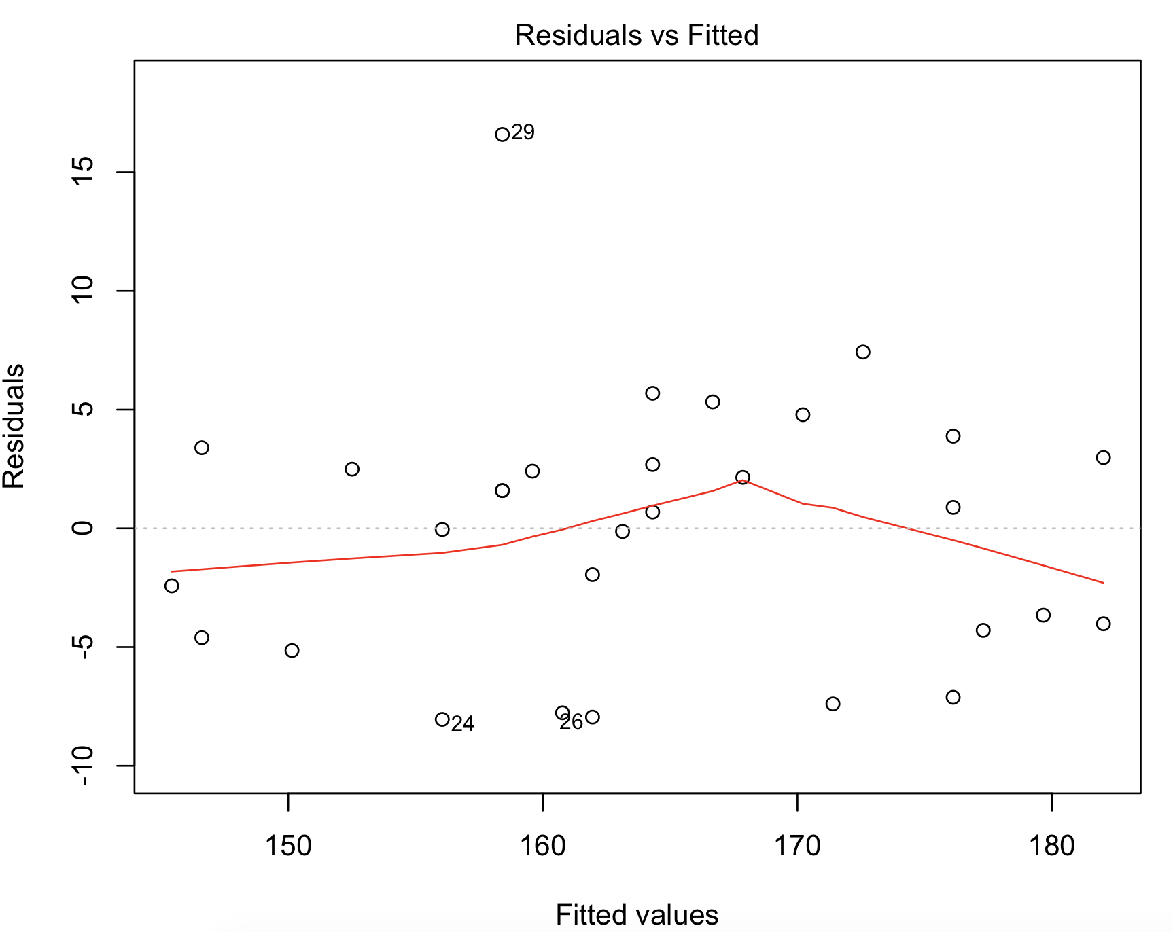
Calculating and Plotting Residuals for this Regression
plot(lm(IceCream$barsold ~ IceCream$temp))
There are appear to be no deviations from homoscedasticity
Notes:
447

Slide 448
Detecting Influential Observations
We see from the scatterplot that there are some points that are bivariate outliers.
Outliers that unduly influence the slope of our regression model are called influential observations.
The vertical distance of a point from a regression line is called its residual or discrepancy. To make the residuals more meaninful, they often are standardized as t-values and called, Studentized residuals.
A function of the horizontal distance of a point from the X mean is called its leverage.
In order to be influential, a point must have both discrepancy and leverage.
Notes:
448

Slide 449
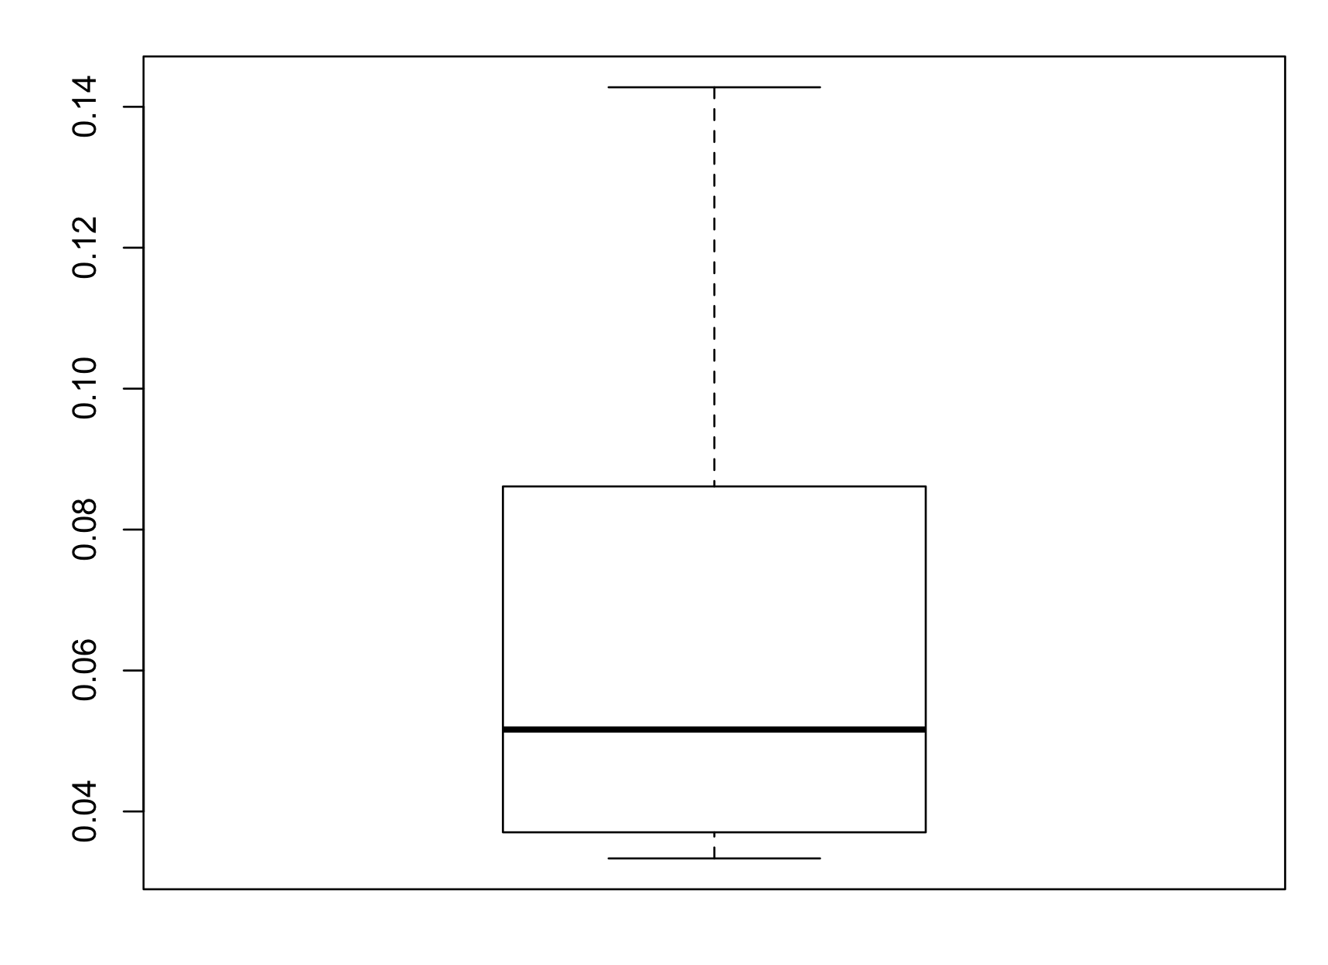
Evaluating Leverage
boxplot(leverage(lm(IceCream$barsold ~ IceCream$temp)))
Notes:
449

Slide 450
Evaluating Influence
We use Cook’s influence to determine whether any of the these outliers are unduly influential in the estimation of the parameters of this model.
We treat cases with Cook’s influence values larger than 1 as influential points and make particular note of such cases in our analysis.
Notes:
450

Slide 451
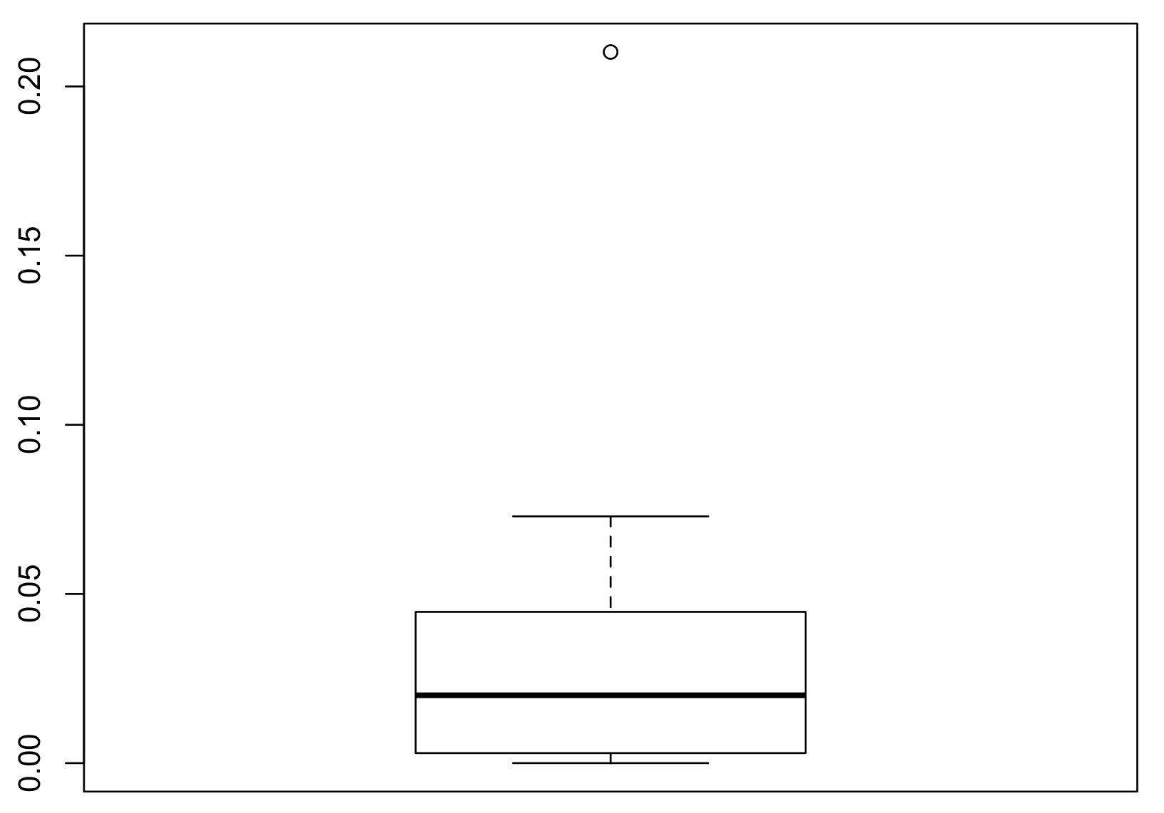
Evaluating Influence
From the following R analysis we see that the maximum value of Cook’s influence is much lower than 1.
boxplot(cooks.distance(lm(IceCream$barsold ~ IceCream$temp)))
Notes:
451

Slide 452
Conducting Power Analysis for Correlation One Tailed
Example: Determine the sample size required to detect with power = 0.80 and α = 0.05 whether an observed correlation of r = 0.30 (a medium effect size) is statistically significantly greater than 0.
Solution: We load library(pwr)
pwr.r.test(r = 0.3, sig.level = 0.05, power = 0.8, alternative = "greater")
We obtain the result N = 67.
Notes:
452

Slide 453
Conducting Power Analysis for Correlation TwoTailed
Example: Determine the sample size required to detect with power = 0.80 and α = 0.05 whether an observed correlation of r = 0.30 (a medium effect size) is statistically significantly different from 0.
Solution: We load library(pwr)
pwr.r.test(r = 0.3, sig.level = 0.05, power = 0.8, alternative = "two.sided")
We obtain the result N = 85.
As pointed out in Chapter 11, all things being equal, two-tailed tests are less powerful than their one-sided counterparts.
Notes:
453

Slide 454
Recall the following effect size indices and guidelines for judging their magnitudes from Chapter 10
Test | Index | Small | Medium | Large
t-test for means | d | 0.20 | 0.50 | 0.80
t-test for correlation | r | 0.10 | 0.30 | 0.50
F-test for regression | f² | 0.02 | 0.15 | 0.35
F-test for ANOVA | f | 0.10 | 0.25 | 0.40
Chi-square | W | 0.10 | 0.30 | 0.50
Notes:
454

Slide 455
Conducting Power Analysis for Simple Linear Regression
Example: Determine the sample size required to detect with power = 0.80 and α = 0.05 whether an R² with a medium effect size (f² = 0.15, corresponding to Cohen’s medium effect size) is statistically significantly different from zero.
Solution:
pwr.f2.test(u = 1, f2 = 0.15, sig.level = 0.05, power = 0.8)
We obtain the result N = 55.
Notes:
455

Slide 456
An Introduction to Multiple Regression
Chapter 16

Slide 457
Overview
The basic equation with two predictors
Testing the model for statistical significance
Testing the b-weights for statistical significance
Assessing the relative importance of the independent variables in the equation
Hierarchical multiple regression

Slide 458
Overview Continued
Interaction in multiple regression
Testing interactions for statistical significance
When both independent variables are dichotomous
Centering variables
When one independent variable is scale and the other is dichotomous
When both independent variables are scale
Notes:
458

Slide 459
Uses of Multiple Regression
Prediction: To construct an equation to predict the value of the dependent variable based on the values of the independent variables and possibly on their interaction.
Explanation: To understand how the dependent variable varies as a function of the independent variables.
Notes:
459

Slide 460
The Basic Equation with Two Predictors
When there are two independent variables and a dependent variable in a multiple regression equation, the equation has the following form:
Notes:
460

Slide 461
Example
Use the NELS data set to perform a multiple regression analysis to determine how twelfth grade math achievement (achmat12) varies as a function of socio-economic status (ses) and whether or not the student took advanced math in eighth grade (advmath8).
Notes:
461

Slide 462
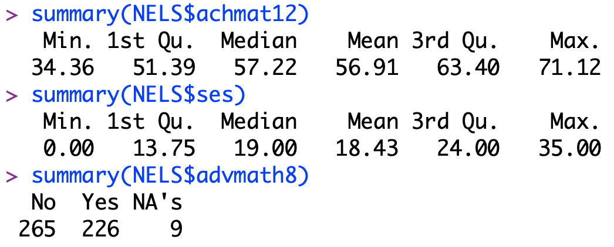
Beginning with Descriptive Statistics
Notes:
462

Slide 463
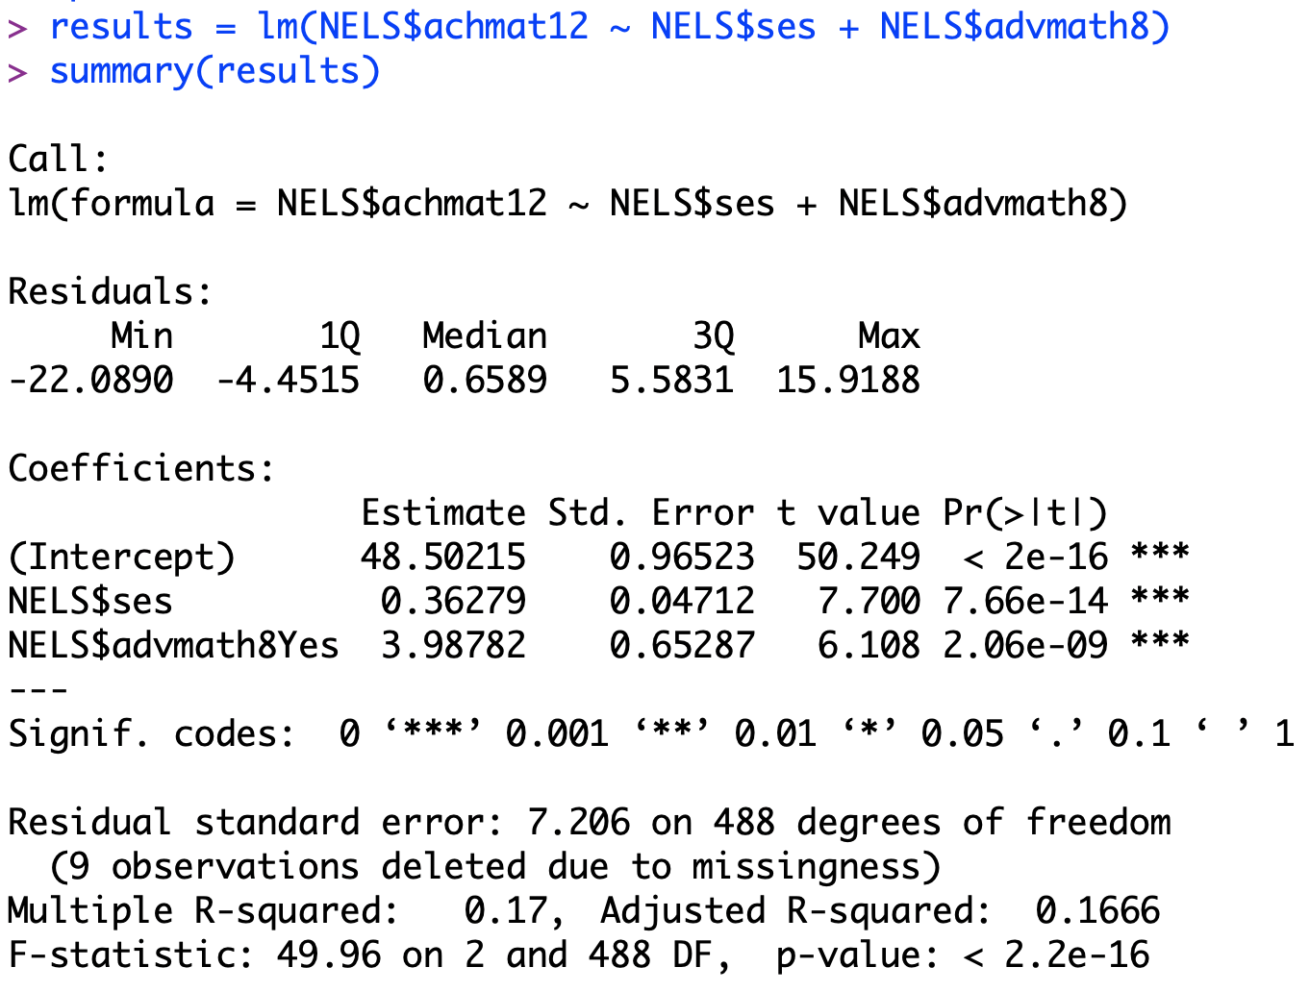
Predicting achmat12 from ses and advmath8
Yhat = 48.5 + .36ses + 3.99advmath8
Notes:
463

Slide 464
Interpreting the Regression Model
Given that R² = .17 is statistically significant, F(2, 488) = 49.96, p = 0.000, we know that ses and advmath8 together explain a significant amount of achmat12 variance; that the overall model is statistically significant.
Given that the t-values for ses and advmath8 are each statistically significant (t=7.7, p=0.000; t=6.11, p=0.000), we know that each variable contributes significantly to explaining achmat12 variance.
With b=.363 for ses, we know that a one unit increase in ses is associated with a .363 unit increase in achmat12, on average, controlling for advmath8.
With b=3.99 for advmath8, we know that a one unit increase in advmath8 is associated with 3.99 units increase in achmat12, on average, controlling for ses.
Notes:
464

Slide 465
Degrees of Freedom and Effect Size
The formulas for the degrees of freedom in the ANOVA summary table are:
df_{Regression} = P = Number of independent variables or predictors or regressors
df_{Residual} = N – P – 1 ; df_{Total} = N – 1
R² is the proportion of achmath12 variance accounted for by the regression model and the model’s goodness of fit or effect size as measured in the original sample.
is the same, but as measured
in a randomly selected sample from the same population as the original sample.
Notes:
465

Slide 466
Some Important Principles of Multiple Regression
b₁ measures the net effect of X₁ partialing out or controlling for X₂.
b₂ measures the net effect of X₂ partialing out or controlling for X₁.
Accordingly, these coefficients are called partial regression coefficients.
b₀ (or _cons) equals the predicted value of the dependent variable when all regressors equal zero, and only will be meaningful if zero is a meaningful value for each regressor.
Notes:
466

Slide 467
Illustrating the proportion of variance in achmath12 explained by ses with shading in the Venn diagram
ACHMAT12
ADVMATH8
SES
Notes:
467

Slide 468
Illustrating the proportion of variance in achmath12 explained by ses controlling for advmath8
ACHMAT12
ADVMATH8
SES
Notes:
468

Slide 469
More Important Principles of Multiple Regression
R² is high when the independent variables are each highly correlated with the dependent variable.
R² is not less than the highest correlation between any of the independent variables and the dependent variable.
R² is larger when the independent variables are not redundant of one another – when their intercorrelations are relatively low.
Notes:
469

Slide 470
Assessing the Relative Importance of the Independent Variables in the Model
The relative importance of the independent variables in an equation may be measured in two ways.
By the amount R² would drop if that variable were removed from the equation; or, likewise, by the amount R² would increase if that variable were added to the equation last. This amount, illustrated in the next slide relative to ses, may be measured by the squared semi-partial (or part) correlation or the R²_{Change} of that variable.
Alternatively, it may be measured by the relative magnitude of the beta weight.
If there are more than two independent variables, the first method is preferable.
Notes:
470

Slide 471
Venn Diagram
ACHMAT12
.101
ADVMATH8
SES
The proportion of variance in ACHMAT12 explained uniquely by SES
Notes:
471

Slide 472

Obtaining and interpreting beta coefficients
To obtain the beta coefficients for this regression, we use
The standardized regression equation is:
z_{achmat12} = .32z_{ses} + .25z_{advmath8}
Because the relative magnitude of the beta coefficients reflects the relative importance of the variables, we infer that, in this case, ses has greater relative importance than advmath8 in explaining achmat12.
Notes:
472

Slide 473
More Important Principles of Multiple Regression
In multiple regression, both b (the regression coefficient) and beta (the standardized regression coefficient) can be greater than 1 or less than –1.
In the case of simple linear regression, however, when there is only one independent variable, beta must be between –1 and 1 because it is equal to the Pearson Correlation Coefficient, r, between the two variables.
Notes:
473

Slide 474
More Important Principles of Multiple Regression
The importance of an independent variable in an equation depends on what other variables are included in the equation along with that variable.
When other variables are included in the equation that correlate strongly with that variable, these other variables “rob” that variable of some of its unique contribution.
As a result, that variable does not appear to be so important in the equation.
Be especially careful when writing up conclusions about individual variables that are not statistically significant.
Notes:
474

Slide 475
Controlling Variables Statistically
When we omit even one critical variable from an analysis, our results and our conclusions based on those results are often in error.
When critical variables are statistically controlled (held constant, accounted for, or partialled out), our conclusions can be radically different.
Notes:
475

Slide 476
Controlling Variables Statistically A Hypthetical Example
Consider the graphic created using the Upper Body Strength dataset that consists of the number of hours eight individuals spend at the gym on a weekly basis along with measures of their upper body strength.
Notes:
476

Slide 477

Controlling Variables Statistically
Simple linear regression yields the following model:
$\hat{Y}= −.61X+8.96$, (Y=strength; X = gym)
These results suggest that longer sessions at the gym associates with lower upper body strength.
Notes:
477

Slide 478

Controlling Variables Statistically
Given men are known to have greater upper body strength than women, there is likely to be a correlation between gender and upper body strength. How would the analysis change if we incorporated gender
results_male = lm(UpperBodyStrength$strength [UpperBodyStrength$gender == "male"] ~ UpperBodyStrength$gym [UpperBodyStrength$gender == "male"])
results_female = lm(UpperBodyStrength$strength [UpperBodyStrength$gender == "female"] ~ UpperBodyStrength$gym[UpperBodyStrength$gender == "female"])
We obtain the following two regression lines, where Y = strength; X = gym:
For males: $\hat{Y}= X+4$; For females: $\hat{Y}= X−7$
Notes:
478

Slide 479

Controlling Variables Statistically
Rather than fitting a separate regression line for males and females, we may obtain these same results by using a more parsimonious approach by adding a dichotomous group membership variable, which we call Z where Z is coded 0 for males and 1 for females.
We fit this new model to the entire sample and obtain the following result:
$\hat{Y}= X−11Z+4$
Notes:
479

Slide 480

Controlling Variables Statistically
Simple linear regression yields the following model:
$\hat{Y}= −.61X+8.96$, (Y=strength; X = gym)
These results suggest that longer sessions at the gym associates with lower upper body strength.
the Z variable serves to control for gender in the model. We are now able to answer the question: “What can we expect one’s upper body strength to be given a particular number of hours at the gym (e.g., X = 3) and a particular gender (e.g. Z = 0)?
Notes:
480

Slide 481
Conducting Power Analysis for Multiple Regression
Example: Determine the sample size required to detect with power = 0.80 and α = 0.05 whether an R² with a medium effect size (f² = .15, corresponding to Cohen’s medium effect size) is statistically significantly different from zero based on a total model that contains two predictors to be tested for significance.
Notes:
481

Slide 482

Conducting Power Analysis for Multiple Regression
Solution:
We load library(pwr)
And see that N = 68.
Notes:
482

Slide 483
Two Way Interaction in Multiple Regression
Chapter 17

Slide 484
Interaction in Multiple Regression
Overview of testing interactions for statistical significance
When both predictors are dichotomous
Centering variables
When one predictor is continuous and the other is dichotomous
When both predictors are continuous
Notes:
484

Slide 485
Interaction Example Between Two Dichotomous Predictors
Example: Predict twelfth grade math achievement (achmat12) from gender (gender), whether or not the student took advanced math in eighth grade (advmath8), and the interaction of the two.
Notes:
485

Slide 486

Interaction Example Between Two Dichotomous Predictors
Notes:
486

Slide 487
Interaction Between Two Dichotomous Predictors
Given that the product term is not statistically significant (t=-.438; p=.6618), there is no interaction between advmath8 and schtypd1.
This means that the b-weight of the regression line that predicts achmat12 from advmath8 is not significantly different for those in public schools from those in non-public schools, and that the difference is b=3.28 units.
This also means that the b-weight of the regression line that predicts achmat12 from schtypd1 is different for those who took advanced math from those who did not, and that the difference is b=3.28 units.
Notes:
487

Slide 488
Interaction when one of the predictors is continuous
Example: Can twelfth grade self-concept (slfcnc12) be explained by eighth grade self-concept (slfcnc08), gender, and their interaction?
For purposes of interpretability and reduced problems due to multicollinearity, we first center all continuous predictors by subtracting their means from the original values of the variables.
In this example, we center the one continuous predictor, slfcnc08.
Notes:
488

Slide 489

Interaction when one of the predictors is continuous

Slide 490
Interaction when one of the predictors is continuous
Predicted slfcnc12 = 32.27 + .386ctrslf08 – 1.23gender + .204inter
The overall relationship is statistically significant (F(3,496) = 43.68, p=0.000). Both main effects (t=4.64; t= -2.09) and the interaction (t=1.98) are statistically significant.
Notes:
490

Slide 491
Plotting the Results of the Regression Analysis with Interaction
The relationship between 8th and 12th grade self-concept is stronger for women (b = .590) than for men (b = .386).
For males: For females:
slfcnc12 = .386ctrslf08 + 32.27 slfcnc12 = .590ctrslf08 + 31.04
The b-weight associated with the interaction is .204 is statistically significant (t = 1.98, p=0.048).
The regression model is:
Slfcnc12 = .386ctrslf08 – 1.23gender + .204inter + 32.27
Notes:
491

Slide 492

Interaction when both predictors are continuous
Example: Is there a relationship between ice cream sales and temperature, humidity and their interaction (represented by the product of temp and relhumid)?
Note: temp, relhumid, and their interaction all are statistically significant.
Pred’d barsold = – 98.675 + 2.968(temp) + 2.583(relhumid) -.0272(product)
Notes:
492

Slide 493
Graphing the Interaction When the Predictor Variables are Continuous
library(interactions)
results = lm(barsold ~ temp*relhumid, data = IceCream)
interact_plot(results, pred="temp", modx = "relhumid", modx.values = c(67,88),
x.label = "Temperature in Degrees Fahrenheit”, y.label = "Average Number of Bars Sold",
main.title = "Relating Ice Cream Sales to Temp and Relhumid \n Relhumid Moderates the Relationship between Barsold and Temp", legend.main = "Relhumid", colors = "Greys")
Notes:
493

Slide 494

More R for the Interaction When the Predictor Variables are Both Continuous
Original temp mean & sd = (75, 9);
original relhumid mean & sd = (78, 10.5).
For inter, b = -.027, t = 1.98, p = .016.
Notes:
494

Slide 495
Interpretation of Results
The results of our analysis suggest that both temperature and humidity are related to summer ice cream sales and that relative humidity moderates the relationship between temperature and ice cream sales; and, likewise that temperature moderates the relationship between relative humidity and ice cream sales.
The pattern for the predicted values depicted in the line graph suggests that the relationship between ice cream sales and temperature is greater when humidity is relatively low rather than when it is relatively high.
Ice cream sales on days with relatively high humidity always exceed sales on days with relatively low humidity regardless of the temperature. However, when temperature is lower, the difference in ice cream sales between days with low and high relative humidity is significantly larger than when temperature is high.
Notes:
495

Slide 496

Non-parametric statistics CHAPTER 18

Slide 497
Parametric Vs Nonparametic Methods
The statistical tests we’ve studied to date have required certain assumptions of the parent population parameters or distributions (e.g., normality, homogeneity of variance, bivariate normality, etc.).
A tacit assumption was made of the continuous variables – that they be at the interval or ratio level.
When either the continuous variables under study are not interval-leveled or the “parametric” or “distribution-tied” assumptions are not met, and typically when small sample sizes are used, one may use nonparametric or “distribution-free” methods.

Slide 498


A Nominal DV: The Chi-Squared Distribution
Given a normal distribution with mean μ and variance σ², if we select a random value X from this population and form the following squared z-score, the distribution of such squared z-scores is called a chi-square distribution (with 1 df ), denoted χ²₍₁₎ , is shown below.
A chi-squared distribution with 2 df is formed as the sum of the following two z-squared values:
The chi-square distribution with 2 df is shown to the left; with 9 df is shown on the right.
Like the t-distribution, the chi-squared distribution is a family of distributions with mean equal to the number of df, mode equal to df -2 (for df >2) and standard deviation equal to √2(df).

Slide 499
A Nominal DV: Chi-Squared Goodness-of-Fit Test
Answers questions about whether an observed distribution of values from a nominal-scaled variable is the same as an expected distribution of values based on a known distribution.
Example: current vs. previous year’s car-sales.
H₀: The current year’s sales distribution is the same as that of the previous year (Nissan: 18%; Mazda: 10%; Toyota: 35%; Honda: 37%)
H₁: The current year’s sales distribution is not the same as that of the previous year.

Slide 500
A Nominal DV: Chi-Squared Goodness-of-Fit Test
Comparison of observed and expected car sales in a sample of N=1,000
Observed freq Expected freq
Nissan 150 180
Mazda 65 100
Toyota 385 350
Honda 400 370
To determine how unlikely it is for the observed values (O_{i}) to differ as much as they do from the expected values (E_{i}), given H₀ is true, we use a procedure developed by Karl Pearson in 1900.

Slide 501
A Nominal DV: Chi-Squared Goodness-of-Fit Test
Equation 17.1, df = K-1, where K = number of categories
Substituting the values from the previous slide into Eq. 17.1, we obtain,

Slide 502
A Nominal DV: Chi-Squared Goodness-of-Fit Test
According to the Table in the online Appendix C, we find that p=.00004 => if the distribution of sales is the same as in the previous year, the probability of obtaining the observed sample distribution is approx. .00004.
Or using R, we find the p-value using,
pchisq(23.19, 3, lower.tail = F), to be p=.00003686
Therefore, we reject H₀ in favor of H₁. The current year’s distribution of foreign car sales for these selected types of cars is not the same as that of the previous year.

Slide 503
Conducting a Chi-Square Goodness-of-Fit Test in R
We first input and label the data as follows:
type = c(“Nissan”, “Mazda”, “Toyota”, “Honda”)
freq = c(150, 65, 385, 400)
prob = c(.18, .10, .35, .37)
We then conduct the chi-square test
chisq.test(freq, p = prob)
Notes:
503

Slide 504
A Nominal DV: Chi-Square Test of Independence
Answers questions about whether two nominal-scaled variable are related.
Example re: Gender and Political Party Affiliation.
H₀: The gender of an individual is not related to his/her political party affiliation; i.e., knowing the gender of an individual would not help to predict the individual’s political party affiliation.
H₁: The gender of an individual is related to his/her political party affiliation; i.e., knowing the gender of an individual would help to predict the individual’s political party affiliation.

Slide 505
A Nominal DV: Chi-Square Test of Independence
Gender & Political Party Cross-tabulation: Observed Frequencies
Political Party Affiliation
Gender Dem Rep Neither Total
Male 40 10 50 100
Female 60 20 20 100
Total 100 30 70
We find the expected frequencies, given H₀ is true that there is no relationship between Gender and Political Party Affiliation, and compare Observed and Expected Frequencies as in the Chi-Square Goodness-of-Fit Test.
Because there are an equal number of Males and Females, given no relationship we would expect there also to be an equal number of Males and Females in each Political Party Affiliation category.
That is, 50 Male and 50 Female Democrats, 15 Male and 15 Female Republicans, and 35 each of Neither party.

Slide 506
A Nominal DV: Chi-Square Test of Independence
The set of Observed and Expected Values are:
Political Party Affiliation
Gender Dem Rep Neither Total
Male O=40 O=10 O= 50 100
E=50 E=15 E=35
Female O=60 O=20 O=20 100
E=50 E=15 E=35
Total 100 30 70 200
Using Formula 17.3, which has a chi-square dist’n with (c-1)(r-1)df = 3 df in this case
=> (40-50)²/50+(10-15)²/15+(50-35)²/35+(60-50)²/50+(20-15)²/15+(20-35)²/35= 20.19
Using the Chi-Square Table in Appendix C, we find that p < .001 and reject H₀ in favor of H₁ – There is a relationship between Gender and PPA.
To find the expected values in general: E_{ij} = (N_{i})(N_{j})/N,
where N_{i} = Total # in Row i; N_{j} = Total # in Row j, and N = Total Number

Slide 507
Conducting a Chi-Square Test of Independence in R
We first load the sur library to gain access to the Politics dataset
library(sur)
We then print out a table of the data
table(Politics$Gender, Politics$Party)
We then conduct the chi square test
chisq.test(table(Politics$Gender, Politics$Party))

Slide 508
Assumptions of the Chi-Square Test of Independence
The individual observations are independent of each other (observations are not from the same or related persons).
The expected cell frequencies are not too small. In general, each cell should have an expected frequency of 5 or more.

Slide 509
A Nominal DV: Fisher’s Exact Test for the 2x2 case
The p-values obtained through the chi-square test of independence are only approximations to the true or exact p-values.
In the case of a 2x2 contingency table, the Fisher’s Exact Test provides exact p-values and should be used instead of the test of independence when samples are small to obtain more accurate results.
When samples are large, the results of the two tests will be the same or quite similar.
Fisher’s Exact test calculates exact probabilities using the hypergeometric probability distribution.

Slide 510
A Nominal DV: Fisher’s Exact Test for the 2x2 case
Example: Is there a relationship between attendance in nursery school (1, 2) and gender (1, 2)?
data = matrix(c(3,3,5,1), nrow = 2, byrow = T)
fisher.test(data)
The two-sided probability for the Fisher’s Test is p=.545 suggesting that there is no relationship between gender and nursery attendance.
By contrast the approximate two-sided Pearson chi-square test of independence is p=.221x2 = .442.
The Fisher’s Test gives the more accurate result and should be the one used in this case.

Slide 511
An Ordinal DV: A Few Common Nonparametric Tests
The Wilcoxon Sign Test for Matched Pairs – Tests whether or not two conditions have identical population distributions for the DV. Based on the proportion of positive or negative differences between the pairs of scores from the two conditions.
The Mann-Whitney U-Test for Unrelated Samples – Like the Wilcoxon, tests whether or not two conditions have identical population distributions for the DV, but where conditions are applied to unrelated samples. It is based on a comparison of the rankings of the scores of both samples when all scores are combined into a single group and rank-ordered from smallest to largest.
The Kruskal-Wallis Analysis of Variance on three or more unrelated samples. Extends the Mann-Whitney, to test whether or not three or more conditions applied to unrelated samples have identical population distributions for the DV. It also is based on a comparison of the rankings of the scores of each sample when combined into a single group and rank-ordered from smallest to largest .

Slide 512
An Ordinal DV: The Wilcoxon Sign Test on Matched Pairs
Example: Test whether weights recorded on packaged snack foods reflect their actual weights. Data are in ozs. below:
Recorded: 11.5, 10.0, 17.0, 16.0, 12.5, 9.0, 8.75, 6.0, 8.0, 20.5, 5.75, 16.0
Actual: 11.8, 10.0, 16.5, 16.0, 13.0, 9.5, 9.00, 6.0, 8.2, 19.5, 6.20, 16.2
+/- Diff: -, 0, +, 0, -, -, -, 0, -, +, -, -
We eliminate the three ties (values of 0) and reduce N from 12 to 9. The test is based on the normal approximation to the binomial.

Slide 513

Conducting the Wilcoxon Sign Test on Matched Pairs in R
We first enter the data, load the BSDA package, and run the Sign Test.
Given that for the two-sided test p= .1797, we do not reject the null hypothesis in favor of the alternative
We conclude that the recorded and actual snack package weights are not statistically significantly different from each other in the population.

Slide 514
An Ordinal DV: The Mann-Whitney U-Test on Two Independent Samples
Example: Test whether a random sample of four boys and a random sample of five girls who participate in varsity college soccer come from identical populations when one considers the number of injuries sustained in a season of play. The data and the U formula are as follows:
Boys: 14 17 18 25
Girls: 7 13 15 16 12
Where R₁ is the sum of sample 1 ranks based on a rank ordering of the nine scores from smallest to largest: 7, 12, 13, 14, 15, 16, 17, 18, 25
R₁ = 4+7+8+9 = 28; N₁ = 4; N₂ = 5; => U = (4)(5)+(4)(5)/2 - 28 = 2
From the U Table in the online Appendix, we find that for a two-tailed test, α=.05, the rejection region is U≤1 or U ≥19.
Because U=2, it does not fall in the rejection region. We do not reject the null in favor of the alternative hypothesis.

Slide 515

Conducting the Mann-Whitney U-Test on Two Independent Samples in R
We first enter the data
girls = c(7, 13, 15, 16, 12)
boys = c(14, 17, 18, 25)
We then perform a two-sided Wilcoxon's test on the girls versus boys data
wilcox.test(girls, boys)

Slide 516
An Ordinal DV: The Kruskal-Wallis Test on Three or More Independent Samples
Example: Test whether there is a relationship between Age and Time Spent (daily average number of minutes) on the Internet, 8 college students, 10 adults between the ages of 35 and 45, and 7 adults between the ages of 60 and 70 were randomly selected from their respective populations of known Internet users.
The data are as follows along with the formula for the Kruskal-Wallis Test.
College Students: 48, 42, 40, 46, 35, 39, 32, 41
35-45 Year Olds: 28, 33, 26, 34, 29, 36, 31, 22, 21, 17
60-70 Year Olds: 15, 19, 20, 25, 18, 27, 16
where K is the number of groups; N_{j} is the size of sample j, N is the total number of scores from all samples, and R_{j} is the sum of the ranks for the scores in sample j. For this test, df = K-1.

Slide 517
An Ordinal DV: The Kruskal-Wallis Test on Three or More Independent Samples
We group together all 25 Times and rank order them to obtain:
Times: 15,16,17,18,19,20,21,22,25,26,27,28,29,31,32,33,34,35,36,39,40,41,42,46,48
Rank: 1 2 3 4 5 6 7 8 9 10 11 12 13 14 15 16 17 18 19 20 21 22 23 24 25
Group: 3 3 2 3 3 3 2 2 3 2 3 2 2 2 1 2 2 1 2 1 1 1 1 1 1
N₁ = 8 N₂ = 10 N₃ = 7 N = 25
R₁ = 168 R₂ = 119 R₃ = 38 K = 3
H = 12/(25)(26)[168²/8 + 119²/10 + 38²/7] – 3(26) = 17.08
From the Chi-Square Table in online Appendix C, we note that a chi-square value closest, but less than, 17.08 with K - 1 = 2 degrees of freedom is 13.82. This value marks off area .001 to its right, suggesting that the probability of observing 13.82 or higher is less than .001.
Because .001 is less than .05, our conclusion is to reject the null hypothesis in favor of the alternative that the populations from which these samples were drawn do not have identical distributions in terms of average daily time spent on the Internet.

Slide 518
Conducting the Kruskal-Wallis Test on Three or More Independent Samples in R
time = c(48, 42, 40, 46, 35, 39, 32, 41, 28, 33, 26, 34, 29, 36, 31, 22, 21, 17, 15, 19, 20, 25, 18, 27, 16)
group = c(rep(1, 8), rep(2, 10), rep(3, 7))
kruskal.test(time~group)
Because p=0.0002, we reject the null in favor
of the alternative that the populations from which
these samples were drawn do not have
identical distributions in terms of average daily time spent on the Internet.

